Slide 1


Application of qualitative research: rationale, research problem and research questions
Presenter: prof. Aurelija Blaževičienė, LSMU
Presenter: dr. Thóra B. Hafsteinsdóttir, UMC Utrecht

Slide 2
Aim of the lecture
To enable students understand what research is and what is not.
To raise awareness of crucial aspect of the nature of knowledge and the value of scientific method.
To introduce the concept at the heart of every research project –the research problem- and to discuss what a researchable problem is.
To identify and justify the basic components of the research framework, relevant to the tackled research problem.

Slide 3
Meaning of Research
The Advanced Learners’ Dictionary of current English lays down the meaning of research as a careful investigation or inquiry specially through search for new facts in any branch of knowledge
Polit & Beck defined research methods as “the techniques used to structure a study to gather and analyze information in a systematic fashion” (Polit & Beck, 2017: 743).

Slide 4
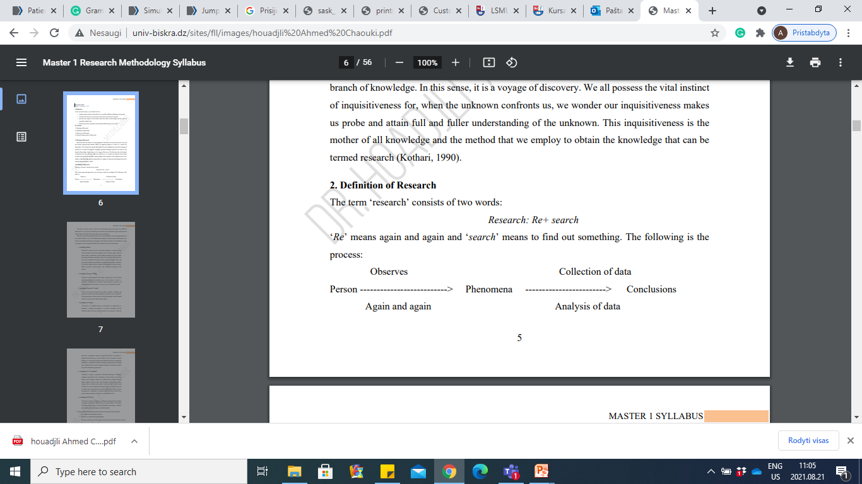
Definition of Research

Slide 5
Research means
Therefore, research means to observe the phenomena again and again from different dimensions.
It is a process of which a person observes the phenomena again and again and collects data on the basis of data s/he draws some conclusions.

Slide 6

Qualitative and Quantitative Approaches

Slide 7
Different approaches
Quantitative Approach | Mixed Methods Quan-Qual methods | Qualitative Approach
Approach: typically deductive, focus on quantity of phenomena Goals: breath, test hypotheses Instrument based questions Large sample of participants Sampling: Random Observational/descriptive data Statistical analysis of numeric data Statistical significance, measures of association. Statistical interpretation Reporting (through statistics) | Complementary (of methods) Both open & closed questions Sample can be large (quan. part) and small sample (qual. part) Multiple forms of data drawing on all possibilities Statistical and qualitative analysis, tekst analysis (f.ex. themantic analysis) Integration (connect, merge, embed) Reporting both narrative and through statistics. | Approach: typically inductive, Focus on the quality of phenomenon GoalsL Depthe, generate hypotheses. Open ended questions Small samples of participants Sampling: purposeful Interviews (semi-structured, open, in-depth interviews), focus group interviews, observation, document, audio-visual data Analysis: iterastive interpretation of textual data Themes, patterns interpretation Narrative reporting.

Slide 8
What is qualitative research?
Qualitative research is defined as “the study of the nature of phenomena”, including “their quality, different manifestations, the context in which they appear or the perspectives from which they can be perceived”, but excluding “their range, frequency and place in an objectively determined chain of cause and effect” [1].
A more pragmatic rule of thumb: “qualitative research generally includes data in form of words rather than numbers”
Source: Philipsen, H., & Vernooij-Dassen, M. (2007). Kwalitatief onderzoek: nuttig, onmisbaar en uitdagend. In L. PLBJ & H. TCo (Eds.), Kwalitatief onderzoek: Praktische methoden voor de medische praktijk. [Qualitative research: useful, indispensable and challenging. In: Qualitative research: Practical methods for medical practice (pp. 5–12).
Houten: Bohn Stafleu van Loghum. 2. Punch, K. F. (2013). Introduction to social research: Quantitative and qualitative approaches. London: Sage

Slide 9
What is qualitative research?
Qualitative Research seeks to understand and interpret personal experiences, behaviours, interactions, and social contexts to explain the phenomena of interest, such as the attitudes, beliefs, and perspectives of patients and clinicians; the interpersonal nature of caregiver and patient relationships; the illness experience; or the impact of human suffering (Wong et al, 2004).
Qualitative studies are subjective; they gain knowledge through the process of induction, involve use of words, and produce findings that are not meant to be generalizable.
Wong SSL, Wilczynski NL, Haynes RB. Developing optimal search strategies for detecting clinically relevant qualitative studies in Medline. Medinfo 2004;311-314
Dearholt, S. & Dang, D. (2012). Individual Research Studies. JOHNS HOPKINS NURSING EVIDENCE-BASED PRACTICE: MODEL AND GUIDELINES. Retrieved http://www.r2library.com/Resource/Title/1935476769/ch0006s0090

Slide 10
How do we decide which approach is appropriate?
Based on the Research Question you want ask → you choose the appropriate approach & design for your research.
Quantitative approach | Qualitative approach
Is your question focusing on how many patients have a certain health problem? Is your question focusing on effects of specific therapy? What is the effect of task oriented training on functional status of patients with stroke? Are practice nurses better than GPs at removing ear wax? | Is your question about how patients experience certain illness? Is your question about how it is to live with cancer? How do stroke patients experience living with stroke?

Slide 11
Qualitative approaches
Qualitative Approach
Approach: typically inductive, Focus on the quality of phenomenon Goals: Depth, generate hypotheses. Research Questions: Open – focus on experiences Small samples of participants Sampling: purposeful Interviews (semi-structured, open, in-depth interviews), focus group interviews, observation, document, audio-visual data Analysis: iterastive interpretation of textual data Themes, patterns interpretation Narrative reporting.
Qualitative approach
Is your question about how patients experience certain illness? Is your question about how it is to live with cancer? How do stroke patients experience living with stroke?

Slide 12

An Example – Qualitative study

Slide 13
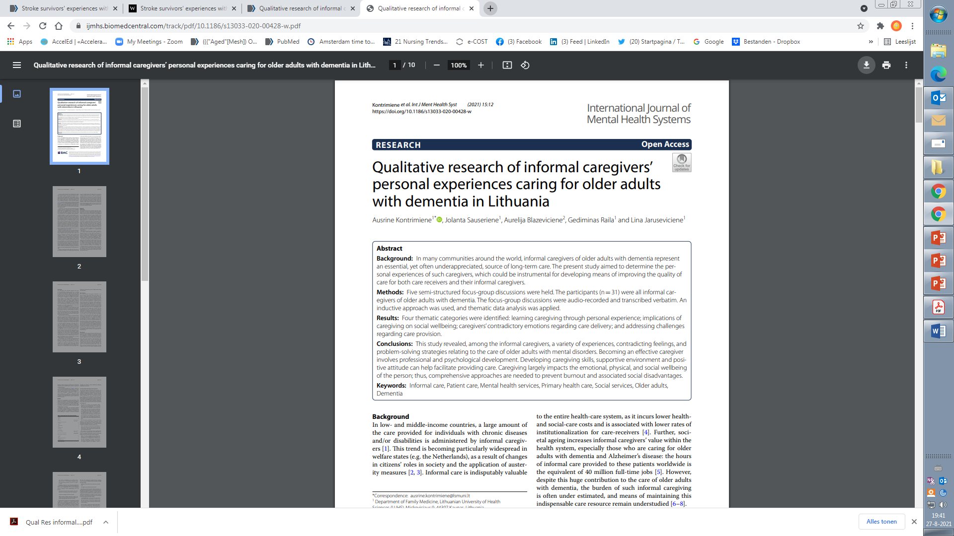
An Example – Qualitative study

Slide 14
Quantiative approaches
Quantitative Approach
Approach: typically deductive, focus on quantity of phenomena Goals: breath, test hypotheses Instrument based questions Large sample of participants Sampling: Random Observational/descriptive data Statistical analysis of numeric data Statistical significance, measures of association. Statistical interpretation Reporting (through statistics)
Quantitative approach
Is your question focusing on how many patients have a certain health problem? Is your question focusing on effects of specific therapy? What is the effect of task oriented training on functional status of patients with stroke? Are practice nurses better than GPs at removing ear wax?

Slide 15
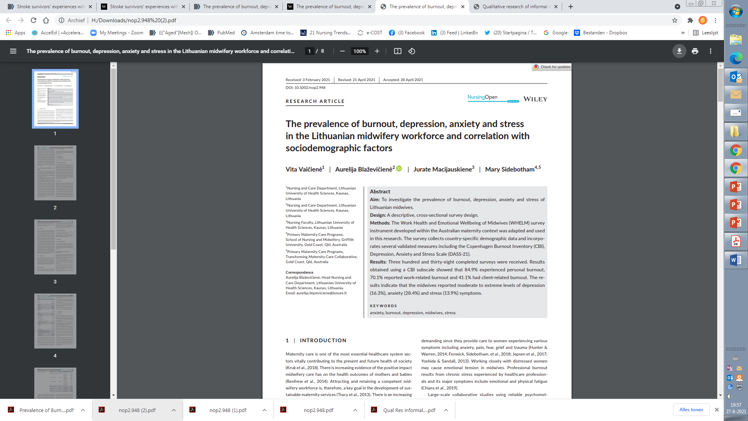
An Example – Quantitative study

Slide 16

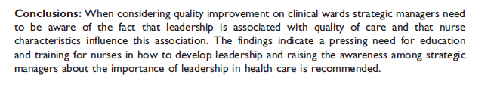
An Example – Quantitative study

Slide 17
Example
one Australian study addressed the issue of why patients from Aboriginal communities often present late or not at all to specialist services offered by tertiary care hospitals. Using qualitative interviews with patients and staff, it found one of the most significant access barriers to be transportation problems, including some towns and communities simply not having a bus service to the hospital.
A quantitative study could have measured the number of patients over time or even looked at possible explanatory factors – but only those previously known or suspected to be of relevance.
To discover reasons for observed patterns, especially the invisible or surprising ones, qualitative designs are needed
Suorce: Kelly, J., Dwyer, J., Willis, E., & Pekarsky, B. (2014). Travelling to the city for hospital care: Access factors in country aboriginal patient journeys. Australian Journal of Rural Health, 22(3), 109–113.

Slide 18
Main Characteristics of Qualitative Research
Emergent research design: The emergent research design means a qualitative research study is kept open and fluid so that it can respond in a flexible way to new details or opinions that may emerge during the process of investigation.
The nature of qualitative data: Qualitative research works with a wide range of data, including interviews, documents, and even images.
The characteristics of the research setting: Because of the qualitative approach nature that seeks to describe social phenomena as they occur naturally, qualitative research takes place in natural setting, without any attempts to manipulate the situation under study.

Slide 19
Main Characteristics of Qualitative Research
Insider meaning: Qualitative research is concerned with subjective opinions, experiences, and feelings of individuals. In this respect, the goal of qualitative research is to explore the participants’ views of the situation being studied.
Small sample size: Qualitative research typically relies on the necessity to use smaller samples of participants.
Interpretive analysis: Qualitative research is fundamentally interpretive, which means that the research outcome is ultimately the product of the researcher’s subjective interpretation of data.

Slide 20
Main Characteristics of Qualitative Research
Qualitative research is a reflexive process, one in which the researcher adapts their approach based on what participants say and do.
The researcher must constantly evaluate whether their question is important and relevant to the participants.
As the researcher gains information from participants, it is normal for the focus of the inquiry to shift.

Slide 21
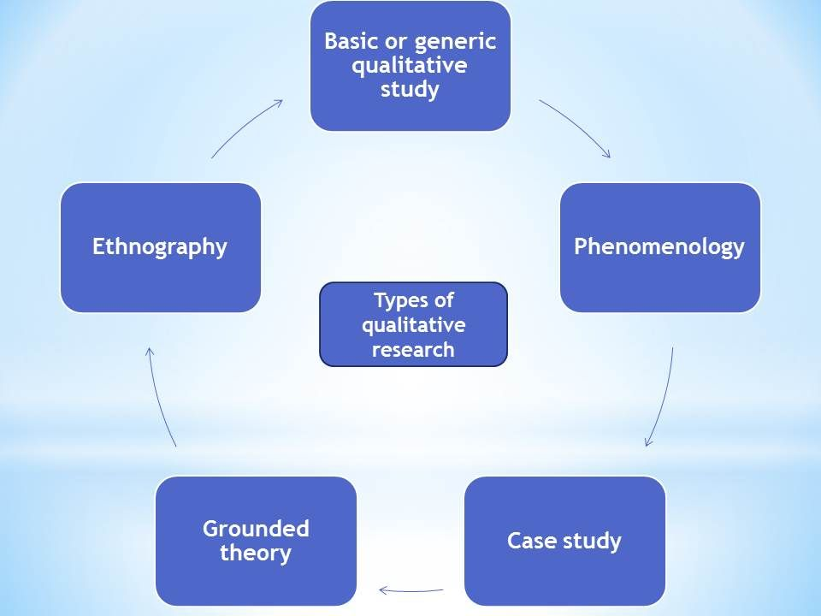
Types of qualitative research

Slide 22
Types of qualitative research
Types of qualitative research designs
Ethnography | Investigates cultures in depth. Ethnographic research is a qualitative method where researchers observe and/or interact with a study's participants in their real-life environment. Ethnography was popularised by anthropology, but is used across a wide range of social sciences.
Phenomenology | Describes the lived experience of patients, professionals. Phenomenology is an approach to qualitative research that focuses on the commonality of a lived experience within a particular group. The fundamental goal of the approach is to arrive at a description of the nature of the particular phenomenon (Creswell, 2013).
Grounded theory | Formulate, test and refine a theory about a phenomena. Grounded theory refers to inductive methods aiming toward theory development. The term grounded theory denotes dual referents: (a) a method consisting of flexible methodological strategies and (b) the products of this type of inquiry. Increasingly, researchers use the term to mean the methods of inquiry for collecting and, in particular, analyzing data. The methodological strategies of grounded theory are aimed to construct middle-level theories directly from data analysis. The inductive theoretical thrust of these methods is central to their logic. The resulting analyses build their power on strong empirical foundations. These analyses provide focused, abstract, conceptual theories that explain the studied empirical phenomena.
Generic Qualitative | “is not guided by an explicit or established set of philosophic assumptions in the form of one of the known [or more established] qualitative methodologies” (Caelli et al., 2003)
Life history or historical | Description analysis of events that occurredd in the past.

Slide 23
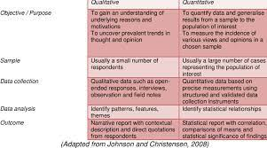
Objectives of Reserch
The purpose of research is to discover answers to questions through the application of scientific procedures.
The main aim of research is to find out the truth which is hidden and which has not been discovered yet.
 | Qualitative research | Quantitative research
Obejcctive/aim | The primary aim of a Qualitative Research is to provide a complete, detailed description of the research topic. ... To gain an understanding of underlying reasons and motivations To uncover prevalent trends in thought and opinions of patients/professionals | Quantitative Research on the other hand focuses more in counting and classifying features and constructing statistical models and figures to explain what is observed. To quantify data and generalize results from sample to the population of interest. To measure the incidence of various views and opinions of a chosen sample of individuals/patients/professionals.

Slide 24
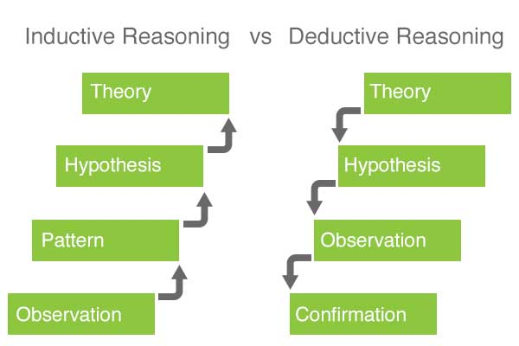
Scientific Thinking
Scientific thinking is usually defined as an inductive-deductive mode of thinking or reasoning.
The scientific thinking starts with facts and continually returns to facts to test and verify its hypotheses.

Slide 25
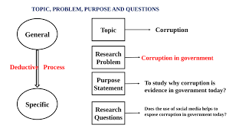
What is a Research Problem
A research problem refers to some difficulty which a researcher experiences in the context of either a theoretical or practical situation and wants to obtain a solution for.
A research problem is one which requires a researcher to find out the best solution by which cause of action the objective can be attained optimally in the context of a given environment.
A Research Problem is a question that a researcher wants to answer or a problem that a researcher wants to solve
Example

Slide 26
Features a research problem
(Walliman 2001)
The research problem should be a great interest to you
The research problem should be significant.
The research problem should be delineated.
The researcher should be able to obtain the information required.
The researcher should be able to draw conclusions related to the problem.
The researcher should be able to state the problem clearly and concisely

Slide 27
Selecting a Research Problem
Novelty and avoidance of unnecessary duplication.
Interest, intellectual curiosity and drive.
Training and personal qualifications.
Importance for the field.
Special working conditions.
Approachability of the sample.
Cost.
Time factor

Slide 28
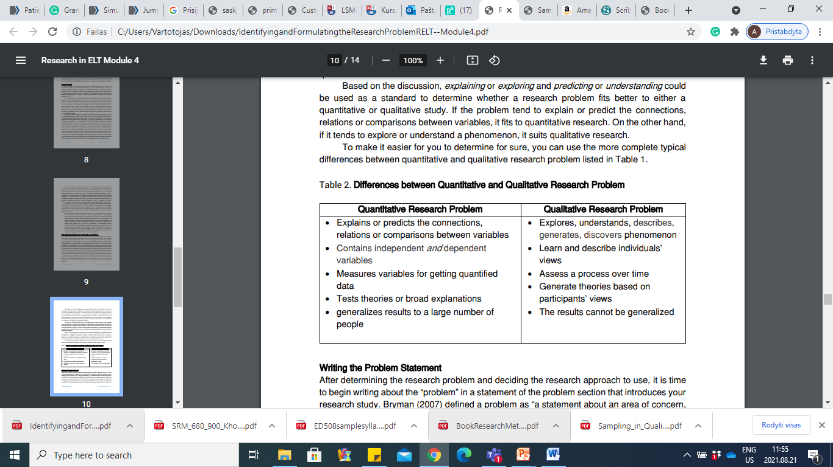
Differences between Quantitative and Qualitative Research Problem

Slide 29
Differences between Quantitative and Qualitative Questions
Quantitative Research Questions | Qualitative Research Questions
How does witnessing domestic violence impact a child’s romantic relationships in adulthood? | How do people who witness domestic violence understand how it affects their current relationships?
What is the relationship between sexual orientation or gender identity and homelessness for late adolescents in foster care? | What is the experience of identifying as LGBTQ in the foster care system?
How does income inequality affect ambivalence in high-density urban areas? | What does racial ambivalence mean to residents of an urban neighborhood with high income inequality?
How does race impact rates of mental health diagnosis for children in foster care? | How do African-Americans experience seeking help for mental health concerns?

Slide 30
Good types of qualitative wording for research questions
How
What
Generate
Identify
Describe
Meaning
Outline
Experience

Slide 31
Words to avoid for qualitative research questions
Relate
Impact
Effect
Cause
Influence
Compare
Contrast

Slide 32

Examples Qualitative Research Questions
Poor example | Good example
Is the customer service good at your favourite café or coffee shop? Reason: As a rule of thumb, qualitative research questions should never be able to be answered ‘yes’ or ‘no’. | What do you like most about your favourite café or coffee shop? Reason: You could discover that the quality of customer service is more important than the location for café patrons when it comes to determining which coffee shop is their favourite.
How much time do you listen to rock music a week? Reason: This would be a much more suitable quantitative research question, as it enables you to collect data en-masse. However, from a qualitative viewpoint, the data could not be used to create a judgment or perception as the data is just factual information. | Why do you prefer listening to rock music more than other music genres? Reason: This is a considerably more subjective question; the results of which could potentially lead to you forming the basis of a more credible argument.
What is the meaning of life? Reason: This type of question is far too broad and lacking in focus to be used as the basis of any type of research study. | Could you describe the most important factors in your life? Reason: Again, this is question is much more subjective, giving the respondent the opportunity to provide a more reasoned, personal response that can form the basis of a credible argument.

Slide 33
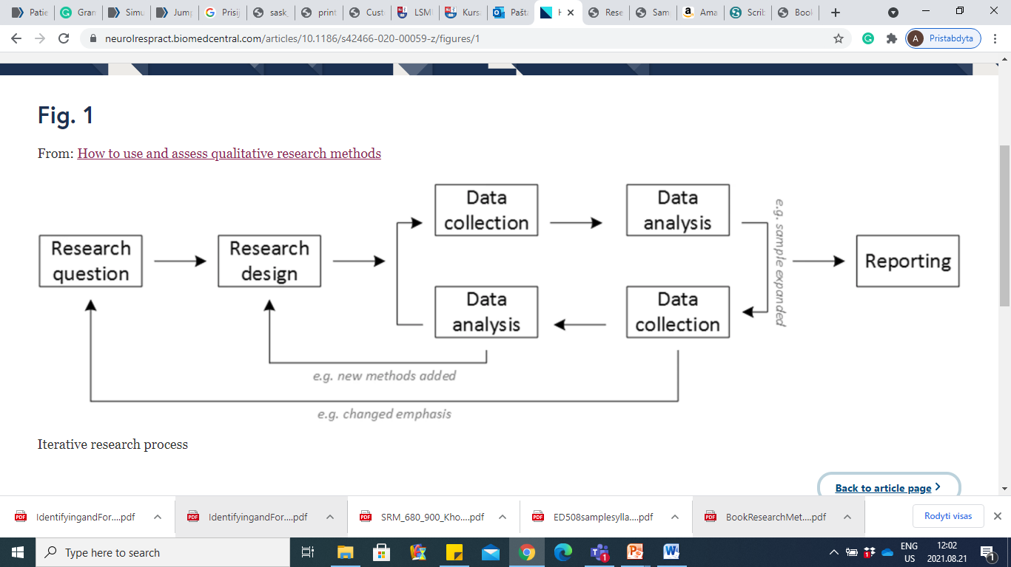
The research proces in qualitative research
Iterative Research Process

Slide 34
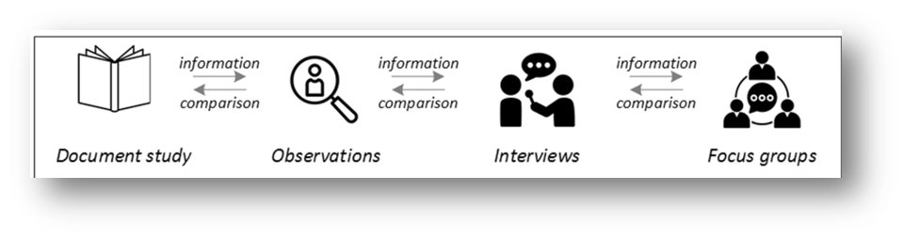
Possible combination of data collection methods

Slide 35
Key Takeaways
Qualitative research questions often contain words like lived experience, personal experience, understanding, meaning, and stories.
Qualitative research questions can change and evolve as the researcher conducts the study.

Slide 36
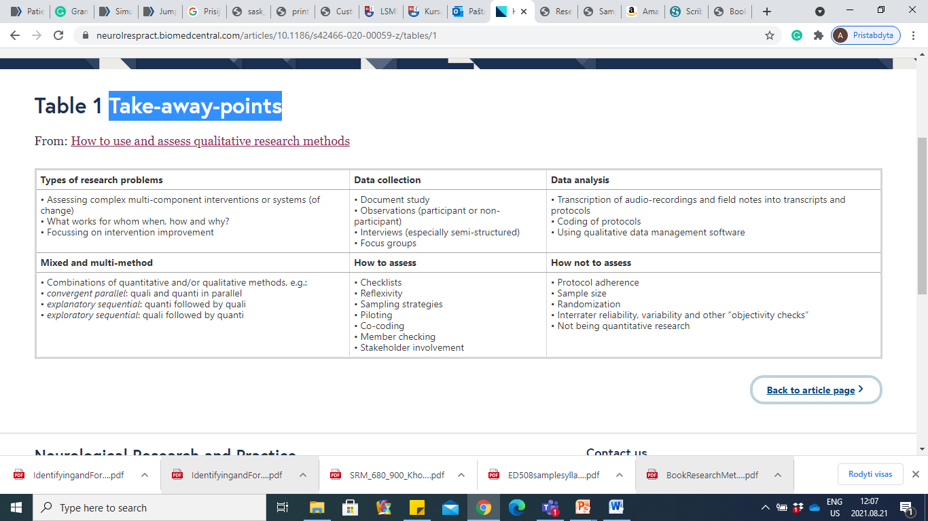
Take-away-points

Slide 37

Reading material
Elizabeth J. Tisdell, Sharan Merriam. Qualitative Research: A Guide to Design and Implementation San Francisco, CA : Jossey-Bass, a Wiley brand, 2016

Slide 38

Questions?

Slide 39

THANK YOU FOR THE
ATTENTION!

