Slide 1
Sampling strategies in qualitative research JAMK University of Applied Sciences FINLAND
Presented by principal lecturer, phd, docent hanna hopia

Slide 2
Day two: 8-12 am, four-hour lecture: Aim and learning outcomes of the lecture
AIM
LEARNINING OUTCOME
Provide an overview of different types of sampling strategies typically used in qualitative research in nursing.
Participants can critically evaluate different sampling strategies used in qualitative research. Participants are able to choose appropriate sampling strategy for qualitative research and can provide rationale for selected strategy .

Slide 3
Content: Sampling in qualitative research
Simple size, sampling units
Data saturation, timing of sampling decisions
Non-probability sampling and probability sampling
Different sampling strategies, tehcniques
Variations by research tradition
Definitions of sampling in qualitative research

Slide 4
Definition of sampling
Merriam-Webster Dictionary: SAMPLING: “The act, process, or technique of selecting a representative part of a population for the purpose of determining parameters or characteristics of the whole population.” Qualitative research – sampling?

Slide 5
How to select samples for the study?

Slide 6
Probability sampling
random selection of elements from the population
each element of the population has an equal and independent chance of being included in the sample.
Non-probability sampling
elements are chosen through non-random methods for inclusion into the research study
advantages and disadvantages must be considered critically
decreases the likelihood of selection bias
minimizes the potential for skewed results.
research results cannot be generalized to entire populations
Randomized
Not randomized
(e.g., Guetterman 2015; Hennink & Kaiser 2019; Gentles et al 2015)

Slide 7
How sampling in qualitative research varies from the sampling in quantitative research?
QUALITATIVE RESEARCH: samples are selected subjectively according to the purpose of the study
How is sample size estimated in qualitative techniques?
QUALITATIVE RESEARCH: depends on data saturation and data sufficiency -> -the collected data is sufficient to capture the themes and theories of the study and -no new information or theme is emerging from the data.
QUANTITIVE RESEARCH: probability sampling technique are used to select respondents.
-> there are no specific techniques to estimate sample size

Slide 8
A random sample appropriate to generalize the findings -> QUANTITATIVE RESEARCH
QUALITATIVE RESEARCH has no rigorous rules regarding the sample size - > depends on the purpose of the study
QUALITATIVE RESEARCH is considered meaningful if the sample selected is information-rich and…
QUALITATIVE RESEARCH …the analytical capabilities of the researcher are high.
Guetterman 2015, Gentles et al. 2015

Slide 9
Sample size – what to consider?
An adequate sample size
-> rich data
Recruit a “good” informant -> who articulates, reflects and is interested in sharing the information with researchers To establish rigor and credibility in qualitative studies it is the responsibility of the researcher to select the right technique of sampling
Focuses typically in-depth on small samples, selected purposefully for the study Even a single sampling unit (n = 1) Purpose is not generalized the findings Purpose is to reveal experiences, describe phenomena, reveal respondents’ perspective and views….

Slide 10
1) If you explore nurses' perception of taking care of patients with coronavirus disease (COVID‐19).
How large should a qualitative sample size be?
2) If you study experience of empowerment for breast cancer survivors in order to increase quality of life after treatment.
3) If you study stroke survivors’ experiences with rebuilding life in the community and exercising at home.

Slide 11
TASK (during a lecture)
Read carefully the three examples of qualitive study presented in the previous slide. Discuss within your group how large should a sample size be in each of the studies in question. Discuss and provide also justification for your decision of the sample sizes. Summarize key points of the discussion in a PowerPoint template and prepare to share it with others.

Slide 12
SAMPLING IN QUALITATIVE RESEARCH
Several approaches to sampling in qualitative research –> each approach has a different purpose.
More than one sampling strategy can be employed in the same study.
Crucial to collect information-rich cases -> are significant for the study and can be analysed in-depth.
Sampling strategy should fit the objectives of the study and within the resources of the researcher/research group.
Researcher/research group evaluates the best sampling strategy considering the relevance and credibility of the study.

Slide 13
Sampling (recruitment) strategy in qualitative research
Qualitative study needs a sampling strategy type and number of data collection activities in the study,
characteristics of the study population, and how to recruit the participants Flexible, can be modified if new topics, research questions, or subpopulations emerge as important to the study, or if initial strategies do not result in the desired number of participants. The criteria for selection can be changed if certain data collection activities or subpopulations of people prove not to be useful in answering the research questions.
(Source: Qualitative Research Methods Overview)

Slide 14
WHAT ARE SAMPLING UNITS IN QUALITATIVE RESEARCH?
Depends on the purpose of the study and specified research questions Sampling units can be individual, individuals, group of people, organisations, written documents, video recordings, events, interaction, cases etc. NOTE. Unit of analysis is not the same as a unit of sample.

Slide 15
Sampling strategies, methods
Several sampling strategies are commonly used in qualitative research
Most fall under the umbrella of purposeful (or purposive) sampling
-> procedures tend to be study-specific.

Slide 16
Non-probability sampling strategies
Purposeful/purposive sampling
Theoretical sampling
Snowball sampling
Convenience sampling
Gentles,

Slide 17
Purposive/purposeful sampling
It is a non-probability sampling technique used in qualitative research on the basis of characteristics of a population and the purpose of the study.

Slide 18
Purposeful / purposive sampling
Purposeful sampling means that participants, documents, or events are selected for -> relevance to the research question, -> based on guiding theory or experiences and -> assumptions of the researchers Over the course of the research process, researchers may determine that additional or different participants, documents, or events should be included to address the research question.

Slide 20
Purposive sampling
Recruiting specific people because of the various characteristics and perspectives they bring to the sample. Specific characters are known prior to respondent recruitment. For example: If you wish to study mental health supports on the university campus, you may want to be sure to include not only students, but mental health practitioners and student affairs administrators -> SPESIFIC PEOPLE - select students who currently use mental health supports -> SPESIFIC PEOPLE - select students who had to have visited the mental health center in the past year -> INCLUSION CRITERIA
- select students who dropped out of supports, and those who are waiting to receive supports -> INCLUSION CRITERIA

Slide 21
Purposive sampling
Inclusion criteria set a priori
Exclusion criteria set a priori
Certain characteristics of individuals
Will be included in sample
Certain charecteristics of individual -> not included in a sample

Slide 22
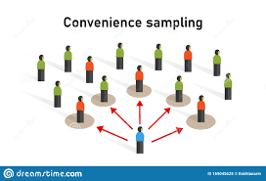
Convenience sampling
Selection of participants from a population in a non-random manner. Selecting participants simply because they are available and accessible. People are sampled simply because they are “convenient" sources of data for researchers. Sampling bias must be taken into account
Including any volunteers with no or minimal criteria for inclusion

Slide 23
Study of vaccination attitudes among nurses who work in hospital settings
1 ) Researcher visits various departments of the hospital during various shifts to recruit whoever is available, until the required sample is attained.
2 ) Researcher posts a general invitation to participate on bulletin boards across the hospital and waits for contacts from nurses - > both are examples of convenience sampling techniques

Slide 24
Theoretical sampling technique
… is developed as a rigorous method employing which qualitative data can be captured to develop a new theory Aim to discover categories and their properties - > develop theory
Data collection and data analysis proceed together Data analysis begins to develop theory that suggest further cases to sample Theoretical saturation point is reached when categories are dense enough – no more cases are needed
A process of collecting, coding, and analyzing data simultaneously in the grounded theory method to generate a theory.

Slide 25
Researchers can use the theoretical sampling method in their study in the following ways:
asking additional interview questions and/or widening the scope of existing interview questions; recruiting participants with additional diversity of attributes within the same group; adding a new group of participants and expanding research settings.
(e.g., Ligita et al 2020)

Slide 26
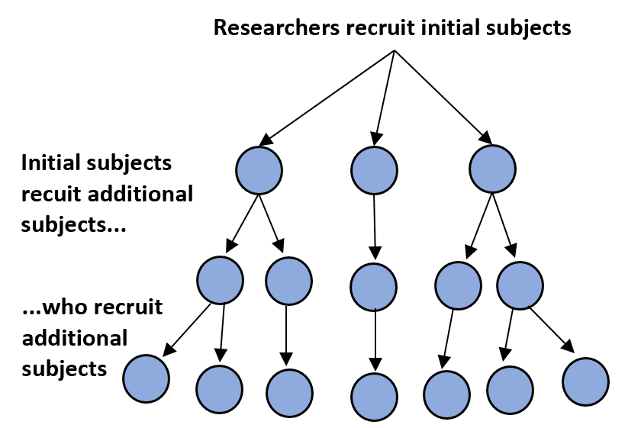
Snowball sampling
Snowball/chain sampling
Using study participants to identify additional participants who meet study criteria
Recommended informants provide the names of recommended respondents who are used in the study.
Excellent way to identify hard-to-reach participants.
A method of gathering information to access specific groups of people. Example: Duisebayeva, G. 2020. The Voice of Nurses: a Qualitative Study of the History of Nursing in Kazakhstan during 1960–1990. Source: www. theseus.fi

Slide 27
Some qualitative study approaches
Phenomenological
Ethnographic
Grounded theory
Historical
Case study
Action research
All can have different sampling techniques

Slide 28
Saturation in qualitative research
It is the point in coding when you find that no new codes occur in the data.
For example, in interviews, when the researcher begins to hear the same comments again and again, data saturation is being reached… It is then time to stop collecting information and to start analysing what has been collected. or For example, when the researcher is analysing the data (while she/he still is collecting it) finds out same codes and categories emerge from the data – it is time to stop collecting any more new data.

Slide 29
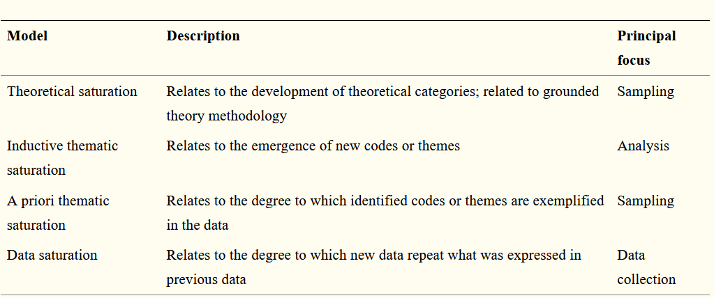
Table from the article of Saunders et al. 2018

Slide 30
Saturation in qualitative research (adapted from Hennink & Kaiser 2019)
Saturation is used to determine when there is adequate data from a study to develop a robust and valid understanding of the study phenomenon. Saturation is applied to nonprobability samples. Saturation provides an indication of data validity.
Saturation often included in criteria to assess the quality of qualitative research. Saturation has its origins in the grounded theory approach to qualitative research, where it is used to determine data adequacy for theory development. Saturation is used to justify sample sizes for qualitative studies (usually in grounded theory approach).
Saturation has attained widespread acceptance as a methodological principle in qualitative research

Slide 31
Standards for reporting qualitative research https://www.equator-network.org/reporting-guidelines/srqr/
SRQR guideline
COREQ guideline
Criteria of individual scholarly journals on how to report sampling inqualitative research (e.g., JAN, JCN)

Slide 32
SRQR guideline (O’Brien et al. 2014)

Slide 33
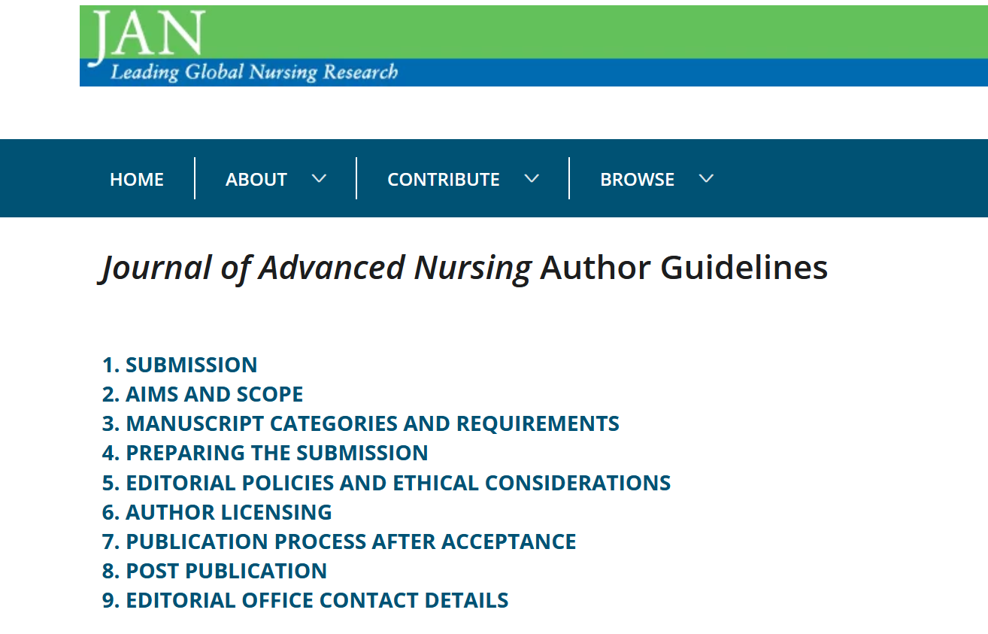
Journal of Advanced Nursing (JAN) author guidelines for qualitative research

Slide 34
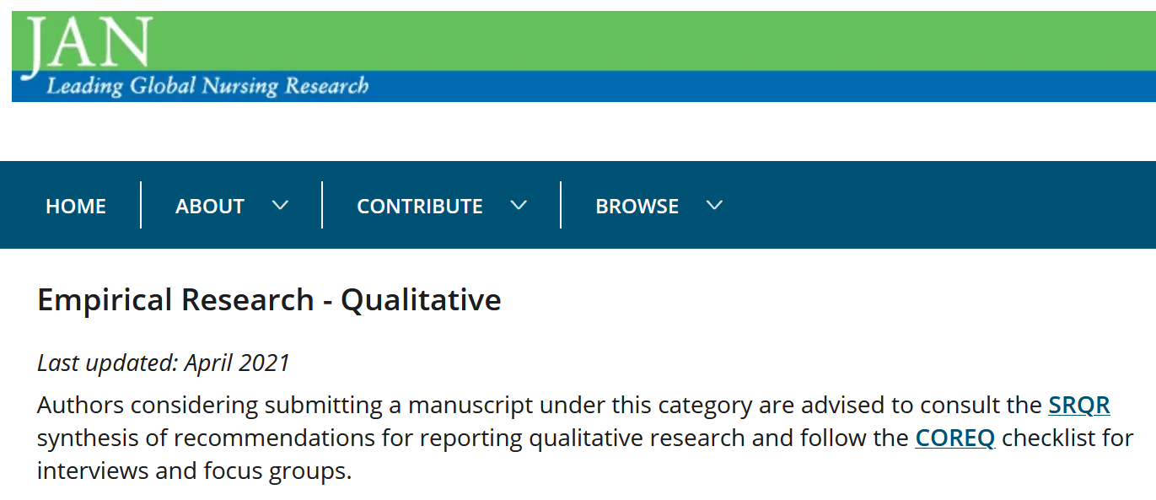
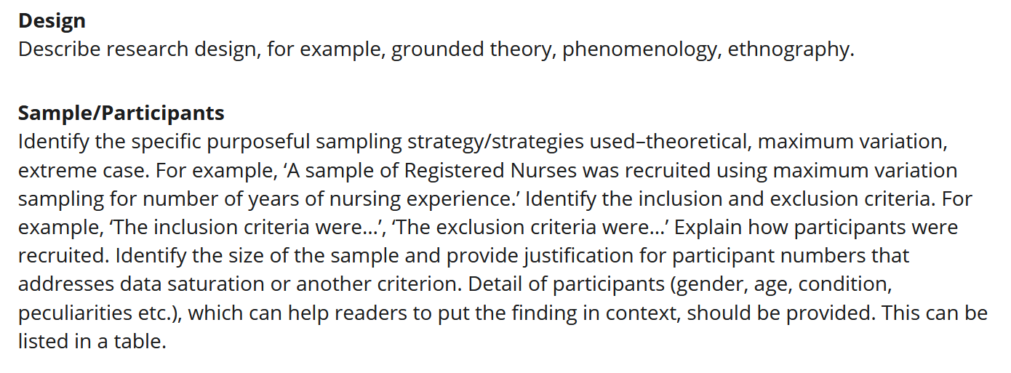

Slide 35
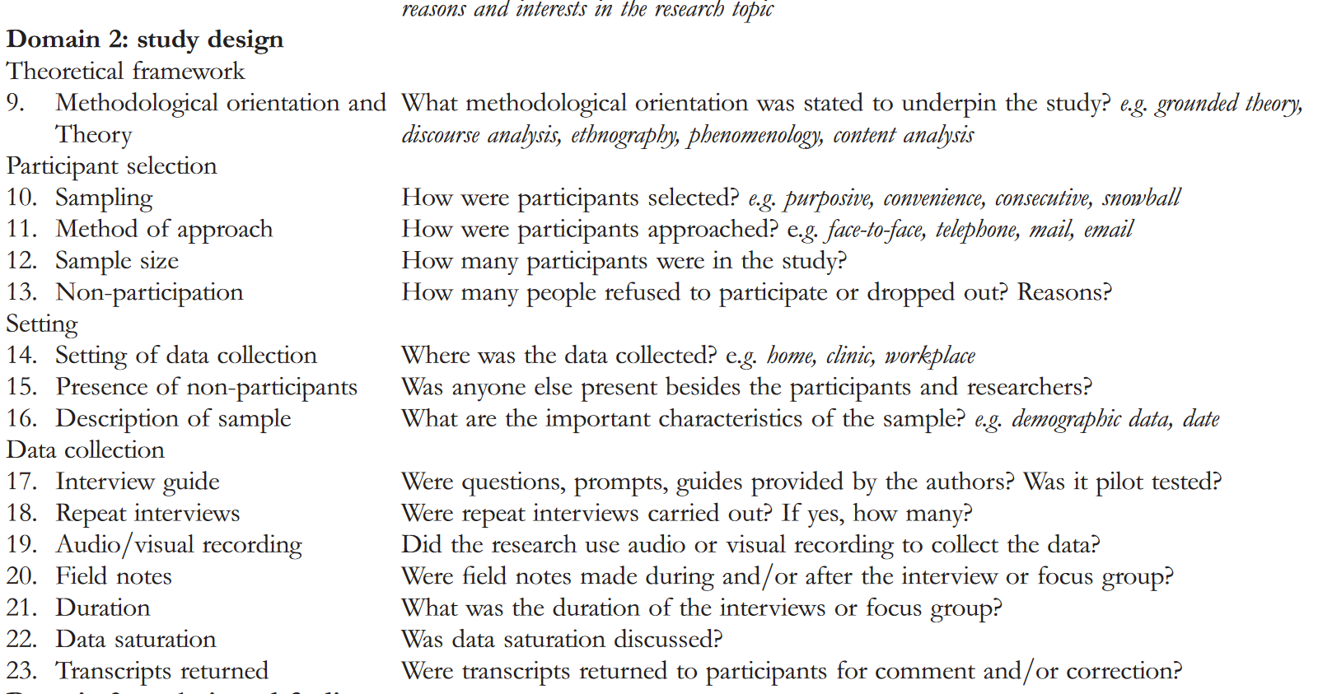

Slide 36
Assignment/Individual work
1) Go to the following websites. Both websites contain open access journals and nursing scienec articles are therefore free for readers. SAGE Open nursing journal: https://journals.sagepub.com/home/son
Nursing Open (Wiley): https://onlinelibrary.wiley.com/journal/20541058?tabActivePane=undefined
2) Find one qualitative research-article on each of the following category from the websites: a) Phenomenological study, b) ethnographic research, b) grounded theory study and c) historical or case study (altogether 4 articles). Then analyse a sampling strategy applied in each of the article. 3) Write a summary of each sampling strategy in your own words. Do not copy the text from the articles. Analyse if all the essential information on sampling are described in the article. If there seems to be missing information concerning a sample description and recruitment, write your remarks and notes. 4) The assignment should include the name of the author(s), the title of the article, the name of the journal, publication year, DOI number plus other important details of each article that you analysed. The length of the paper should be at least 2 pages (font 11, space 1.5).
5) Evaluation criteria (pass/fail): - Participant has followed the given instructions carefully.
- The summary has been written with critical focus on clarity and accuracy and it is based on the reviewed articles.
- Participant has shown deep understanding of principals of sampling strategies of qualitative research.

Slide 37
References and a reading list
Gentles, S. J., Charles, C., & Ploeg, J. 2015. Sampling in qualitative research: Insights from an overview of the methods literature. The Qualitative Report, 20(11), 1772–1789. Glaser, B., & Srauss, A. 1967. The Discovery of Grounded Theory. Chicago: Aldine Publishing Co. Guetterman, T. 2015. Descriptions of Sampling Practices Within Five Approaches to Qualitative Research in Education and the Health Sciences. Educational Psychology Papers and Publications, 263. Hennink, M., & Kaiser, B. 2019. Saturation in Qualitative Research. In P. Atkinson, S. Delamont, A. Cernat, J.W. Sakshaug, & R.A. Williams (Eds.), SAGE Research Methods Foundations. Kandola, D., Banner, D., O’Keefe-McCarthy, S., & Jassal, D. 2014. Sampling Methods in Cardiovascular Nursing Research: An Overview. Canadian Journal of Cardiovascular Nursing, 24(3), 15–18 Lewis-Pierre et al. 2017. The Application of Grounded Theory: An Example from Nursing Workforce Research. The Qualitative Report, 22(5), 1269-1283.
Ligita, T., Harvey, N., Wicking, K., Nurjannah, I. and Francis, K. 2020. A practical example of using theoretical sampling throughout a grounded theory study: A methodological paper. Qualitative Research Journal, 20(1), 116-126. O’Brien, BC. Et al. 2014. Standards for Reporting Qualitative Research. Academic Medicine, 89(9), 1245-1251. Qualitative Research Methods Overview. N.d. https://course.ccs.neu.edu/is4800sp12/resources/qualmethods.pdf
Saunders, B., Sim, J., Kingstone, T., Baker, S., Waterfield, J., Bartlam, B., Burroughs, H., & Jinks, C. 2018. Saturation in qualitative research: exploring its conceptualization and operationalization. Quality & quantity, 52(4), 1893–1907.
Tong, A., Sainsbury, P. & Craig, J. 2007. Consolidated criteria for reporting qualitative research (COREQ): a 32-item checklist for interviews and focus groups. International Journal for Quality in Health Care, 19(6), 349–357.

Slide 38
Thank you for your attention and cooperation!
- Hanna Hopia -

