Slide 1
Publishing the research article
Olga Riklikiene RN, PhD
olga.riklikiene@lsmuni.lt

Slide 2
Aim
To raise the awareness of the importance of publishing the research results
To explain the submission and review process for scientific publication
To become acknowledged about the main ethical challenges and threat in publishing

Slide 3
Why it is important to write for scientific journal?
From an academic and clinical point of view, the preparation of scientific publications is important for:
A) individual nurse/researcher development
B) the nursing community
C) nursing profession
D) research insitution
How could you justify this?
What factors motivate authors – the young researchers – to write and publish?
1. ...........
2. ...........
3. ...........
4. ...........
5. ...........

Slide 4
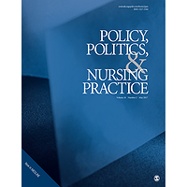
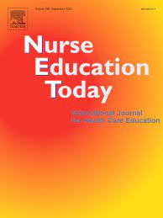
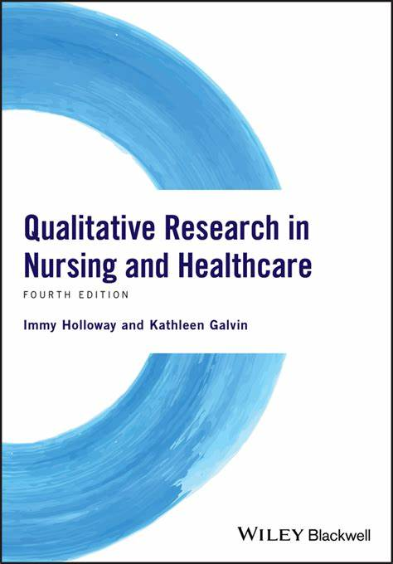
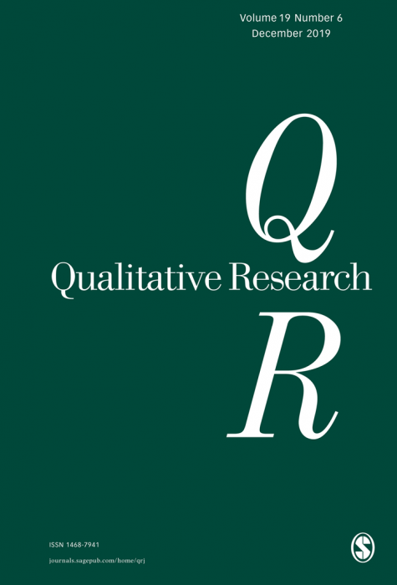
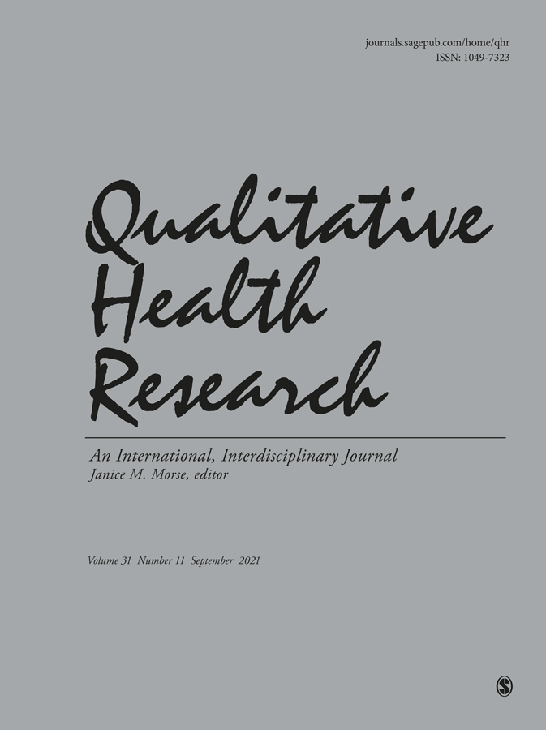
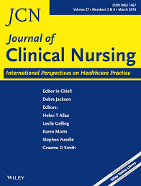
Who is your best audience?
To whom your paper will be addressed: practitioners, educators, managers, policy makers?
What is the research competence of the audience?
In selecting the journal:
What are favourite topics for particular journal?
When similar topic to yours was published?
Is the journal limited to any specific geographical location?
Do you have previous experience with this journal and what it is?
Is it open access journal and is any publication fee applied?
Choose the journal and use it style and guidelines for writing

Slide 5
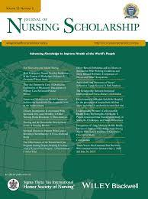
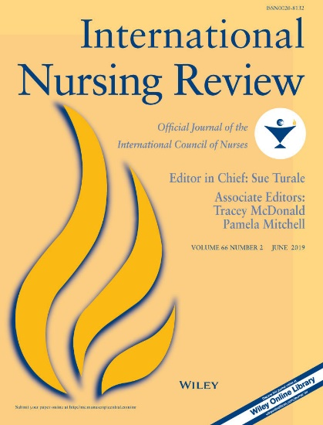
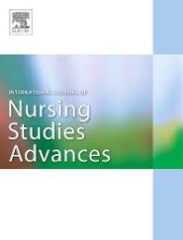
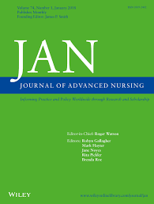
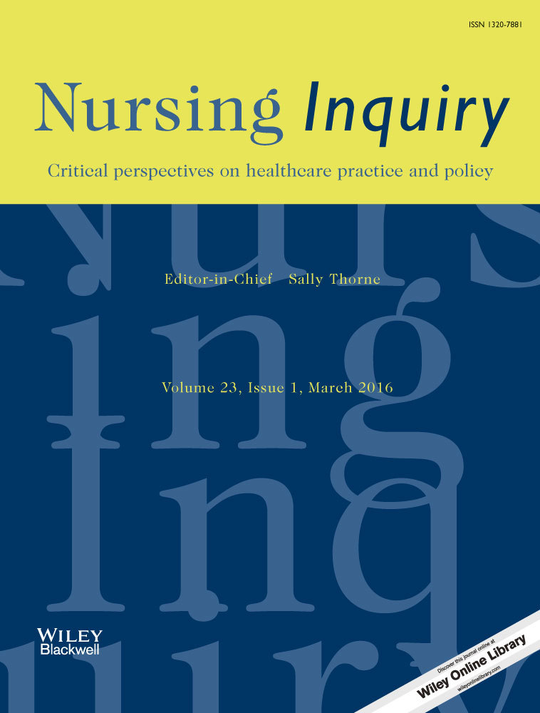
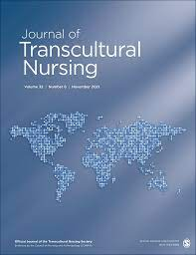
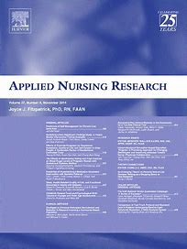
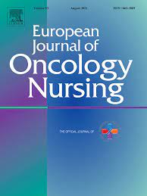
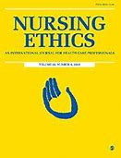
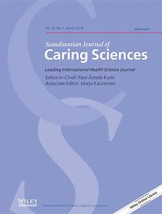
Other leading nursing journals

Slide 6
Follow top 10 publishing ethics tips for authors from
Declare to your chosen journal that your manuscript is not published elsewhere
Declare any conflicts of interest
Check all co-authors meet criteria for authorship and ensure appropriate acknowledgements made in the manuscript
Include appropriate funding statements in the manuscript
Show informed consent and provide assurances that participants’ rights are protected
Register clinical trials
Explain how research using animals is conducted responsibly
Be alert to bias and follow guidelines for accurate and complete reporting of research
Inform the journal if you subsequently find errors in your research
Sign a copyright agreement
https://authorservices.wiley.com/author-resources/Journal-Authors/Prepare/publishing-ethics.html

Slide 7
When the maniscript is ready to submit?
Does the article sends intended message?
Read your article with ‚fresh eyes‘
Read it out laud
Check the article for consistency
Check the format
Check the reference list for completeness
Collect all file and pages in one place to assure they all will be uploaded
Ask the agreement of each author on the final version of the mansucript

Slide 8
First step of review process: ‘Under the Editor’s decision’
‘High percentages of submitted papers are rejected at editorial levels without offering a second chance to authors by sending their papers for further peer-reviews. In most cases, the rejections are typical quick answers without helpful argumentations related to the content of the rejected material. More surprisingly, some journals vaunt their high rejection rates as a ‘‘mark of prestige’’!
‘Blind Manuscript Submission to Reduce Rejection Bias?’ (Khaled Moustafa, 2015)’
‘Of importance are editors who will not consider qualitative research rigorous or a science‘ (Morese and Field, 1995).

Slide 9
Peer review process
A process in which a researcher‘s work is assessed and evaluated by peers or other researchers from the field
Applied for academic publishing or grant applications
Assures quality of the prospective article
Editor or editorial board appoints reviewers according to their expertise
Double-blind or single-blind review (Moustafa, 2015)
Reviewers report on:
originality and significance of the work
methodology problems (methods, design, sampling)
clear presentation of the results and discussion
writing style
other criteria (eg. Implications for practice)
Editor/editorial board considers the comments from reviewers and makes the decision relating the manuscript

Slide 10
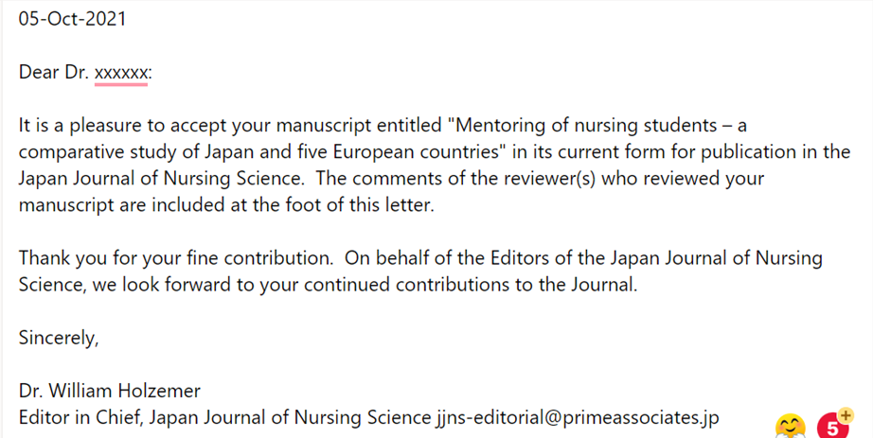
Decisions on acception
Accept – no changes are requested
Accept with minor changes – e.g. use the passive voice, add/change subheadings
Accept with major changes – comments from the reviewers what/how to change in the manuscript
Reject – the chance to submit to another journal

Slide 11
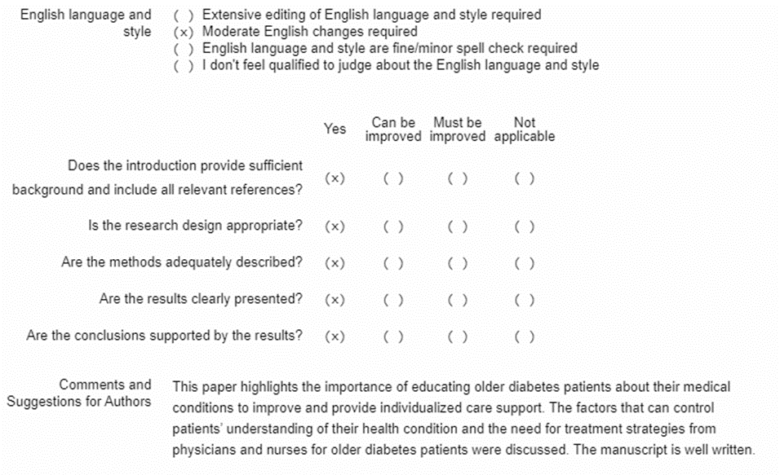
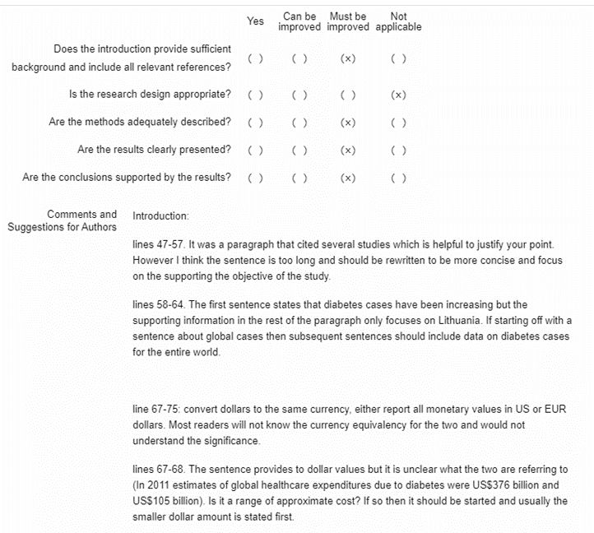
Responding to the reviewers
Be grateful for developmental comments that helps you to improve the manuscript
Address each of the reviewer‘s remark with explanation of change – prepare the table
Not all criticisms should be accepted and addressed by the author but have to be justified
Submit two versions of the revised manuscript: with changes marked and clean one
Keep the deadline for the reviewing/improving your manuscript
Be aware:
Some of the reviewers‘ remarks or comments may be contradictory
The improvements in the manuscript do not guarantee the acception after second revision

Slide 12
Why your manuscript was rejected?
Focus out of the scope of the journal
Focus too narrow or too wide
Not scholarly
Too defensive
Not sufficiently original
Poor structure
Not significant and relevant
Theoretically or methodologically flawed
Too many spelling and grammatical errors
Ethical misconduct
Specific regulations that weaken the reporting of qualitative research
Restricted lenght of submission
A certain outline not conducive to qualitative reporting (e.g. literature review before the results in GD study)
Lack of competent reviewers on qual study
By J.M.Morse and P.A. Field, 1995
Based on Belcher (2009)

Slide 13
Ethical issues in scholarly publishing
Inappropriate authorship
Plagiarism
Falsification of data
Fabrication of data
Self-citation (requested by the journal and self-initiated)
Dual publication or self-plagiarism
‘Salami slicing’
Predatory/fake publishing

Slide 14
Authorship
http://www.icmje.org/recommendations/browse/roles-and-responsibilities/defining-the-role-of-authors-and-contributors.html
The ICMJE recommends that authorship be based on the following 4 criteria:
Substantial contributions to the conception or design of the work; or the acquisition, analysis, or interpretation of data for the work
Drafting the work or revising it critically for important intellectual content
Final approval of the version to be published
Agreement to be accountable for all aspects of the work in ensuring that questions related to the accuracy or integrity of any part of the work are appropriately investigated and resolved.
All those designated as authors should meet all four criteria for authorship, and all who meet the four criteria should be identified as authors.
Those who do not meet all four criteria should be acknowledged
The order of the authors on a publication must be jointly determined before submitting the manuscript
Basic principal – do not accept the
authorship without sufficient input and fulfilled responsibilities to the joint work

Slide 15
Plagiarism
Appropriating the ideas, analysis, methods, data, results, research papers or word(s) of others without formal permission or giving the appropriate credits
Common type of academic dishonesty
Various forms:
Plagiarism by translation
Plagiarism by inappropriate citation
no reference or borrowed
verbatim text is not enclosed in the quotation marks
Superficial paraphrasing
Self-plagiarism or duplicate publication
To avoid plagiarism the authors must distinguish in a clear and unambiguous way their own ideas, thoughts, theories, and data from the work of others with formal reference citations
Results and findings of other researchers have to be reported in a condensed form by summarizing or paraphrasing
Publishers using software such as iThenticate to identify if 30% or more of the paper is replicated
The Croatian Medical Journal (CMJ): all manuscripts submitted in 2009–2010 were analyzed; of 754 submitted manuscripts, 105 (14%) were identified as suspicious of plagiarism; manual verification confirmed that 85 (11%) manuscripts were plagiarized: 63 (8%) were true plagiarism and 22 (3%) were self-plagiarism (Baždaric et al., 2012).

Slide 16
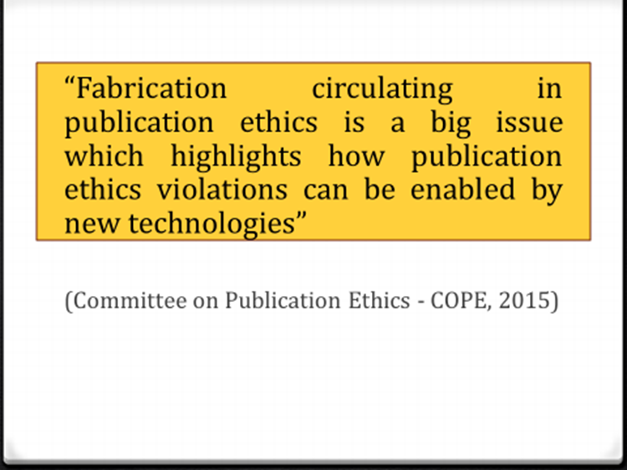
Falsification and fabrication. Self-citation
Falsification – manipulating research data, material, equipment
Fabrication – the making up of data, results, or other non existed material
Self-citation – the intention to cite own work intensively or to cite the publications from the journal which manuscript is submitting to (Mahian and Wongwise, 2015)
Reviewers‘ request to cite their own work

Slide 17
Dual publication: an example for the group discussion
CASE TEXT (ANONYMISED)
A study by Japanese authors was submitted to specialist journal A. The manuscript was sent to three reviewers, including expert X. After two weeks, expert X contacted the editorial office to say that an identical manuscript had been sent by the competing specialist journal B to expert Y in the same unit as expert X. Expert X and expert Y had compared and discussed both manuscripts. Expert X said that the Japanese authors were clearly attempting dual publication, were therefore completely unethical, and should be reprimanded severely. As editor of journal A, what should be done about: 1 The issue of apparently simultaneous submission to two journals? 2 The breach of condentiality by expert X (and also expert Y, commissioned by another journal B)?
ADVICE:
Journal B doesn’t state that reviewers should maintain confidentiality. The editor wrote to authors and received a garbled response saying that they meant to withdraw the paper from Journal A. There had also been a letter from the head of the institution saying that the “authors were considering their response.” It seems that this may be a genuine mistake because of sickness. This story was corroborated by all the authors. As to reviewer confidentiality, journals vary in their practice. Breaches of confidence may be justified “in the public interest”.
FOLLOW UP:
The paper was withdrawn from both journals. The head of the institution formally apologised to both journal and gave sufficient explanation to make it apparent that a genuine mistake had obviously been made. He also added that he felt the corresponding author, as well as all the others, had learnt from this mistake. The breach of confidentiality was discussed by the editors of both journals involved. Expert X admitted that he had not read the instructions to referees, and had not been aware of this particular aspect of peer review. He undertook to reform his ways. He is still being used as a reviewer for journal A.
YEAR: 1998, COPE Forum

Slide 18
‘Salami slicing‘
To split or not to split?
Editors prefer to publish really original work
The ‘slicing’ of research that would form one meaningful paper into several different papers is called ‘salami publication’ or ‘salami slicing’(Abraham, 2000).
Why? - A preassure to err on the side of more publications : ‘quantity over quality’ (Collyer, 2019)
If the slices of a broken-up study share the same hypothesis, populations, and methods- then publishing data in separate papers is not acceptable.
Different to duplicate publication (where same data is in two or more publications)
Why not ethical?
The overall picture of the study is not clear
The space in the journal is wasted and occupied
Results in a distortion of the literature
Wastes readers’ time as well as the time of editors and reviewers
Unfairly inflates the author’s citation record
A
B
ABC
C
Occurrence
17% of publications in Medline are duplicates (Norman & Griffiths, 2008)
1.39 % of papers in a three year period of Ophthalmics & Physiological optics (Elliott, 2013)

Slide 19
‚Salami slicing‘ – a strategy to avoit it
Ensure as little similarity between papers in a study (Jackson et al., 2013)
Make a clear publication plan according the design of the study and expected results
Consult the Editor and be prepared to provide copies of previously published papers (including those ‘in press’) related to the study
Slicing papers is considered appropriate provided that each publication is cross referenced and that each ‘slice’ addresses a distinct and important research question (Durani 2006)
If the primary publication is cited/cross-referenced in these successive manuscripts, then this is transparent and the editor can determine whether subsequent manuscripts are worthy of publication (Karlsson & Beaufils 2013)

Slide 20
The spectrum of ‘fakery’ in publishing
Expanding
Reaches a higher level of sophistication
Fake journals: hijacking scientific journals, assigning misleading metrics, accrediting fake IF
Fake reviewing:
Completely fictitious characters (borrowed affiliations)
“Fabricated identities”
Self-peer-review or falsified peer-review process (bogus email accounts)
Fake data
Fake authorship
Fake……
Statistics
2014, BioMed Central - 43 retracted papers because of “fabricated” peer reviews (Retraction Watch)
Journal of Vibration and Control retracted 60 articles at one time (Barbash, 2014)
Is anything real?

Slide 21
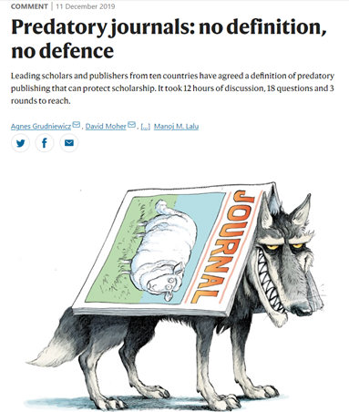
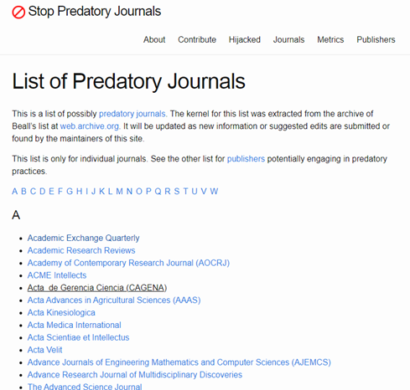
Predatory journals
Definition
‘Predatory journals are a global threat. They accept articles for publication — along with authors’ fees — without performing promised quality checks for issues such as plagiarism or ethical approval. Naive readers are not the only victims. Many researchers have been duped into submitting to predatory journals, in which their work can be overlooked’.
“Predatory journals and publishers are entities that prioritize self-interest at the expense of scholarship and are characterized by false or misleading information, deviation from best editorial and publication practices, a lack of transparency, and/or the use of aggressive and indiscriminate solicitation practices.”
List of predatory journals: https://predatoryjournals.com/journals/
https://www.nature.com/articles/d41586-019-03759-y?utm_source=Nature+Briefing&utm_campaign=058ce17b3a-briefing-dy-20191211&utm_medium=email&utm_term=0_c9dfd39373-058ce17b3a-44166757

Slide 22
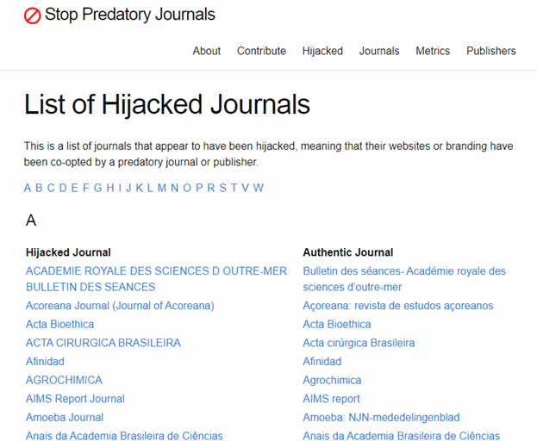
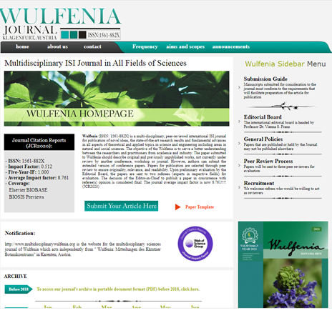
Faked journals
Fake/Hijacked journals:
Hijacked identity of scientific journal
Fake, non-existent, or mis-represented impact factors
Hijacked identity of editors and reviewers

Slide 23
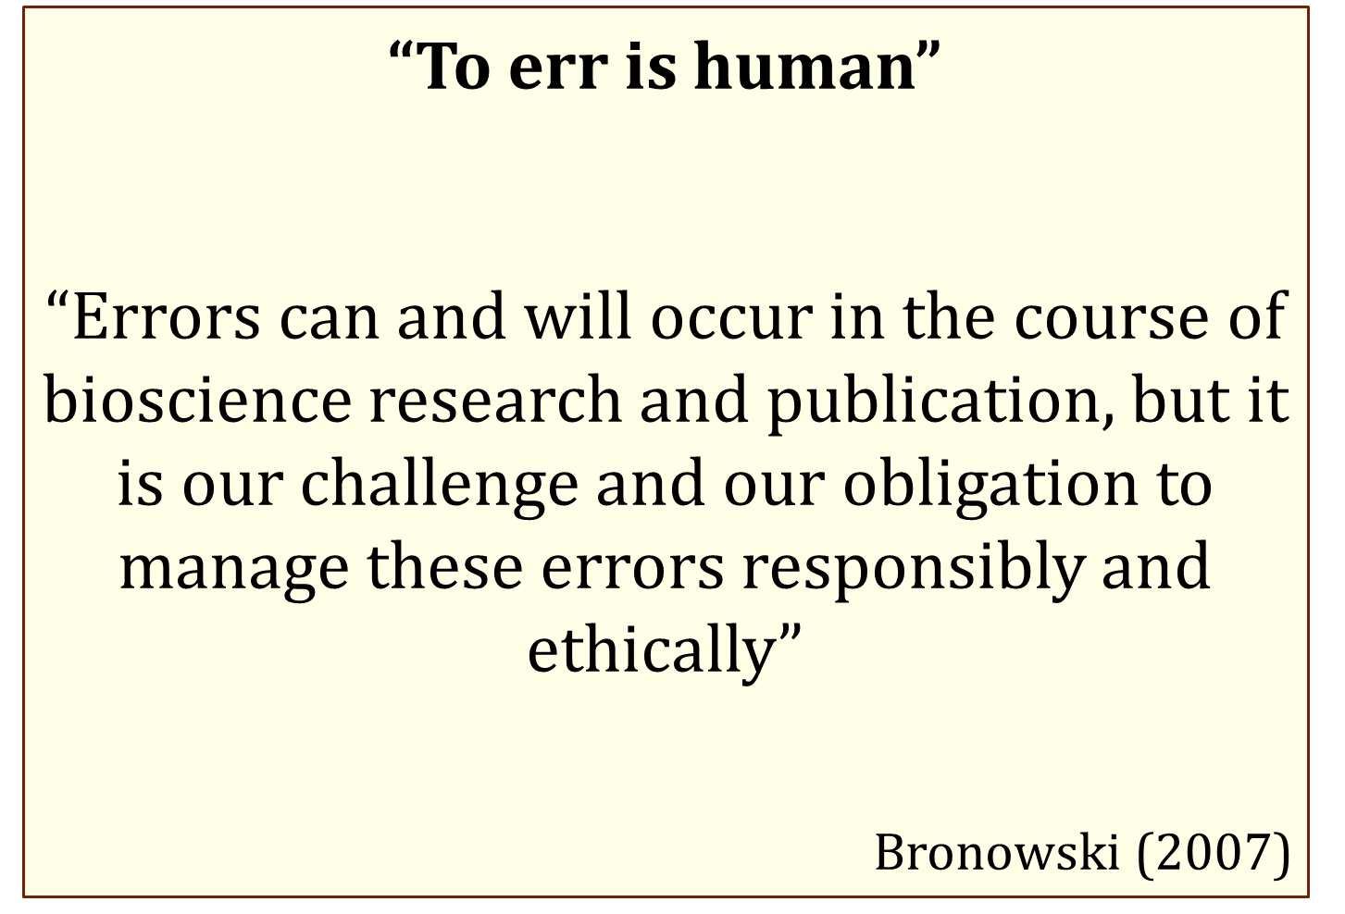
Strategy to avoid fake publishing:
Be familiar with the leading journals of your field
Check where do your colleagues publish
Carefully select and analyze the journal information, check the identity
Always consult your research librarian about the credibility of the journal
Disclosure of the fact of “fake” publication

Slide 24
References and recommended readings
Baždarić, K., Bilić-Zulle, L., Brumini, G., & Petrovečki, M. (2012). Prevalence of plagiarism in recent submissions to the Croatian Medical Journal. Science and engineering ethics, 18(2), 223–239. https://doi.org/10.1007/s11948-011-9347-2
Moustafa K. (2015). Blind manuscript submission to reduce rejection bias?. Science and engineering ethics, 21(2), 535–539. https://doi.org/10.1007/s11948-014-9547-7
Mahian, O., & Wongwises, S. (2015). Is it ethical for journals to request self-citation?. Science and engineering ethics, 21(2), 531–533. https://doi.org/10.1007/s11948-014-9540-1
Recommended readings
Yi, N., Nemery, B., & Dierickx, K. (2020). Perceptions of plagiarism by biomedical researchers: an online survey in Europe and China. BMC medical ethics, 21(1), 44. https://doi.org/10.1186/s12910-020-00473-7
Li Y. (2013). Text-based plagiarism in scientific publishing: issues, developments and education. Science and engineering ethics, 19(3), 1241–1254. https://doi.org/10.1007/s11948-012-9367-6
Li Y. (2013). Text-based plagiarism in scientific writing: what Chinese supervisors think about copying and how to reduce it in students' writing. Science and engineering ethics, 19(2), 569–583. https://doi.org/10.1007/s11948-011-9342-7

