Slide 1
Different approaches of qualitative research and their application I
Phenomenological research
Presenter Joseph Almazan, Assistant Professor, Nazarbayev University | School of Medicine

Slide 2
Phenomenology

Slide 3
Aim of the lecture
The aim of this lecture is:
Learn how to design a phenomenology research study.
Learn about qualitative data collection procedures.
To illuminate the specific, to identify phenomena through how they are perceived by the actors in a situation.

Slide 4
Terminologies:
Meaning: Lies in the relationship between a person and his or her world of objects.
Noema: the appearance of an object or or item as the perceiving subject apprehends it.
Noetic: harboring a meaning or meanings of some sort.
Noesis: How beliefs are acquired; how it is that we are experiencing what we are experiencing.
Ontology: the study of our mode and process of being and existing in the world
Intentionality: consciousness actively reaches out toward the object in a directed way.
World-design: the all-encompassing pattern of a person's mode of being in the world.
From:Phenomenology glossary - Sonoma State University

Slide 5
Terminologies:
Verstehen (German for "to understand"). Through influence and empathy people can understand each other. Experience is not just hidden inside the person, but appears in the words, on our faces, and in our language.
Umwelt, mitwelt, and eigenwelt: Umwelt: biological or physical surroundings or landscape. Mitwelt: the human environment; Eigenwelt: the person himself or herself, including the body and inner psychological reality.
Intersubjectivity: The process of several, or many people, coming to know a common phenomenon, each through his or her subjective experience, and relating their experiences to each other.
Objectivism: positing the procedures of the natural sciences as THE procedures for establishing objectivity and conducting science.
From:Phenomenology glossary - Sonoma State University

Slide 6
BRACKETING is suspending or setting aside our biases, everyday understandings, theories, beliefs, habitual modes of thought, and judgments. Part of the larger process of epoche´.
Since bias is an inevitable part of the study of human beings, phenomenologists deal with it by putting it completely in the situation, by attempting to become aware of their preconceptions and biases before beginning the study and while the study is occurring, and then "bracketing" or suspending them so as to be as open as possible to what the subject wants to share.
EPOCHE´: Learning to look at things in a way such that we see only what stands before our eyes, only what we can describe and define. FACTICITY: A belief in factual characteristics of real objects. In phenomenology, by bracketing our facticity, we transfer our focus from assumed things "out there" to our experience.
FIRST OPENING: A direct experience of a person, object, or event, before any of our mental screens of filters change it.)
PHENOMENOLOGICAL REDUCTION is (1) an attempt to suspend the observer's viewpoint. (2) Hearing another person's reality and focusing on the central, dominant, or recurring themes which represent the essential qualities or meanings of that person's experience.
From:Phenomenology glossary - Sonoma State University

Slide 7
DIALOGICAL PHENOMENOLOGY involves interview of the co-researcher, and involving the co-researcher in thematizing during the interview. The researcher may explicitly pay attention to and refer to observations of the co-researcher's behavior as well as to the co-researcher's descriptions of experience.
THEMATIZING is examining the central and subsidiary themes that recur in the report of the co-researcher.
Part of the method is to try to uncover the LAYERS OF MEANING in phenomenology.
Seemingly irrelevant contents in the interviews which were originally overlooked may be later seen as important clues to themes and feelings that were not initially perceived. This may include observed behaviors, and tensions and gaps in the interview that Giorgi has pointed out can indicate hidden meanings.
When the group of respondents is large enough, a researcher may pay explicit attention to whether there are subgroups who cluster around certain themes and others that cluster around others.
Horizonalization- A “significant sentences or quotes that provide an understanding of how participants experienced the phenomenon.”
From:Phenomenology glossary - Sonoma State University

Slide 8
Phenomenology
Notes:
Phenomenology is a type of qualitative research in that its focus is in answering the 'what is it' question rather than questions of frequency or magnitude such as 'how much' and 'how many.' While quantitative research answers these questions of frequency and magnitude and therefore explains why the phenomenon of interest occurs, qualitative research, including phenomenology, works to describe the phenomenon (Giorgi, 2009). Phenomenology as a qualitative method therefore does not oppose the quantitative method but simply asks a different question in order to further explicate the meaning of the phenomenon.
Although phenomenology is used in many ways by many famous philosopher such as Kant, Hegel, Heidegger, and Husserl in the scope of research, we can used as referring to first person moral experience. The term phenomenology is derived from the Greek ‘phainein’, which means ‘to appear’, and it was first used by Immanuel Kant in 1764. Kantian phenomenology is based on constructivist philosophy for the reason that the phenomena are constructed by cognitive subject who is human being. In constructionist view, the subject constructs what it knows, and in phenomenological view, the subject knows what it construct which are not appearance but it has appearance in the consciousness (Rockmore, 2011).
Another important distinction before discussing phenomenology specifically is that of the natural science approach versus the human science approach. Phenomenology follows the human science approach in that it "respects the essential characteristics of humanness throughout the research process" (Giorgi, 2009). Giorgi (2009) outlines the criteria for both a human science approach and a natural science approach to illuminate the distinction between the two. He states that a human science approach uses research modes other than experimentation, studies quality and meaning, uses explication, intentional responses, and identity through variations, along with utilizing a participant observer. In contrast, a natural science approach uses experimentation, studies quantity and measurement, uses analysis-synthesis determined reactions, and identical repetition, along with utilizing an independent observer. Though the natural science approach as used in quantitative studies is useful in understanding one aspect of the particular phenomenon, phenomenology utilizes the human science approach to study the same phenomenon from a different perspective in order to more fully understand the topic of interest.
These distinctions between quantitative and qualitative research as well as a natural science approach and a human science approach are necessary in understanding where phenomenology positions itself within psychological research. However, the question of what phenomenology is has not specifically been addressed. Phenomenology, as it would seem, is the study of phenomena. Yet phenomena are defined as all things that can present themselves to consciousness and phenomenology studies its structures as they appear to consciousness (Giorgi, 2009). Phenomenology distinguishes itself from other qualitative research by its focus on experienced meaning rather than on descriptions of overt actions and behaviors (Polkinghorne,1989). The phenomenological approach aims to study a phenomenon as it is experienced and perceived by the participant and to reveal what the phenomenon is rather than what causes it or why it is being experienced at all.
Phenomenology uses the phenomenological philosophy of Edmund Husserl as a foundation while making attitudinal changes in order to study phenomena psychologically rather than philosophically. Giorgi (2009) points to two necessary adjustments in order to make phenomenological philosophy a rigorous and scientific psychological method. Included in these changes are the alterations of operating at a scientific level of analysis rather than a philosophical level and the desire to analyze data so as to be psychologically sensitive rather than philosophically so. Though phenomenological psychology must differ from the philosophical ideas of Husserl in some ways to be a psychological approach, it does uphold the noetic-noematic relationship outlined by Husserl. As summarized by Giorgi (2009), this relationship identifies the idea that the "meaning of what is 'given' to consciousness is influenced by its manner of giveness." To visually illustrate the noetic-noematic relationship, if you were to draw a man and the world next to each other with an arrow going from the man to the world at the bottom and the world to the man at the top, creating a cyclical relationship, the noematic relationship (noema) is represented by the top arrow and the noetic relationship (noesis) is represented by the bottom arrow. The noema is the meaning of the thing as opposed to the thing itself (Garza & Landrum, 2012).
In other words, when one walks into a classroom as a student on the first day of school, the classroom, being the thing, will likely appear differently than it would if one were walking into the same classroom on the last day of class. In the first situation, perhaps it appears to one as an anxiety provoking situation in which the presence of uncertainties regarding the class or the professor are overwhelming. In contrast, in the second situation, one will likely not understand the classroom as a place of anxiety but rather one in which one grew closer to my classmates, learned about a particular subject, or formed a relationship with my professor. Though the thing, the classroom, is still the same classroom, the way in which one experiences it, the noema, is different. The meaning the particular person brings to the thing or situation so that it appears to one in the way that it does is the noesis. The noesis is an act of the consciousness and the participant's intentionality, or projections in the words of Heidegger (Garza & Landrum, 2012). In phenomenology, the data, given as descriptions of an experience, present the researcher with the noema, and the aim of the study is to explicate the noesis, that is the meanings or intentionality that were necessary in order for the participant to experience the situation as they did.
The noetic-noematic relationship also illustrates the argument that humans are "being-in-the-world" and therefore cannot encounter a thing transcendently (Garza & Landrum, 2012). The phrase, "being-in-the-world" is a Heideggerian idea that simply means we can never encounter the world without our consciousness. To encounter something transcendentally is often described as knowing what the thing 'really is,' meaning outside of our consciousness. Husserl and Heidegger argue that this transcendental perspective is impossible to obtain and that consequently, the world always appears to us subjectively through the use of our consciousness. Therefore, the noetic-noematic relationship that is fundamental in phenomenology describes the inescapable cycle of the intentionality, projects, or horizons of our consciousness influencing the ways in which our personal world reveals its meaning to us.
In order to analyze the cyclical relationship between consciousness and the world, a rigorous method, outlined by Giorgi (2009), is used. The first step is simply to read and re-read the data in order to gain an understanding of it as a whole. In phenomenology, data is a participant's descriptive account of their experience of the phenomena and is often in written form. The second step requires the researcher to divide the data into 'meaning units,' in places where there are significant shifts in the meaning. Dividing the data gives the researcher a practical way to organize and analyze the data in the third step. The third step is to transform the meaning units. This step is the heart of the phenomenological method and involves illuminating the intentionality and horizons of consciousness necessary to reveal the world with particular meanings. The purpose of identifying the participant's intentionality, or noesis, and the ultimate purpose of partaking in phenomenological research, is to answer the research question, "What is this phenomena?"
In order to answer this question and transform the data, the researcher must first participate in the 'epoche' which involves 'bracketing' or putting into suspension the presumption of their transcendence. Participating in the epoche involves putting aside the questions of "Is that how it really happened?" or "Is the participant remembering the situation correctly?" and instead analyzing how the situation was experienced. The 'truth' of the description is irrelevant for phenomenological research because it does not conflict with the analysis of consciousness and what the phenomenon was for the particular person. Idhe (1986) outlines the general attitude the researcher must hold while transforming the data. He points to the necessity of attending to the experience as experienced, describing rather than explaining the data, and 'horizontalizing' rather than creating an importance hierarchy while analyzing. It is also important for the phenomenologist to empathically analyze the data while magnifying and amplifying the descriptions provided.
Free imaginative variation is used in addition to magnification and amplification to move from the particularly description data to a more universal essence of the phenomenon in order to answer the research question. In order to engage in free imaginative variation, the researcher mentally removes an identified characteristic of the phenomenon in order to see if it is in fact essential to the experience. If by removing the characteristic the experience is essentially altered, that particular aspect of the phenomenon can be identified as an essential part of what it means to experience the phenomenon (Giorgi 2009). After the data has been transformed, a situated structure is created in which the translated meaning units and their interactions are outlined to answer the guiding question of "What is this phenomenon?"
Phenomenology is a method of psychological research that sheds light on another dimension of phenomena that is not addressed using quantitative methods. Just as quantitative methods of research are limited in the questions they can ask and answer, qualitative methods and phenomenology is limited to researching human experiences as they are present consciously. Therefore, phenomenology is not a replacement or opposing perspective of quantitative methods, but rather works in conjunction with other methods of research to more fully illuminate psychological phenomena.
From dialogue with Art Warmoth.) The notion is that social reality is always composed of persons in society, as though that were a single word. Not as if persons are clumped together in society, but rather it is a way of describing a fundamental structure of social reality. People are always in some sense in a society, and are also always in a situation.
Closed and open attitudes. Closed: an approach of constant narrowing or zeroing in on a phenomenon. Open: Consists of gaps as well as "filled" sections, and we remain open to notice what happens and evolves. Social psychologist Milton Rokeach studied this in detail.
It's important to pay attention to our experience, and especially to others' experience because in a sense that's the main source of data available to us. Sometimes it's about all we've got.In order to begin the study of any situation or social issue, it is fundamental to try to understand the experience of the people who are caught in the situation you are concerned with. This includes thoughts, feelings, sensations&emdash;the whole thing. Studying people's behavior is important but it is not enough, because it leaves out important dimensions of experience and meaning that lead to that behavior. This is very different from placing our primary emphasis on measuring objective behavior. What's happening with reinforcers and discriminative stimuli do not tell us all there is to know about a situation, or the person's history in regard to it. Some examples of this from the family therapy literature. In some families, for instance, there is no room for the expression of real emotion if it does not fit the prescriptions of the family's dominant emotional theme or themes. If what's allowed is only anger, assertiveness, or a deadpan front, the overt expression of tenderness or affection may not be allowed. Paying attention only to the behavior can leave out centrally important dimensions of people's inner experience. Similar dynamics occur on the larger social stage. Or take another example&emdash;"crossing generation boundaries." In this case the child is often made to feel as if he or she is responsible for the adults' feelings and well being. Again, there is much more than observable behavior going on. This is not to deny the importance of behavior, but to emphasize that it is not the whole story. We could make the interesting observation that the dynamics observed in dysfunctional families are directly correlated with a set of dysfunctional assumptions about the relative values of subjective and objective truths. We can trace this back to the start of the moder period in the 17th and 18th century, starting with Descartes' argument that mind and body are distinct and separate, rather than interrelated. The realms of subjective knowing and objectively measurable knowing are largely different realms of reality, and the upshot of the development of this kind of dualism ended up being a distinct preference for looking at objectively observable behaviors, whether we are paying attention to organizational, political, or family systems. This has, however, led to a number of significant dead ends, and now is beginning to change.In more traditional cultures, there tends to be a widely shared set of assumptions about the meaning of various behaviors. This is less true in the pluralistic western industrial cultures of America and Northern Europe which have a high degree of social and cultural mobility. With no implication of relatively good or bad, right or wrong in this case, in traditional cultures there is more of a shared history of common experience and shared meanings. A "community of meanings" is taken for granted by most of the members of the society. But speaking about some of the shared experiences that are involved may be forbidden, such as in cultures where women are severely repressed.
In areas like physics and chemistry, objective science and the techbnology built on it is highly appropriate in a broad variety of circumstances. But we have tended to apply this model also to the social sciences where it fits some phenomena and situations and not others, and partly as a result have ended up creating a lot of organizational systems that are pretty dysfunctional in terms of their ability to meet human needs.
In some quarters there appear to be substantial restructurings going on, in which we realize that listening to peoples' subjective experiences in regard to the conditions society is creating for them is extremely important. Part of this involves looking at questions of value and values as a central issue for investigation, instead of dominant social groups blindly and automatically assuming that their own values will produce good lives and experiences for everyone. In this view, the right way to do psychology is to look at what's going on in people's experience as well as how they behave, and before you run out trying to change anything, and especially social policies that everyone has to live with, you make sure you understand as fully as possible the history of events that led people to their present behavior, positions, and experiences of the world. You find out what they're thinking and feeling.
In a polarized situation where people are in conflict, there are two general choices:
Decide that your side is in fact correct and retreat to a position of might makes right, that war or violence of some sort is a legitimate way of resolving the issue. This is basically taking a win-lose position--that "my side has gotta win." An alternative is to assume that we're dealing with an incomplete understanding of the situation, and find out how it looks to those on the other side, what their experience of the situation is. Notice the profound difference between "We have an incomplete understanding of the situation," and "We have a correct understanding of the situation." There is the ever-so-common tendency (to which I still fall victim sometimes myself) to hear one person tell about a situation, and then move toward action without taking time to listen to the other side or sides. Phenomenology reminds us to do our best to understand the other person's experience, rather than jumping to a conclusion based on incomplete information.

Slide 9
Phenomenology
- noun
-The philosophical study of phenomena, as distinguished from ontology, the study of being; specif., such a study of perceptual experience in its purely subjective aspect
-A descriptive or classificatory account of the phenomena of a given body of knowledge, without any further attempt at explanation
-noun
-A philosophy or method of inquiry based on the premise that reality consists of objects and events as they are perceived or understood in human consciousness and not of anything independent of human consciousness.
-A movement based on this, originated about 1905 by Edmund Husserl

Slide 10
Phenomenological Approach
◆ Anything that has been experienced by an individual or a group of people could be researched using phenomenological approach
◆ Data is collected (through interviews and focus groups) from people who have experienced the phenomenon
◆ Data can also be collected (through observations) as people are experiencing a phenomenon
Description of experience is a key part of the phenomenological orientation.
From:Phenomenology glossary - Sonoma State University

Slide 11
A phenomenological research should focus on:
Describing participants’ experience – depicting to the underlying or core experience
Describing participants’ perspective of their experience
Interpreting participants’ experience
Interpreting participants’ understanding of their experience
From: LibGuides: Qualitative Research Methods

Slide 12
3 Elements of Phenomenology
1. “The study of the lived experiences of persons”
2. Experience is a conscious process
3. The “development of [interpretations] of the essences of these experiences”

Slide 13
APPROACHES TO PHENOMENOLOGY ARE:
INDIVIDUAL PHENOMENOLOGY: Researchers use their own actual and imaginary experiences and others' factual and fictional written accounts and theories to develop a thematic description of a phenomenon.
EMPIRICAL PHENOMENOLOGY: The researcher examines descriptions written by the co-researcher, and thematizes after collecting the descriptions.

Slide 14
Arie Cohen (2001) describes the steps in this approach as follows:
1. Immersion in the data which requires reading the transcript several times. 2. The statements that are relevant to the phenomenon are identified and thematized. 3. These excerpts and themes are used to develop an exhaustive description of the participant experience of the phenomenon. This description is often referred to as " situated structural description" (SSD). If there are more than one participant, then additional SSDs are made for each participant, and they are compared in order to identify shared themes and a synthetic general structural description.
From:Phenomenology glossary - Sonoma State University

Slide 15
The characteristics of the empirical phenomenology are:
1. Emphasis on commonality that is present in the many diverse appearances of the phenomenon. 2. Reliance on the actual words of the participants 3. Explicitness about the design and the steps taken to obtain the findings. 4. These characteristics leads to verifiability and ability to be replicable. 5. Stressing more on rigor of the approach than on its creative aspects. 6. Acceptance that hermeneutic activity (interpretation) is intrinsic process of research

Slide 16
THEMATIZING
THEMATIZING is examining the central and subsidiary themes that recur in the report of the co-researcher.
-Part of the method is to try to uncover the LAYERS OF MEANING in phenomenology.
From:Phenomenology glossary - Sonoma State University

Slide 17
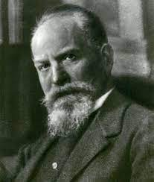
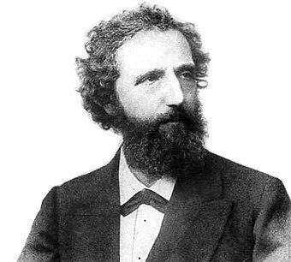
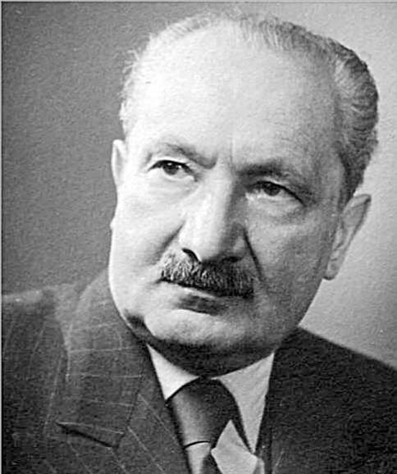
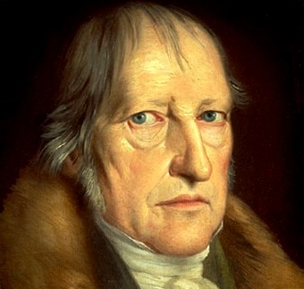
Major People and their influence in the development of phenomenology
Notes:
PHENOMENOLOGICAL RESEARCH Historical Perspective: Phenomenology can be looked at as both a philosophy and a method of research.Begun in the 20th-century as a philosophical movement by such noted philosophers as Edmund Husserl, Martin Heidegger, and Jean Paul Sartre.The philosophical movement they dedicated themselves to wished to describe how the structures of experience as they present themselves to consciousness, without relying upon any preconceived theory, assumption, reason of deduction, formulated hypothesis or foundationally based laws of the natural sciences.To state more simply: The purpose of phenomenological research is to describe experiences as they are lived in phenomenological terms (i.e. to capture the “lived experience” of study participants) of a unique experience/phenomenon.To phenomenologist want to answer the question “What is the meaning ofone’s lived experience?”
Although phenomenology is used in many ways by many famous philosopher such as Kant, Hegel, Heidegger, and Husserl in the scope of research, we can used as referring to first person moral experience. The term phenomenology is derived from the Greek ‘phainein’, which means ‘to appear’, and it was first used by Immanuel Kant in 1764. Kantian phenomenology is based on constructivist philosophy for the reason that the phenomena are constructed by cognitive subject who is human being. In constructionist view, the subject constructs what it knows, and in phenomenological view, the subject knows what it construct which are not appearance but it has appearance in the consciousness (Rockmore, 2011).
Phenomenologists focus on describing what all participants have in common as they experience a phenomenon.The phenomenon can be almost any experience an individual or in the case of phenomenological research a group of individuals collectively experience in consciousness (i.e. such universal experiences as hopelessness, grief, social events, learned behaviors, mental health concerns, or psychological situations of mass stress episodes, etc.).The basic purpose of phenomenology is to reduce individual experiences with a phenomenon to a description of the universal essence (a “grasp of the very nature of the thing,” van Manen, 1990, p. 177).So in essence we as qualitative researchers wish to identify the collective phenomenon as the “object of the participating humans to the experience.

Slide 18
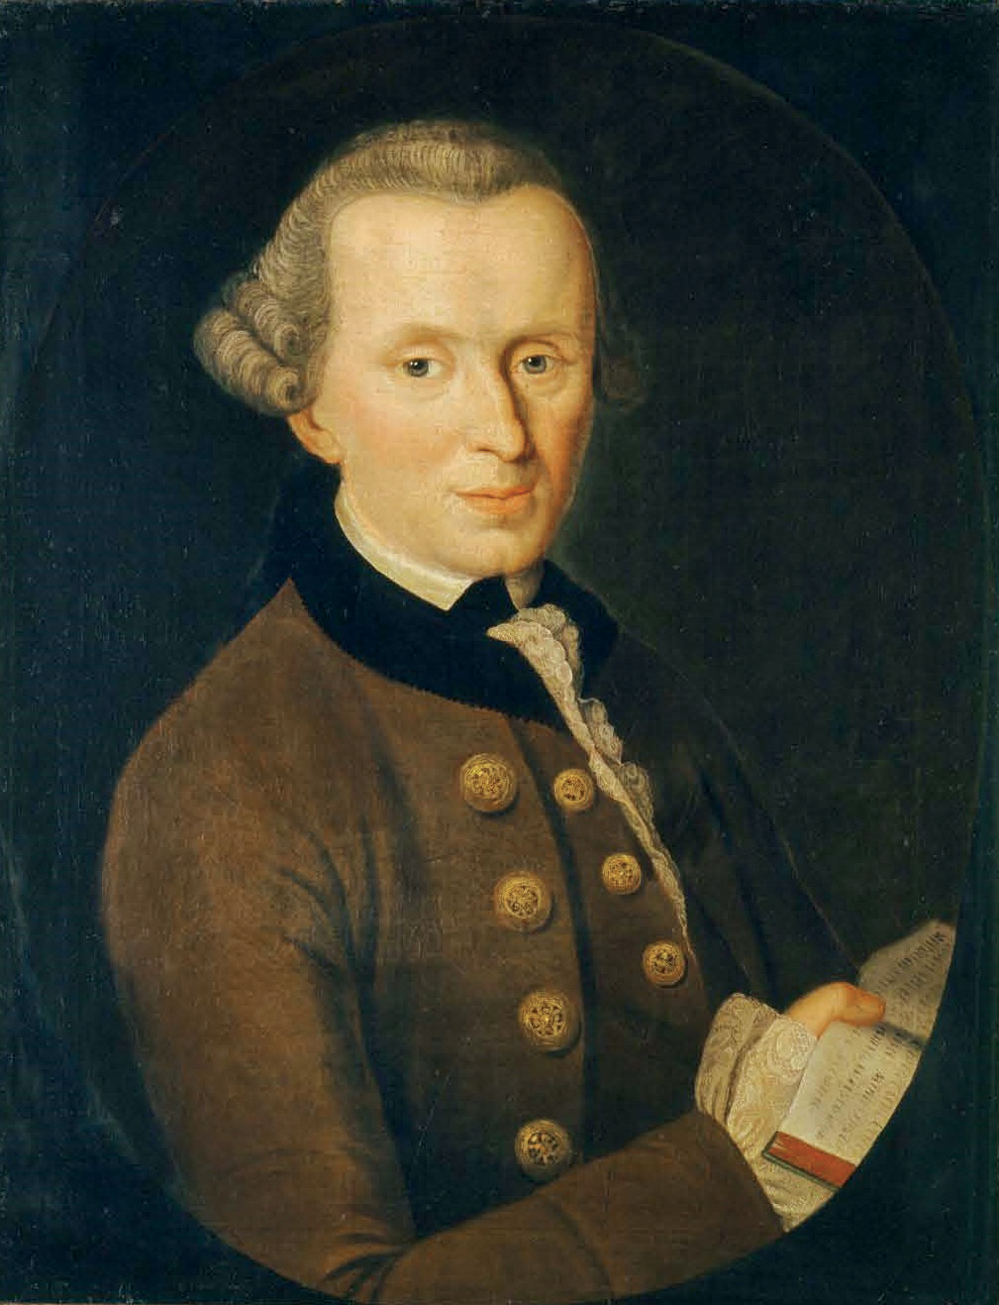
Immanuel Kant (Left) and George Wilhelm Hegel (Right)Their theories on the aesthetics of art in relation to the human experience influenced the later field of phenomenology

Slide 19
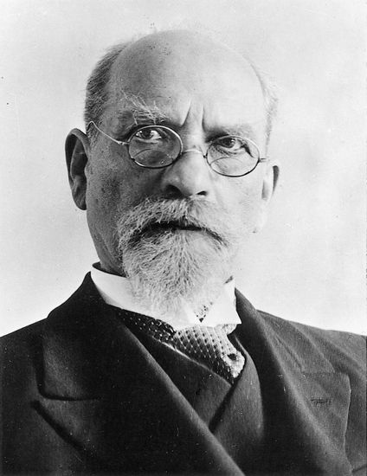
Franz Bretano (1839-1917) (Below) Provided basis for phenomenology
Edmund Husserl (1859-1968) (Above) Known as the founder of phenomenology.

Slide 20
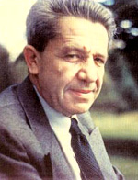
Martin Heidegger (1889-1976) (Below) Hermeneutic Phenomenology
Alfred Schultz (Above) Furthered idea that "the human world comprises various provinces of meaning” significant furthers sociological phenomenology seeks a basis for "sociology of understanding
Notes:
Major People and their influence: Martin Heidegger (1889-1976) Did not believe it was possible to step back from consciousness.Believed we must pursue ‘authentic’ experiences in lifeIntroduced the concept of 'Dasein' (or being/existing as a being)Idea of the dialogue between the person and their world [Hermeneutic Phenomenology].side note: controversial because was sympathetic to the Nazi party in Germany, and openly demonstrated support for Hitler (interestingly Husserl, his teacher, was Jewish)Suggested focusing on the lived experience (or the ‘Dasein’), rather than the phenomena or personsidea that one's reality is always influenced by the world they live in including as researchers (termed one’s “lifeworld”)Rejected Husserl's idea of the "transcendental ego”
On the other hand, hermeneutic phenomenology emphasizes interpretation as opposed to just description. This study used the transcendental phenomenological framework developed by Edmund Husserl who provided the basis for phenomenology (Moustakas, 1994).
Major People and their influence: Alfred Schultz furthered idea that "the human world comprises various provinces of meaning"significant furthers sociological phenomenologyseeks a basis for "sociology of understanding

Slide 21
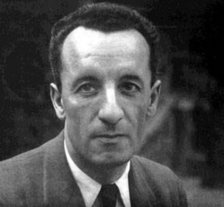
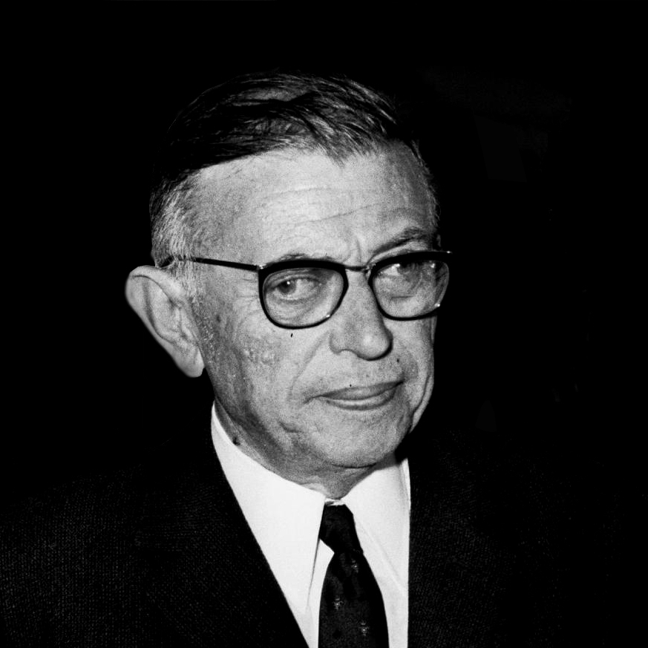
Paul Sarte (below) believed humans were free to choose their lives and were responsible for their experiences
Heidegger Marice Merleau-Ponty believed (above) described you can only really understand phenomenology by experiencing it rather than solely comprehending it intellectually

Slide 22
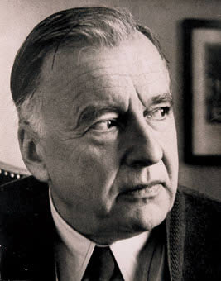
Hans-Georg Gadamer (1900-2002) Introduced the topic of co-constitutionally, where meanings arrived at in the research are comprised of a blend of both researchers and participants.

Slide 23
The Procedures of Phenomenological Inquiry
Determine if phenomenological approach is best
2. Do several people share a common experience?
3.Can you develop policies, practices or develop deeper understanding of the features of the phenomenon?
4. Define the phenomenon of interest to be studied
5. Recognize and understand the philosophy behind phenomenology including bracketing, objective reality and individual experience
6. Collect data through multiple in-depth interviews or other forms of collection
7. Begin with the broad “What” and “How” questions. Proceed with broader open-ended questions to gather textural and structural data
(Creswell 2010)

Slide 24
Four Philosophical Perspectives of Phenomenology
Philosophy without presupposition
Philosophy as a search for wisdom
Intentionality of consciousness
Refusal of subject-object dichotomy
)
Adopted: Arthurton, & Gavritsas (2021)

Slide 25
Unique Features of Phenomenology
Most of the literature review is conducted at the end of the data collection.
It is conducted by gathering interview data from others.
Phenomenology has ties to both qualitative and quantitative research in that there is a subjective-objective perspective

Slide 26
Advantages and Disadvantages of Phenomenology
Advantages | Disadvantages
Can look at change processes over time | Data gathering can take up a great deal of time and resources
Help to understand people’s meanings | The analysis and interpretation of data may be difficult
Contribute to the development of new theories | Policy-makers may give low credibility to a phenomenological study
Gather data which is seen as natural rather than artificial
Adopted : Easterby-Smith, Thorpe, & Jackson (2008)

Slide 27
Phenomenological Research
Strategy of inquiry in which the researcher identifies the essence of human experiences about a phenomenon as described by participants (Moustakas, 1994).

Slide 28
Four Main Phenomenological Approaches
◆ Transcendental phenomenological approach (TPA)
◆ Existential phenomenological approach (EPA)
◆ Hermeneutic phenomenological approach (HPA)
◆ Interpretative phenomenological analysis (IPA)
( Adu, 2021; Kafle, 2013; Smith, Flowers & Larkin, 2012 )

Slide 29
Transcendental Phenomenological Approach (TPA)
Describing participants’ experience – depicting the underlying or core
experience
Main Characteristics
◆ Preventing your prior knowledge/ experience from filtering data being analyzed (i.e. bracketing or practicing epoché)
◆ Seeking for the core features of participants’ experience(Kafle, 2013)
Adopted: Adu (2021)

Slide 30
Transcendental/Empirical/ Psychological Phenomenology
Moustakas, psychologist, phenomenological researcher
Research focused less on interpretation and more on description of experience of participants
Relies on Husserl’s concept of epoche, wherein investigator sets aside their experience to take fresh perspective
The epoche leads to the transcendental approach “in which everything is perceived freshly, as if for the first time” (Moustakas, 1994, p.34)
Researcher develops two descriptions:
Textural: What participants experiences
Structural: How they experienced it (conditions, situations, context) (Creswell, 2013)(Moustakas, 1994)
Researcher derives overall essence of experience from these two descriptions
Adopted: Adu (2021)

Slide 31
Main Characteristics
Preventing your prior knowledge/ experience from filtering data being analyzed (i.e. bracketing or practicing epoché)
Seeking for the core features of participants’ experience
Adopted: Adu (2021)

Slide 32
Existential Phenomenological Approach (EPA)
Describing participants’ perspective of their experience
◆ Main Characteristics
◆ Bringing to light participants’ description of their reality
◆ What they have conceptualized, in terms of
their lived experience
◆ Proponents of existential phenomenology questions the relevance of practicing epoché (bracketing your prior knowledge/ experience) since it is impossible to fully achieve it.
(Adopted: Adu 2021;Kafle, 2013)

Slide 33
Hermeneutic Phenomenological Approach (HPA)
Interpreting participants’ experience
Main Characteristics
◆ Practicing epoché (bracketing your prior knowledge/ experience) is not encouraged because it is not feasible.
◆ Examining participants’ experience with the purpose of gaining understanding and presenting your interpretation.
(Adopted: Adu 2021;Kafle, 2013)

Slide 34
Interpretative Phenomenological Analysis (IPA)
Interpreting participants’ understanding of their experience
◆ Main Characteristics
◆ Practicing epoché (bracketing your prior knowledge/ experience) is encouraged
◆ Examining participants’ interpretation of their experience with the purpose of gaining understanding and presenting your interpretation(Adu 2021; Smith, Flowers & Larkin, 2012 )

Slide 35
Notes:
From this shared understanding, we now address how transcendental (descriptive) phenomenology and hermeneutic (interpretive) phenomenology approach this study in different ways. These approaches are summarized in Tab. 2.
Transcendental phenomenology
Phenomenology originates in philosophical traditions that evolved over centuries; however, most historians credit Edmund Husserl for defining phenomenology in the early 20th century [14]. Understanding some of Husserl’s academic history can provide insight into his transcendental approach to phenomenology. Husserl’s initial work focused on mathematics as the object of study [15], but then moved to examine other phenomena. Husserl’s approach to philosophy sought to equally value both objective and subjective experiences, with his body of work ‘culminating in his interest in “pure phenomenology” or working to find a universal foundation of philosophy and science [13].’ Husserl rejected positivism’s absolute focus on objective observations of external reality, and instead argued that phenomena as perceived by the individual’s consciousness should be the object of scientific study. Thus, Husserl contended that no assumptions should inform phenomenology’s inquiry; no philosophical or scientific theory, no deductive logic procedures, and no other empirical science or psychological speculations should inform the inquiry. Instead, the focus should be on what is given directly to an individual’s intuition [16]. As Staiti recently argued, this attitude towards phenomenology is akin to that of ‘a natural scientist who has just discovered a previously unknown dimension of reality [17].’ This shift in focus requires the researcher to return ‘to the self to discover the nature and meaning of things [18].’ As Husserl asserted: ‘Ultimately, all genuine and, in particular, all scientific knowledge, rests on inner evidence [19].’ Inner evidence—that is, what appears in consciousness—is where a phenomenon is to be studied. What this means for Husserl is that subjective and objective knowledge are intimately intertwined. To understand the reality of a phenomenon is to understand the phenomenon as it is lived by a person. This lived experience is, for Husserl, a dimension of being that had yet to be discovered [17]. For Husserl, phenomenology was rooted in an epistemological attitude; for him, the critical question of a phenomenological investigation was ‘What is it for an individual to know or to be conscious of a phenomenon [20]?’ In Husserl’s conception of phenomenology, any experienced phenomenon could be the object of study thereby pushing analysis beyond mere sensory perception (i. e. what I see, hear, touch) to experiences of thought, memory, imagination, or emotion [21].
Husserl contended that a lived experience of a phenomenon had features that were commonly perceived by individuals who had experienced the phenomenon. These commonly perceived features—or universal essences—can be identified to develop a generalizable description. The essences of a phenomenon, according to Husserl, represented the true nature of that phenomenon. The challenge facing the researcher engaging in Husserl’s phenomenology, then, is:
To describe things in themselves, to permit what is before one to enter consciousness and be understood in its meanings and essences in the light of intuition and self-reflection. The process involves a blending of what is really present with what is imagined as present from the vantage point of possible meanings; thus, a unity of the real and the ideal [18].
In other words, the challenge is to engage in the study of a person’s lived experience of a phenomenon that highlights the universal essences of that phenomenon [22]. This requires the researcher to suspend his/her own attitudes, beliefs, and suppositions in order to focus on the participants’ experience of the phenomenon and identify the essences of the phenomenon. One of Husserl’s great contributions to philosophy and science is the method he developed that enables researchers ‘to suspend the natural attitude as well as the naïve understanding of what we call the human mind and to disclose the realm of transcendental subjectivity as a new field of inquiry [17].’
In Husserl’s’ transcendental phenomenology (also sometimes referred to as the descriptive approach), the researcher’s goal is to achieve transcendental subjectivity—a state wherein ‘the impact of the researcher on the inquiry is constantly assessed and biases and preconceptions neutralized, so that they do not influence the object of study [22].’ The researcher is to stand apart, and not allow his/her subjectivity to inform the descriptions offered by the participants. This lived dimension of experience is best approached by the researcher who can achieve the state of the transcendental I—a state wherein the objective researcher moves from the participants’ descriptions of facts of the lived experience, to universal essences of the phenomenon at which point consciousness itself could be grasped [23]. In the state of the transcendental I, the researcher is able to access the participants’ experience of the phenomenon pre-reflectively—that is ‘without resorting to categorization on conceptualization, and quite often includes what is taken for granted or those things that are common sense [13].’ The transcendental I brings no definitions, expectations, assumption or hypotheses to the study; instead, in this state, the researcher assumes the position of a tabula rasa, a blank slate, that uses participants’ experiences to develop an understanding of the essence of a phenomenon.
This state is achieved via a series of reductions. The first reduction, referred to as the transcendental stage, requires transcendence from the natural attitude of everyday life through epoche, also called the process of bracketing. This is the process through which the researchers set aside—or bracket off as one would in a mathematical equation—previous understandings, past knowledge, and assumptions about the phenomenon of interest. The previous understandings that must be set aside include a wide range of sources including: scientific theories, knowledge, or explanation; truth or falsity of claims made by participants; and personal views and experiences of the researcher [24]. In the second phase, transcendental-phenomenological reduction, each participant’s experience is considered individually and a complete description of the phenomenon’s meanings and essences is constructed [18]. Next is reduction via imaginative variation wherein all the participants’ descriptions of conscious experience are distilled to a unified synthesis of essences through the process of free variation [25]. This process relies on intuition and requires imagining multiple variations of the phenomenon in order to arrive at the essences of the phenomenon [25]. These essences become the foundation for all knowledge about the phenomenon.
The specific processes followed to realize these reductions vary across researchers engaging in transcendental phenomenology. One commonly used transcendental phenomenological method is that of psychologist Clark Moustakas, and other approaches include the works of: Colaizzi [26], Giorgi [27], and Polkinghorne [28]. Regardless of the approach used, to engage rigorously in transcendental phenomenology, the researcher must be vigilant in his/her bracketing work so that the researcher’s individual subjectivity does not bias data analysis and interpretations. This is the challenge of reaching the state of the transcendental I where the researcher’s own interpretations, perceptions, categories, etc. do not influence the processes of reduction. It is important to note that modern philosophers continue to wrestle with Husserl’s notions of bracketing. If bracketing is successfully achieved, the researcher sets aside the world and the entirety of its content—including the researcher’s physical body [17]. While dedication to this bracketing is challenging to maintain, Husserl asserts that it is necessary. Suspending reliance on and foundations in physical reality is the only way to abandon our human experiences in such a way as to find the transcendent I. Researchers might borrow [29] practices from other qualitative research methods to achieve this goal. For instance, a study could be designed to have multiple researchers triangulate [30] their reductions to confirm appropriate bracketing was maintained. Alternatively, a study could involve validation of data [18] via member checking [31] to ensure that the identified essences resonated with the participants’ experiences.
Husserl’s transcendental phenomenology has been employed by HPE researchers. For example, in 2012, Tavakol et al. studied medical students’ understanding of empathy by engaging in transcendental phenomenological research [32]. The authors note that medial students’ loss of empathy as they transition from pre-clinical to clinical training is well documented in the medical literature [33], and has been found to negatively impact patients and the quality of healthcare provided [34]. Tavakol et al. [32] used a descriptive phenomenological approach (i. e. using the methodology of Colaizzi and Giorgi) to report on the phenomenon of empathy as experienced by medical students during the course of their training. The authors identified two key factors impacting empathic ability: innate capacity for empathy and barriers to displaying empathy [32].
Go to:
Hermeneutic phenomenology
Hermeneutic phenomenology, also known as interpretive phenomenology, originates from the work of Martin Heidegger. Heidegger began his career in theology, but then moved into academia as a student of philosophy. While Heidegger’s philosophical inquiry began in alignment with Husserl’s work, he later challenged several key aspects of Husserl’s transcendental phenomenology. A foundational break from his predecessor was the focus of phenomenological inquiry. While Husserl was interested in the nature of knowledge (i. e., an epistemological focus), Heidegger was interested in the nature of being and temporality (i. e., an ontological focus) [21]. With this focus on human experience and how it is lived, hermeneutic phenomenology moves away from Husserl’s focus on ‘acts of attending, perceiving, recalling and thinking about the world [13]’ and on human beings as knowers of phenomenon. In contrast, Heidegger is interested in human beings as actors in the world and so focuses on the relationship between an individual and his/her lifeworld. Heidegger’s term lifeworld referred to the idea that ‘individuals’ realities are invariably influenced by the world in which they live [22].’ Given this orientation, individuals are understood as always already having an understanding of themselves within the world, even if they are not constantly, explicitly and/or consciously aware of that understanding [17]. For Heidegger, an individual’s conscious experience of a phenomenon is not separate from the world, nor from the individual’s personal history. Consciousness is, instead, a formation of historically lived experiences including a person’s individual history and the culture in which he/she was raised [22]. An individual cannot step out of his/her lifeworld. Humans cannot experience a phenomenon without referring back to his/her background understandings. Hermeneutic phenomenology, then, seeks ‘to understand the deeper layers of human experience that lay obscured beneath surface awareness and how the individual’s lifeworld, or the world as he or she pre-reflectively experiences it, influences this experience [35].’ Hermeneutic phenomenology studies individuals’ narratives to understand what those individuals experience in their daily lives, in their lifeworlds.
But the hermeneutic tradition pushes beyond a descriptive understanding. Hermeneutic phenomenology is rooted in interpretation—interpreting experiences and phenomena via the individual’s lifeworld. Here, Heidegger’s background in theology can be seen as influencing his approach to phenomenology. Hermeneutics refers to the interpretation of texts, to theories developed from the need to translate literature from different languages and where access to the original text (e. g., the Bible) was problematic [36]. If all human experience is informed by the individual’s lifeworld, and if all experiences must be interpreted through that background, hermeneutic phenomenology must go beyond description of the phenomenon, to the interpretation of the phenomenon. The researcher must be aware of the influence of the individual’s background and account for the influences they exert on the individual’s experience of being.
This is not to say that the individual’s subjective experience—which is inextricably linked with social, cultural, and political contexts—is pre-determined. Heidegger argued that individuals have situated freedom. Situated freedom is a concept that asserts that ‘individuals are free to make choices, but their freedom is not absolute; it is circumscribed by the specific conditions of their daily lives [22].’ Hermeneutic phenomenology studies the meanings of an individual’s being in the world, as their experience is interpreted through his/her lifeworld, and how these meanings and interpretations influence the choices that the individual makes [13]. This focus requires the hermeneutic phenomenologist to interpret the narratives provided by research participants in relation to their individual contexts in order to illuminate the fundamental structures of participants’ understanding of being and how that shaped the decisions made by the individual [37].
Another key aspect that distinguishes hermeneutic phenomenology is the role of the researcher in the inquiry. Instead of bracketing off the researcher’s subjective perspective, hermeneutic phenomenology recognizes that the researcher, like the research subject, cannot be rid of his/her lifeworld. Instead, the researcher’s past experiences and knowledge are valuable guides to the inquiry. It is the researcher’s education and knowledge base that lead him/her to consider a phenomenon or experience worthy of investigation. To ask the research to take an unbiased approach to the data is inconsistent with hermeneutic phenomenology’s philosophical roots. Instead, researchers working from this tradition should openly acknowledge their preconceptions, and reflect on how their subjectivity is part of the analysis process [16].
The interpretive work of hermeneutic phenomenology is not bound to a single set of rule-bound analytical techniques; instead, it is an interpretive process involving the interplay of multiple analysis activities [35]. In general, this process:
Starts with identifying an interesting phenomenon that directs our attention towards lived experience. Members of the research team then investigate experience as it is lived, rather than as it is conceptualized, and reflect on the essential [phenomenological] themes that characterize the participant’s experience with the phenomenon, simultaneously reflecting on their own experiences. Researchers capture their reflections in writing and then reflect and write again, creating continuous, iterative cycles to develop increasingly robust and nuanced analyses. Throughout the analysis, researchers must maintain a strong orientation to the phenomenon under study (i. e., avoid distractions) and attend to the interactions between the parts and the whole. This last step, also described as the hermeneutic circle, emphasizes the practice of deliberately considering how the data (the parts) contribute to the evolving understanding of the phenomena (the whole) and how each enhances the meaning of the other [35].
In the hermeneutic approach to phenomenology, theories can help to focus inquiry, to make decisions about research participants, and the way research questions can be addressed [22]. Theories can also be used to help understand the findings of the study. One scholar whose engagement with hermeneutic phenomenology is widely respected is Max van Manen [38]. Van Manen acknowledges that hermeneutic phenomenology ‘does not let itself be deceptively reduced to a methodical schema or an interpretative set of procedures [39].’ Instead, this kind of phenomenology requires the researcher to read deeply into the philosophies of this tradition to grasp the project of hermeneutic phenomenological thinking, reading, and writing.
A recent study published by Bynum et al. illustrates how hermeneutic phenomenology may be employed in HPE [2]. In this paper, Bynum et al. explored the phenomenon of shame as an emotion experienced by medical residents and offer insights into the effects of shame experiences on learners. As a means in scholarly inquiry, this study demonstrates how hermeneutic phenomenology can provide insight into complex phenomena that are inextricably entwined in HPE.

Slide 37
Phenomenological Methodology
1. Identify phenomena .
2. Bracket and interpret researcher bias and expectation.
Data Collection.
Reduction: (identification of salient or seminal points of interpretation/description).
Description of themes:
Textural description: What participants experienced.
Structural Description: How participants experienced.
Essence of the experience: Combination of both textural and structural descriptions.

Slide 38
Methods and Procedures for Conducting Phenomenological Researches
THE RESEARCH APPROACH INCLUDES THESE PRINCIPLES:
Don't test hypotheses
Don't use a theoretical model to determine the question.
From:Phenomenology glossary - Sonoma State University
Notes:
After describing the theoretical background of phenomenological research, this part of the paper presents the methods and procedures developed in preparation to conduct a phenomenological study, including data collection, organization, analysis, and synthesis

Slide 39
Similar with other qualitative methods Phenomenology have:

Slide 40
Central role of the Interviewee
The interviewee sets the rules and the times of the interview as he weaves the narrative nets of his experiences.
Interviewee could activate a biographical reconstruction process of his identity: he narrates himself, he reflects on his existence and he is finally able to place it in a wider context in which suspensions of doubt mechanisms are unveiled.
Adopted: Addeo (2013)
‌
Notes:
As the interviewee is the only expert of his lifeworld, in the Hermeneutic approach he has the central role in the whole research process: the interviewee sets the rules and the times of the interview as he weaves the narrative nets of his experiences.
So the classical interview situation is upset: the interviewer has no more a hegemonic role over the interviewee (i.e. the usual asymmetric power relation is virtually dissolved).
Qualitative interviewing techniques are the most suitable to collect narrations because they allow the interviewees to express their visions of the world using their own personal way of communicating.
Interviewee could activate a biographical reconstruction process of his identity: he narrates himself, he reflects on his existence and he is finally able to place it in a wider context in which suspensions of doubt mechanisms are unveiled.
From a methodological point of view, the central role of the interviewee implies that
potentially, everything interviewee says is important and worth analyzing
it is important not only what he tells, but also HOW: means of expressions should be
deeply analyzed
Non directive techniques are more advisable as they are flexible and adaptable
Researcher and Interviewer has to be highly skilled: they should have hermeneutic
sensitivity and maieutic skill

Slide 41
Interviewer Role
⁻ Plays a maieutic role, so the interviewer should minimize interruptions and od few but effective interventions
⁻ Must make interviewer comfortable
⁻ Should be skilled, experienced, motivated , creative and hermeneutic sensitivity
⁻ Must REALLY listen: “Hearing is physiological phenomenon, listening is a psychological act”
⁻ Has to know very well the research goals, should have an active role in the research group

Slide 42
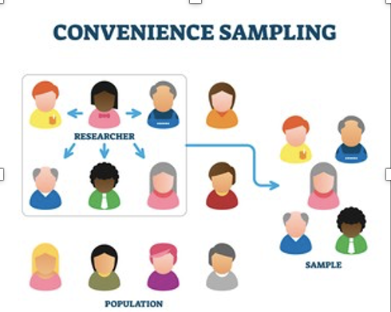
How to select Interviewees

Slide 43
Phenomenological Data Collection
Interview-In depth interview
Participation observation
Conversation
Action research
Focus Meeting
Analysis of Personal Texts ( Diary Writing)

Slide 44
Data collection technique
Data collection technique are complex and time- and resource- consuming , so is it not possible to have huge sample.

Slide 45
Analyzing the Data
Two key questions are foundation for building and organizing data (What, How)
Highlight significant statements
Develop clusters of meaning into themes
Use themes to develop descriptions
Textural description includes what the participant experienced
Imaginative variation/structural description includes how the context or setting influenced the experience of the phenomenon
Composite description written based on data represents the “essence” of the phenomenon called the “essential invariant structure”

Slide 46
Phenomenological analysis and representation
Adopted:Ortamlarında et al(2015)

Slide 47
Conclusion/Key messages
Phenomenology seeks to understand how individuals construct meaning and how they experience the phenomenon. Specifically, a researcher must understand:
Researcher may bracket self out of study by discussing personal experience of phenomenon (this does not necessarily exclude researcher from study)
Data collection through interview (or poems, observations and documents)
Data analysis through systematic procedures looking at narrow units (significant statements) and then broader units (meaning units).

Slide 48
Assignment/individual work
Activity . Students may choose phenomenology article in their field. Structure your presentation in the following way:
What is the research question?
What did they do to find out an answer?
Who did they ask to participate?
How did the authors interpret the data?
1-paragraph statement about the results

Slide 49
Resources
Addeo, F. (2013). Hermeneutic as a Research Method. Retrieved October 31, 2021, from Slideshare.net website: https://www.slideshare.net/FeliceAddeo/hermeneutic-as-aresearchmethoddraft
Adu, P.(2021). Phenomenological approaches: Four main phenomenological methods and their characteristics. https://www.slideshare.net/kontorphilip/phenomenological-approaches-four-main-phenomenological-methods-and-their-characteristics
Arthurton,N. & Gavritsas,M.(2021).Phenomenology Research: “The Lived. (2016, February 4). Retrieved October 31, 2021, from studylib.net website: https://studylib.net/doc/5485224/phenomenology-research--%E2%80%9Cthe-lived
Clarke, V. (2010) Review of the book ”Interpretative Phenomenological Analysis: Theory, Method and Research”. Psychology Learning & Teaching, 9 (1).
Creswell, John. (1998). Qualitative Inquiry and Research Design: Choosing Among Five Approaches (p. 52). Los Angeles, CA: Sage Publications.
Creswell, John. (2013). Qualitative Inquiry and Research Design: Choosing Among Five Approaches (p. 76-82). Los Angeles, CA: Sage Publications.

Slide 50
Resources
Daniel, V. (2021).Lecture on Phenomenology. (2021). Retrieved September 5, 2021, from Sonoma.edu website: http://web.sonoma.edu/users/d/daniels/phenomlect.html
Duquesne University(2021) LibGuides: Qualitative Research Methods: Phenomenology. (2012). Retrieved October 31, 2021, from Duq.edu website: https://guides.library.duq.edu/c.php?g=836228&p=5972144
Easterby-Smith, M, Thorpe, R. & Jackson, P. (2008). Management Research” 3rd ed, SAGE Publications Ltd., London
Giorgi, A. (1985). (Ed). Phenomenology and Psychological Research. Pittsburgh, PA: Dusquesne University Press.
Kafle,N,P.(2013). Hermeneutic phenomenological research method simplified. An Interdisciplinary Journal,5(1).
Moustakas, C. E. (1994). Phenomenological research methods. Sage Publications, Inc.
Nelson, B. (2011). Research: Phenomenology. Encyclopedia of Creativity, 299–303. https://doi.org/10.1016/b978-0-12-375038-9.00149-7
‌Ortamlarında, E., Çalışmaları, F., İçin, Y., Çerçeveler, T., Ve Prosedürler, Y., Yüksel, P., & Yıldırım, S. (2015). Theoretical Frameworks, Methods, and Procedures for Conducting Phenomenological Studies in Educational Settings. Turkish Online Journal of Qualitative Inquiry, 6(1). Retrieved from https://dergipark.org.tr/tr/download/article-file/199867

Slide 51
Resources
Research-Methodology (2021). Phenomenology - Research Methodology. Retrieved September 4, 2021, from Research-Methodology website: https://research-methodology.net/research-philosophy/phenomenology/
Stack, C. (1974). All Our Kin: Strategies for Survival in a Black Community. New York, NY: Harper & Row Publishers.
Smith, J., Flowers.P., & Michael Larkin, M. (2012).Interpretative Phenomenological Analysis: Theory, Method and Research. London:Sage.
Turner, d S. (2003). Horizons Revealed: From Methodology to Method. International Journal of Qualitative Methods, 2(1). Article 1. Retrieved from http://www.ualberta.ca/~iiqm/backissues/2_1/html/turner.html
van Manen, M. (1990) Researching Lived Experience: Human Science for an Action Sensitive Pedagogy. ( p. 168-173). Albany, NY: State University of New York Press.
Webster’s New World College Dictionary, Fourth Edition (1999). Foster City, CA : IDG Books Worldwide Inc.

