Slide 1
Different approaches of qualitative research and their application II
Grounded theory
Presenter Joseph Almazan, Assistant Professor, Nazarbayev University | School of Medicine

Slide 2
Aim of the lecture:
This topic will help the learner to explain general aspects of grounded theory. Specifically:
1. Summarize the historical background of grounded theory.
2. Discuss methodological influences on grounded theory as an approach. to research.
3. Outline key positions taken in the literature about grounded theory.

Slide 3
❖ Grounded theory method is a research method which operates almost in a reverse fashion from traditional social science research. Rather than beginning with a hypothesis, the first step is data collection, through a variety of methods.
❖ A grounded theory design is a systematic, qualitative procedure used to generate a theory that explains, at a broad conceptual level, a process, an action, or an interaction about a substantive topic (Creswell, 2008).
“A qualitative research method that uses a systematic set of procedures to develop an inductively derived grounded theory about a phenomenon” (Strauss & Corbin ,1998 p24)

Slide 4
When to use Grounded theory research
-To generate a theory rather than use one “off the shelf”
-To explain a process, action or interaction
-When you want a step-by step systematic procedure
-When you want to stay close to the data
Adopted by: Cresswell 2015

Slide 5
• Review of the literature in the substantive area of the study is reserved until after the theory begins to emerge from the study data.
• Researcher integrates the literature with the emerging theory during saturation, sorting memos, & report writing.

Slide 6
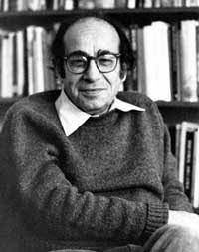
Two sociologists, developed grounded theory in the late 1960s
Barney G. Glaser
Anselm L Strauss
Notes:
6.  Two sociologists, Barney G. Glaser and Anselm L Strauss, developed grounded theory in the late 1960s.  Their collaboration in research on dying hospital patients led them to write the book Awareness of Dying. In this research they developed the constant comparative method, later known as Grounded Theory Method.  Glaser and Strauss developed a pioneering book that expounded in detail on their grounded theory procedures, The Discovery of Grounded Theory(1967). Development of the Grounded TheoryDevelopment of the Grounded Theory

Slide 7
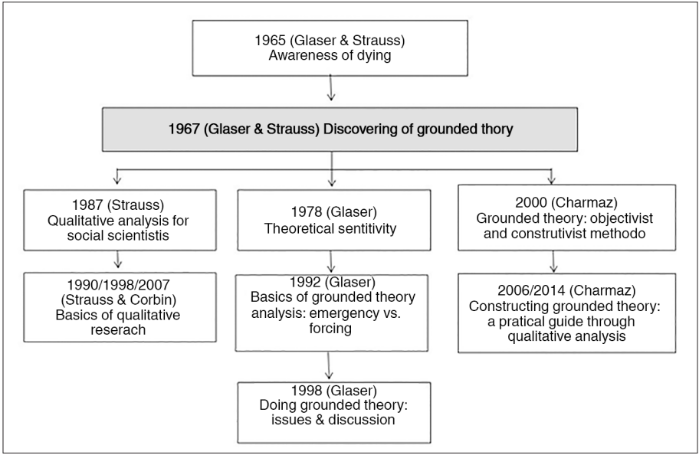
Adopted: Glaser (2011)

Slide 8
Discovering theory
“In discovering theory ,one generates conceptual categories or their properties from evidence, then the evidence from which category emerged is used to illustrate the concept.”(Glaser and Strauss,1967)

Slide 9
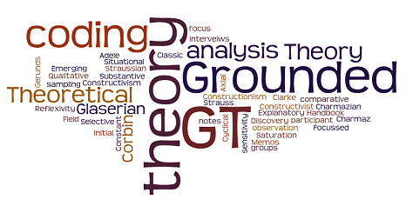
-Ignore existing theory and focus on the study
-Work in the areas that have little to no literature already
-Collection,coding,and analysis should be done together as much as possible
Adopted:Glaser and Strauss,1967

Slide 10
Why use comparative analysis?
-Accurate Evidence
-Empirical Generalizations
-Specifying a concept
- Verifying theory
-Generating theory

Slide 11
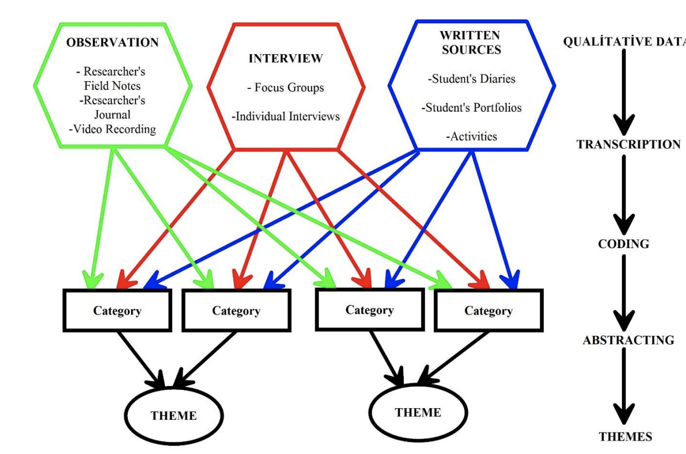
The phases of constant comparative analysis
Adopted: Servet,Erkan, & Ismail (2019) ‌

Slide 12
Advantages:
- An effective approach to build new theories and understand new phenomena - High quality of the emergent theory - Emergent research design reflects the idiosyncratic nature of the study -Findings and methods are always refined and negotiated - Requires detailed and systematic procedures for data collection, analysis and theorizing - The resulting theory and hypotheses help generate future investigation into the phenomenon - Requires the researcher to be open minded, and able to look at the data through many lenses Data collection occurs over time, and at many levels, helping to ensure meaningful results
Adopted: Ke & Wenglensky (2010)

Slide 13
Disadvantages:
Huge volumes of data
Time consuming and painstakingly precise process of data collection/analysis
Lots of noise and chaos in the data
Prescribed application required for the data-gathering process
There are tensions between the evolving and inductive style of a flexible study and the systematic approach of grounded theory.
It may be difficult in practice to decide when the categories are “saturated” or when the theory is sufficiently developed
It is not possible to start a research study without some pre-existing theoretical ideas and assumptions
Requires high levels of experience, patience and acumen on the part of the researcher
Adopted: Ke & Wenglensky (2010)

Slide 14
General elements in a grounded theory research design
1. Question formulating 2. Theoretical sampling 3. Interview transcribing and Contact summary 4. Data chunking and Data naming – Coding 5. Developing conceptual categories 6. Constant comparison 7. Analytic memoing 8. Growing theories
Adopted: Ke & Wenglensky (2010)

Slide 15
Developing the Question
Question may not be explicitly stated but can be implied from the purpose
Question is broad & may change several times as data are analyzed
Basic social process
Gerund (noun ending in ing )
"What is going on?
“What are people doing?
What is the person saying?
Example question attached in word document:
Charmaz, Kathy. (2003). Qualitative interviewing and grounded theory analysis. In J.A. Holstein & J.F. Gubrium (Eds.), Inside interviewing: New lenses, new concerns (pp. 311-330). Thousand Oaks: Sage Publications.

Slide 16
Getting started: Theoretical Sensitivity
Theoretical sensitivity: The ability to understand what is going on with data; what is relevant and what is not; having insight; found in the researcher; it is conceptual
Takes place before analysis of data and during the analysis of data.

Slide 17
Getting Started: Asking the Research Question
Two concerns:
C1: Finding a researchable question that is flexible enough to allow for in-depth investigation (Broad)
C2: Narrowing down the question enough to allow us to work with it.
A: Based on the nature of grounded theory a research question starts out broadly but then in the data analysis stage (remember the “dialogue”), the question narrows and becomes a statement that specifically identifies what is being studied
Adopted: Pradhan, M. (n.d.).

Slide 18
Review of Getting Started Section
Asking the research question- broad to narrow due to the nature of GT.
Theoretical sensitivity- to keep you on track and focused on what the data is saying.
Role of literature- can review minimally before your study and then the data will show you what to research further.
Adopted: Pradhan, M. (n.d.).

Slide 19
Getting Started: Theoretical Sensitivity
Sources of Theoretical Sensitivity:
Professional experience
Personal experience of an event
Analysis process itself: become sensitive to concepts, meanings and relationships
Literature
Adopted: Pradhan, M. (n.d.).

Slide 20
Getting Started: Theoretical Sensitivity
Theoretical sensitivity is a good thing in that it helps us connect what we know to what we don’t known about what we are studying (awareness of our biases)
Forces us to step back and make sure what we are truly seeing is FOUND in the data.
Think of it as a “grounding tool” for conducting grounded theory…
Adopted: Lazarides (2008)

Slide 21
Getting Started: The Role of Literature Reviews
Debate on whether or not to read existing literature before conducting one’s study
Most suggest reading beforehand to gain minimal knowledge in the beginning stage of your research project and increase literature reading/knowledge during the data analysis stage because the data itself will lead you to further literature about “what you are seeing” (“dialogue”)
Adopted: Pradhan, M. (n.d.).

Slide 22
Doing Grounded Theory: Theoretical Sensitivity
Example of Theoretical Sensitivity :
All female research team. Two members with hidden disabilities were on the team.
Held extensive discussions as a research team on research expectations and biases
Researched literature and were aware that of little research done on the career development of women with disabilities the research focused on obstacles
Adopted: Lazarides (2008)

Slide 23
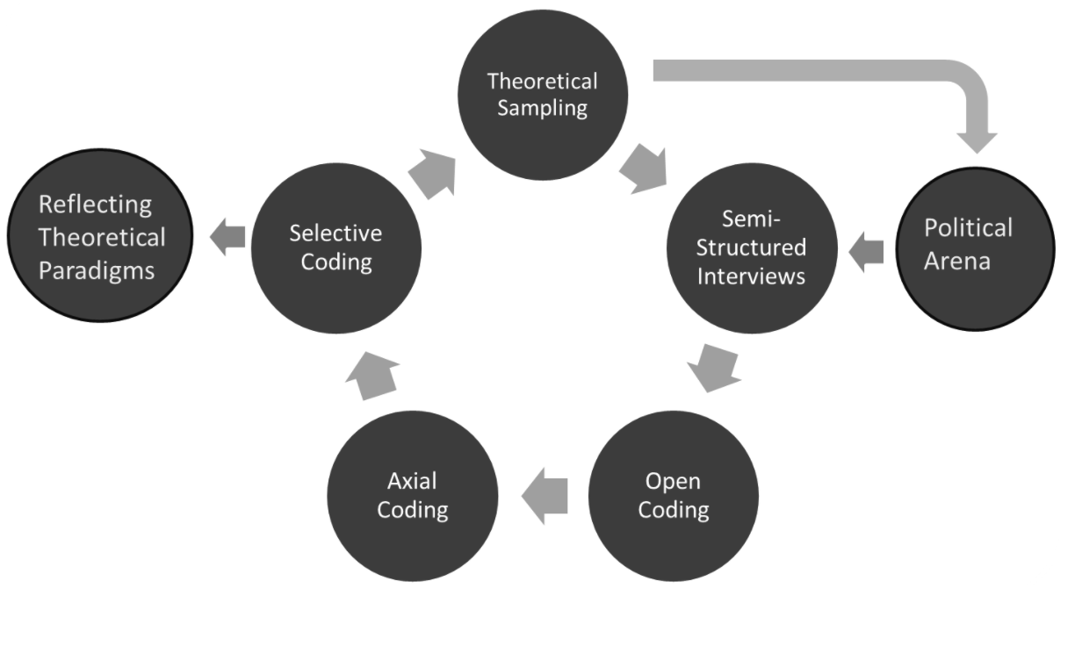
2. Theoretical sampling
When utilizing theoretical sampling, the process of collecting data, coding it, and analyzing it, happens simultaneously and recursively, and not as discrete steps that lead into one another.
‌

Slide 24
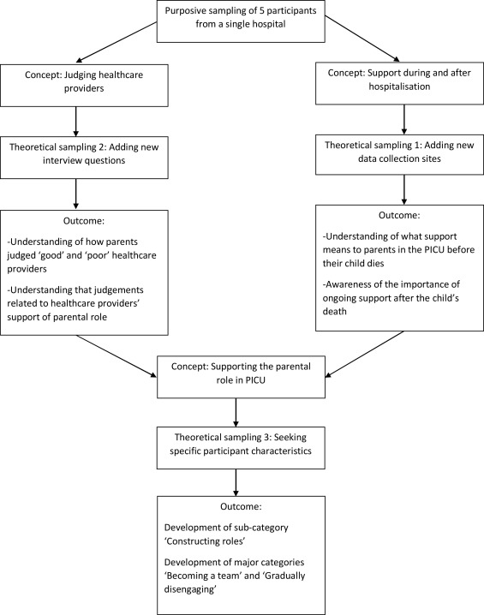
Adopted: Butler, Copnell, & Hall, (2018).

Slide 25
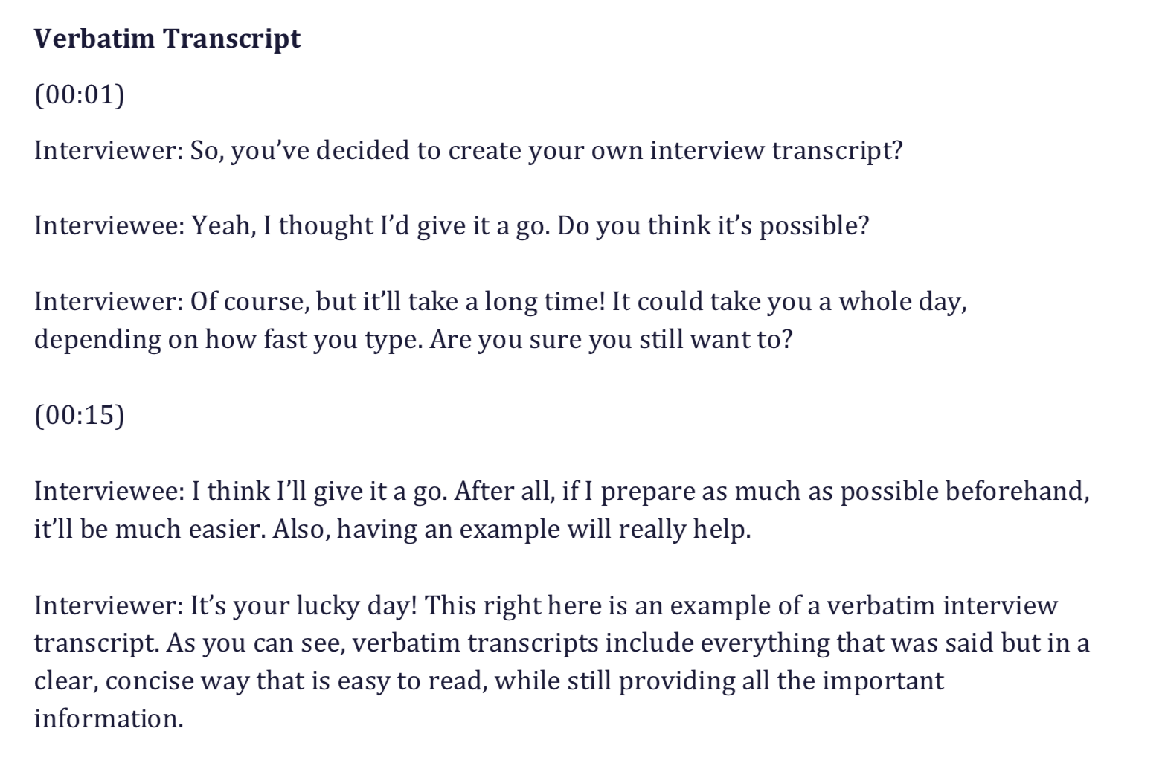
3. Interview transcribing and Contact summary
To make your recordings as useful as possible you will need to summarise and, possibly, transcribe them. Summaries are brief lists, in order, of the topics discussed and stories told.
A quick guide to the interview, they also help you review interviewing techniques, and highlight gaps and vague responses.
If you’re planning to use the interviews as written speech you’ll need to transcribe them, either in full or as extracts (the summary will help you decide which portions of the interview to use).
Adopted: University of Leicester (2021).

Slide 26
4. Data chunking and Data naming – Coding
It involves a process of reading through your data, applying codes to excerpts, conducting various rounds of coding, grouping codes according to themes, and then making interpretations that lead to your ultimate research findings.
You may start with an initial round of coding to summarize or describe excerpts, and then do a second round of coding that adds your own interpretive lens.
There’s no right or wrong way to code a set of data, just some approaches that are more or less appropriate depending on your research objective.
Frampton (2020)

Slide 27
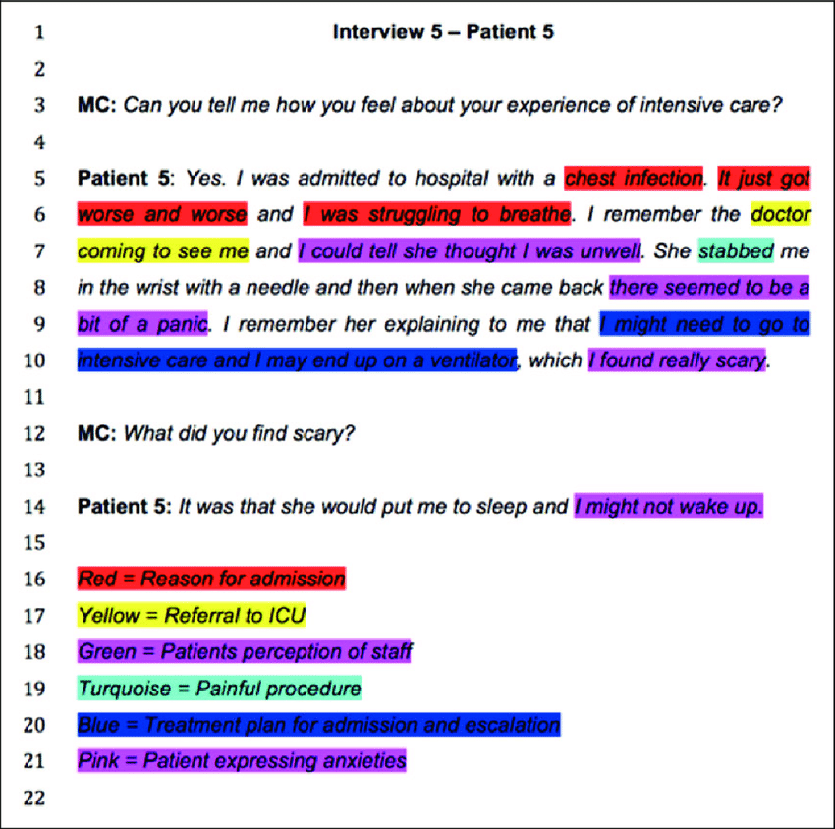
Adopted :Charlesworth & Foëx (2015)
‌

Slide 28
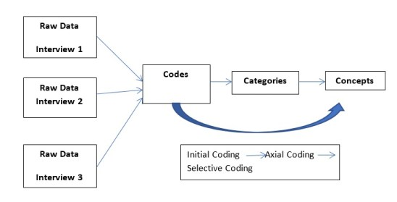
5. Developing conceptual categories
Coding and categorizing in qualitative data means clustering and classification schemes; linking categories to the concept and forming a theory (Maxwell & Miller, 2008).

Slide 29
Steps in coding
Step 1: An initial code is a word or short phrase that denotes a salient feature of visual data.
Step 2: This step comprises the development of a large number of codes. The redundant codes will be collapsed and codes will be renamed. After removing redundant codes, codes will be modified from raw data.
Step 3: After modifying codes, they will be organized into categories. It explains the major topic will be grouped and every important topic. So there is a long list of categories and sub-categories with related codes.
Step 4: Initial list will be modified by combining two categories. So the movement of coding initial data to category identification and from identified category to emerging concepts entail the analysis process.
Step 5: Categories and sub-categories will be revisited after removing redundancies and identifying critical elements.
Step 6: Final step of this process contains the identification of concepts in relation to identified codes and categories.
Adopted: Chetty(2020).

Slide 30
6. Constant comparison
-The codes arising out of each interview are constantly compared against the codes from the same interview, and those from other interviews and observations (Rashina Hoda, Noble & Marshall,2017).
- This is GT’s Constant Comparison Method which is used to group these codes to produce a higher level of abstraction called concepts, and is repeated on these concepts to produce another level of abstraction called a category (Glaser, 1978).

Slide 31
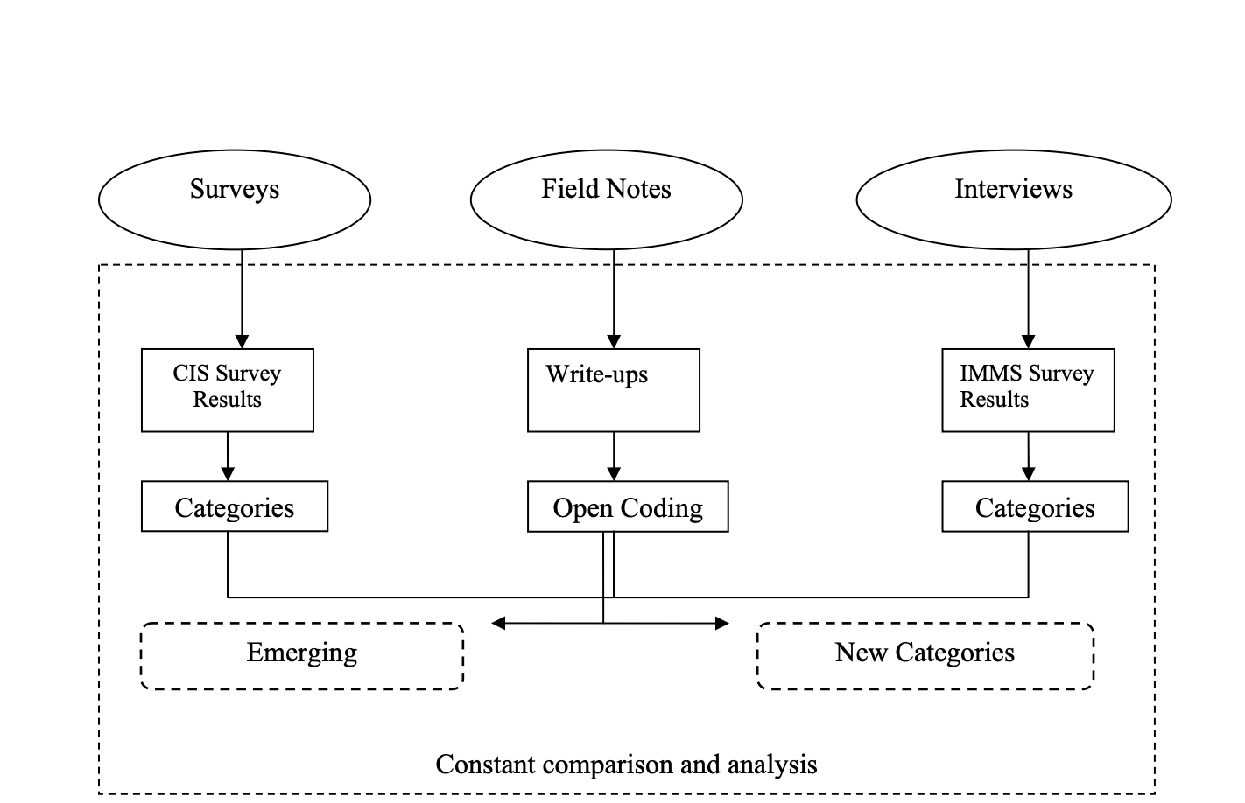

Slide 32
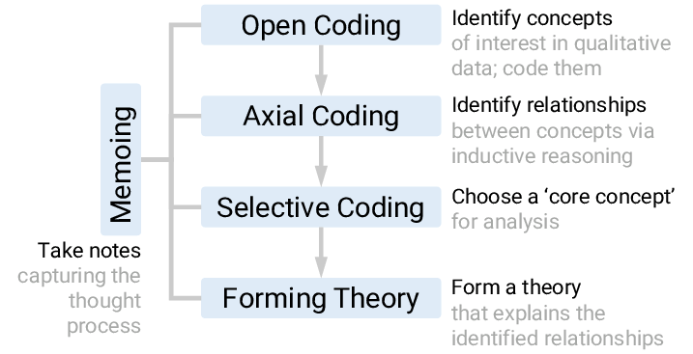
7. Analytic memoing
Memoing is the ongoing process of writing theoretical notes throughout the GT process. Memos capture the conceptual links between categories as the researcher notes down their reflections on different categories.
Rich, P. (2012). Inside the Black Box: Revealing the Process in Applying a Grounded Theory Analysis. The Qualitative Report, 17, 1–23. Retrieved from https://files.eric.ed.gov/fulltext/EJ981472.pdf
‌

Slide 33
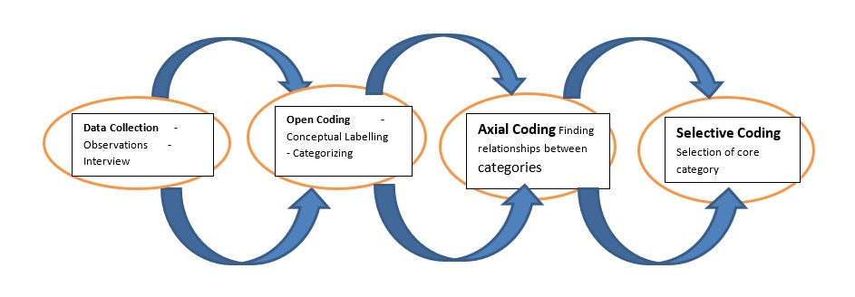
The process is initiated by coding & categorizing the data.
There are several types of coding : OPEN, AXIAL & SELECTIVE CODING.

Slide 34
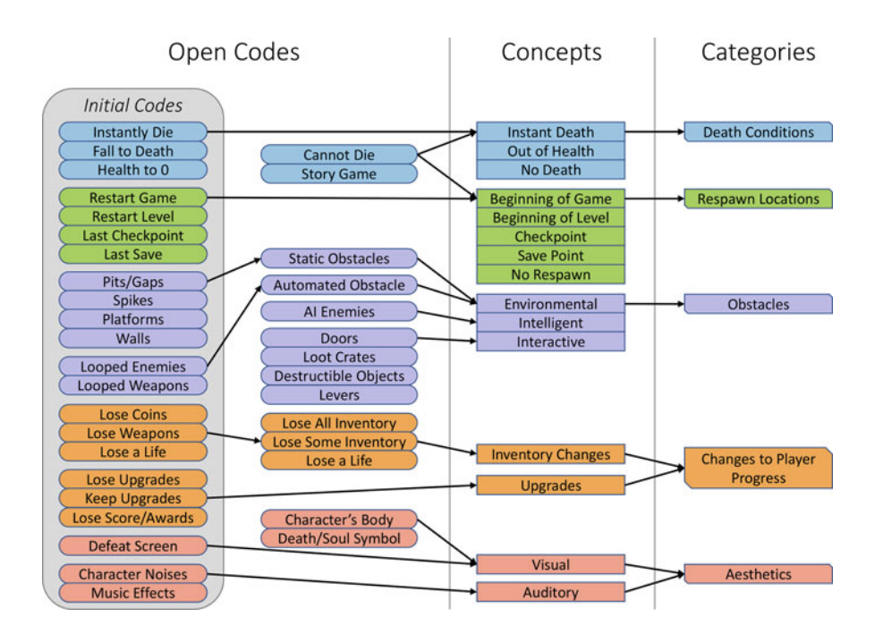
OPEN CODING
Melcer & Cuerdo (2020)

Slide 35
OPEN CODING
- Open coding is concerned with identifying, naming, categorizing & describing phenomenon found in the text.
-Each line or a paragraph is read in search of the answer to the repeated questions (Glaser & Strauss (1967);Strauss & Corbin (1990).
‌

Slide 36
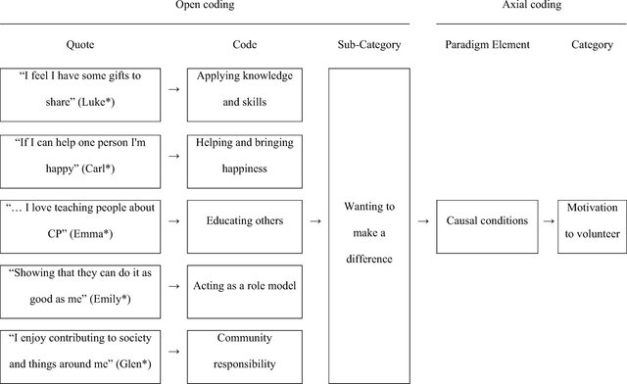
Trembath, Balandin, Togher, & Stancliffe, (2009).

Slide 37
Doing Grounded Theory: Coding
OPEN CODING
First level coding- gives units meaning based on labeling concepts. Focus on the words of the participants. Unit to analyze varies from an individual word, line-by-line, several sentences or paragraphs; (circle words, reflective memos about potential interpretations of data)
“adjusting to disability occurs over a lifetime” (AB, 47- the way they coded answers)
“adjusting to disability is an ongoing process”
“no adjustment process due to being born with a disability”
Adopted: Lazarides (2008)

Slide 38
Doing Grounded Theory: Coding
Open Coding: next step
Organize relationships among and between
Categories (concepts become categories)
“Adjustment to Disability”
Over lifetime
Ongoing process
No adjustment
Adopted: Lazarides (2008)

Slide 39
Trembath, Balandin,Togher, & Stancliffe (2010)

Slide 40
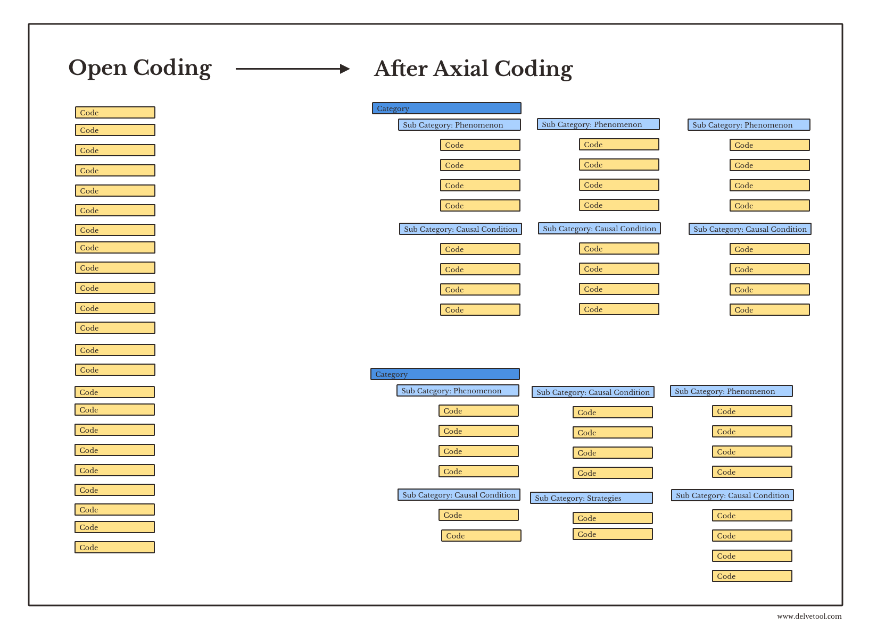
AXIAL CODING
• Is a process of relating (categories & properties) to each other via inductive & deductive thinking.
• The ground theorist emphasize causal relationship & fit things into a basic frame of generic relationship
Adopted: Lazarides,2008

Slide 42
Example of Doing Grounded Theory: Axial Coding
AXIAL CODING
Second step of coding: Identify Properties and dimensions of categories (key categories subsume sub categories & specify interrelationships). Constant comparative method used. Saturation reached when no new information appears about categories or their properties
Previous category: “Adjustment to disability” (result of open coding)
Category:
“Disability Identity”
Disability adjustment process
Acquisition/development of disability
Adopted: Lazarides (2008)

Slide 43
Example of Doing Grounded Theory: Axial Coding Continue.
Properties of “Disability Identity”
“Acquisition/development of disability”
“Disability Adjustment Process”
Dimensions:
Congenital birth ________________ Acquired in adulthood
No Adjustment_________________ ongoing adjustment
Adopted: Lazarides (2008)

Slide 44
Example of Doing Grounded Theory: Axial coding Continue
Acquisition/development of disability” &
“Disability Adjustment Process”
Congenital birth ________________ Acquired in adulthood
EF AB CD
No Adjustment _________________ ongoing adjustment
EF AB CD
Can see relationship and connection between properties and dimensions of acquisition and adjustment process
Adopted: Lazarides (2008)

Slide 45
Example of Doing Grounded Theory: Axial coding Continue
Category groupings:
“Disability Identity” with Gender identity; racial/ethnic/cultural identity
Broader Category of “Identity constructs”
Other constructs that came out of the data
Family influences; career attitudes and behaviors; disability impact
Continue this process until saturation (no new relationships among categories pop up)
Adopted: Lazarides (2008)

Slide 46
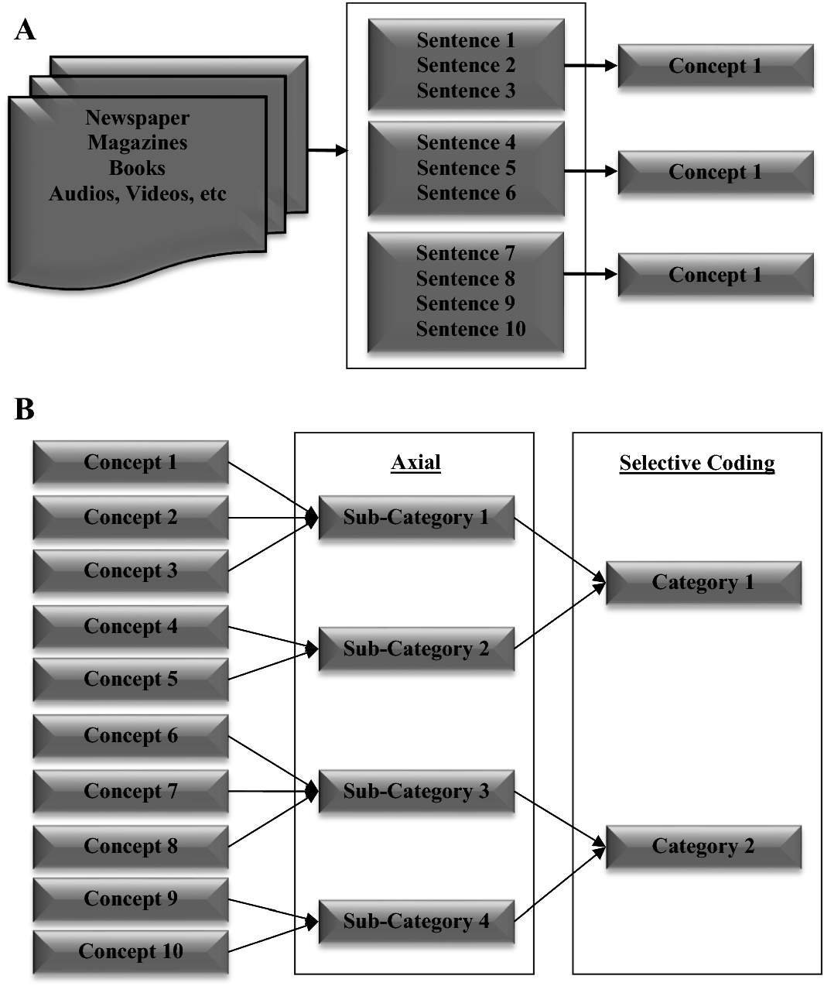
SELECTIVE CODING
• Is the process of choosing one category to be the core category & relating all other categories to that category.
• The essential idea is to find the driver that implies the story forward.
Adopted:Palma, Trimi, & Hong (2018)

Slide 47
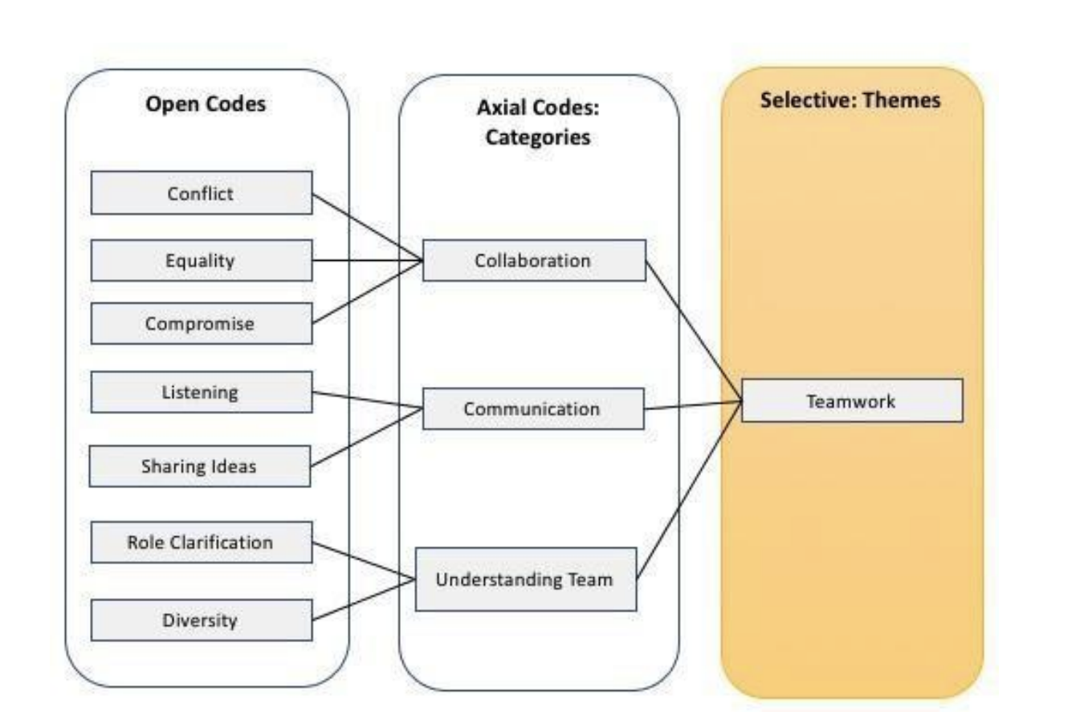
Adopted: Williams & Moser (2019)

Slide 48
Example of Doing Grounded Theory: Coding continuation.
Selective Coding
Final stage of coding: Where we create substantive theory from “core” categories”
Generate category that integrates all other categories (tells the whole story)
Theory shows up as either diagrams or narratives (broad question now becomes your statement about what is found).
Adopted: Lazarides (2008)

Slide 49
Example of Doing Grounded Theory: Core Story of the Data
Dynamic Self was the core story (category) and it was made up of 6 domains of influence (identity categories): family, career, social, developmental, disability, and socio-political.
Final model seen as dynamic and mutual (self influences domains and vice versa)
Adopted: Lazarides (2008)

Slide 50
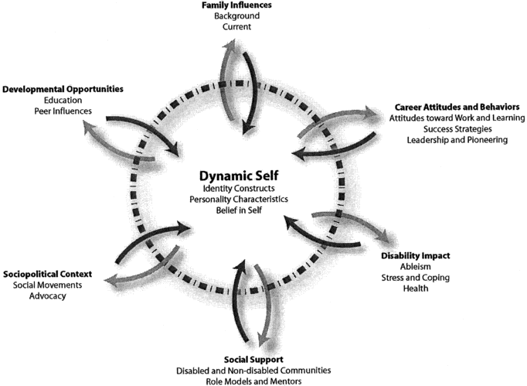
Example of Doing Grounded Theory: Model of career development of women with disabilities that has 6 domains of influence
Adopted:Noon et al (2004)

Slide 51
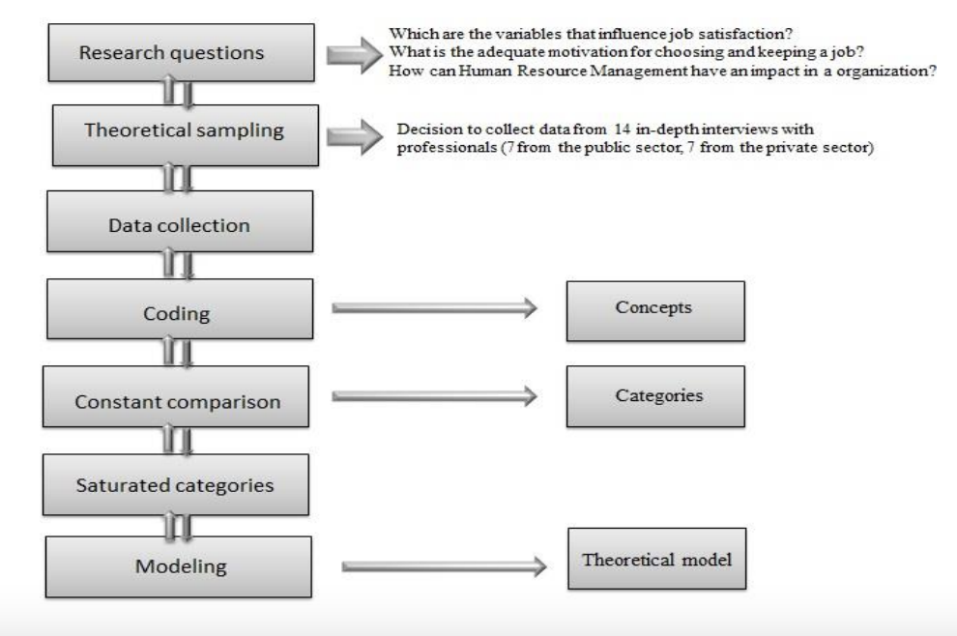
8. Growing theories
Write up The final step in GT is writing up the theory, which follows the theoretical outline generated as a result of sorting and theoretical coding.
‌
Izvercian, Potra, & Ivascu (2016)

Slide 52
Sample
• Participants who are experiencing the social process under study
• Size determined by theoretical sampling (collects, codes & analyzes data & then decides what additional data are needed)
• Saturation- inability of new data to add new codes

Slide 53
DATA COLLECTION
• The researcher uses his/her – all senses.
• Sources of data collection:
-Audio/video tape recording
-Diaries
-Case studies
-Art work
-Participant observation
-Formal & informal interviews
- Self-reflection

Slide 54
ISSUES GROUNDED THEORY DATA COLLECTION POINTS
Cross sectional or longitudinal.
2. Longer length of time to collect the data

Slide 55
DATA ANALYSIS
Typical sample sizes vary from a few up to 30 participants.
A smaller sample size is justified because power in qualitative research comes from thick and dense descriptions of lived experiences, social processes, cultures, and narrative accounts (McGregor, 2019).

Slide 56
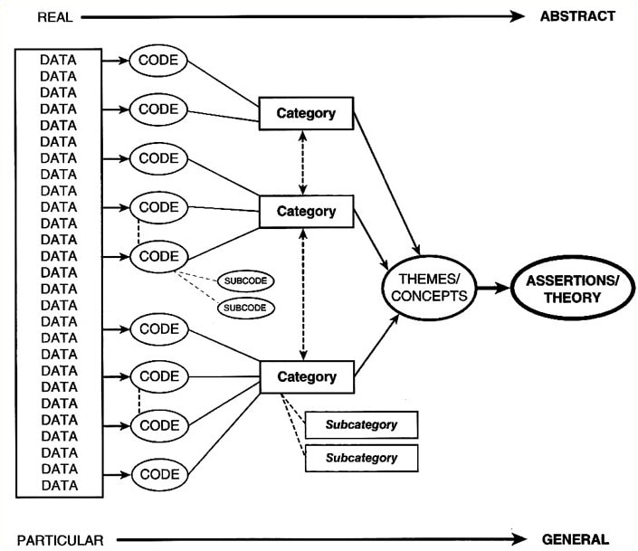
Data Analysis
Coding & analysis occur simultaneously
Constant comparative method
Early data are coded with words that describe the action in the setting
Codes get revised & data recoded
Categories develop from the clustering of codes
Categories are then linked to develop a tentative theory or conceptual framework

Slide 57
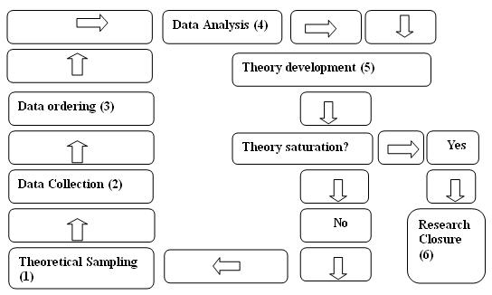
When does this process end?
None. The process could continue indefinitely. Grounded theory doesn't have a clearly demarcated point for ending a study. Essentially, the project ends when the researcher decides to quit.

Slide 58
Conclusion/Key messages
The value of grounded theory is in its ability to examine relationships and behaviour within a phenomenon from an unbiased in-depth perspective.
That is to say, when a researcher enters a study with no framework or theory they are wish to fit the data into the doors are open to discovering explanations that have yet to be articulated. More importantly, the explanations ultimately come from the participants being studied.
When a grounded theory study is executed correctly and rigorously, there is little chance that the resulting explanations have distorted by the researchers personal worldview. The time and detailed analysis required to properly execute grounded theory methodology makes its use daunting and limited.
There are many variables that must be in place (i.e. resources, experience of researcher, acceptance of methodological processes etc…)in order for grounded theory to be successfully carried out. When this occurs the results can be invaluable to the understanding of social phenomena.
From:Ke & Wenglensky (2021).

Slide 59
Individual Activity 1
Assigning codes to the passage of text
Please click below about the text about Amanda finding out she was pregnant.
Look at the list of codes below and decide which code sums up what is being talked about in each line of the text (you may use a code more than once).
Click of the radio button to indicate which code you are assigning to that line. For example to select 'lifestyle' which is number 4 in the list, click on radio button number 4 next to the line of text.
Once you have selected codes for ALL the lines of text, click on the submit button below the passage of text. (Use the Reset button if you want to remove ALL you choices and start again).
http://onlineqda.hud.ac.uk/amanda.php

Slide 60
Activity 2
Coding line by line
Please click the link of text below about Karen leaving home.
Type in a code that summaries what is happening for each line of text in the boxes provided.
When you have finished click the Submit button below the passage of text. (Use the Reset button if you want to remove ALL your choices and start again).
http://onlineqda.hud.ac.uk/karen.php

Slide 61
References
Birks, M. & Mills, J. (2011). Grounded theory: A practical guide. Thousand Oaks, CA: Sage. Borgotti, S. (2011). Introduction to Grounded Theory. Retrieved October 25, 2011 from http://www.analytictech.com/mb870/introtoGT.htm
Butler, A. E., Copnell, B., & Hall, H. (2018). The development of theoretical sampling in practice. Collegian, 25(5), 561–566. https://doi.org/10.1016/j.colegn.2018.01.002
Charmaz, K. (2006). Constructing grounded theory: A practical guide through qualitative analysis. Thousand Oaks, CA: Sage.
Charmaz, Kathy. (2003). Qualitative interviewing and grounded theory analysis. In J.A. Holstein & J.F. Gubrium (Eds.), Inside interviewing: New lenses, new concerns (pp. 311-330). Thousand Oaks: Sage Publications.
Creswell, J. (2015). Educational Research: Planning, Conducting, and Evaluating Quantitative and Qualitative Research. New York: Pearson.
Corbin, J. & Strauss, A. (2008) Basics of Qualitative Research: Grounded Theory Procedures and Techniques. Thousand Oaks: Sage.
Dick, B. (1990) Convergent interviewing, version 3. Brisbane: Interchange. An interviewing method which uses structured process, unstructured content, and a procedure for increasing the rigor of qualitative information. Retrieved from http://www.scu.edu.au/schools/gcm/ar/arp/grounded.html
Frampton, S. (2020). Coding Qualitative Data: A Beginner’s How-To + Examples. Retrieved October 31, 2021, from Chattermill.com website: https://chattermill.com/blog/coding-qualitative-data/

Slide 62
References
Glaser, B.G., & Strauss, A.L. (1967). The discovery of grounded theory: Strategies for qualitative research. Chicago, IL: Aldine.
Glaser, B.G. (1978). Theoretical sensitivity: Advances in the methodology of grounded theory. Mill Valley: CA: Sociology Press.
Izvercian, M., Potra, S., & Ivascu,L (2016). Job Satisfaction Variables: A Grounded Theory Approach. Retrieved October 31, 2021, from undefined website: https://www.semanticscholar.org/paper/Job-Satisfaction-Variables%3A-A-Grounded-Theory-Izvercian-Potra/42b73b2eda3e58e1c1c9bcde86a3b036b4923efb
Ke,J., & Wenglensky,S (2021). Grounded Theory. Retrieved October 31, 2021, from Blogspot.com website: http://avantgarde-jing.blogspot.com/2010/03/grounded-theory.html
Lazarides, K.(2008). UW System Leadership Site. Analyzing Written and Spoken Data Retrieved October 31, 2021, from
https://slideplayer.com/slide/5838402/
Lincoln, Y.S., & Guba, E.G. (1985). Naturalistic Inquiry. Beverly Hills, CA: Sage Publications.
Maxwell, J., & Miller, B. (2008). Categorising and connecting strategies in qualitative data analysis. In Handbook of emergent methods. New York: Guildford Press.
McLeod, J. (1994). Doing counseling research. London: Sage Publications.
Sue L. T. McGregor (2019).Reporting Qualitative Research Methods . Publishing Company: SAGE Publications, Inc City: Thousand Oaks

Slide 63
References
Morse, J. M., Stern, P. N., Corbin, J., Bowers, B., Charmaz, K. & Clarke, A. E. (2009). Developing grounded theory: The second generation. Walnut creek, CA: Left Coast Creek.
Melcer, E. F., & Cuerdo, M. A. M. (2020). Death and Rebirth in Platformer Games. Game User Experience and Player-Centered Design, 265–293. https://doi.org/10.1007/978-3-030-37643-7_1
Noonan, B. M., Gallor, S. M., Hensler-McGinnis, N. F., Fassinger, R. E., Wang, S., & Goodman, J. (2004). Challenge and Success: A Qualitative Study of the Career Development of Highly Achieving Women With Physical and Sensory Disabilities. Journal of Counseling Psychology, 51(1), 68–80.
Rashina Hoda, Noble, J., & Marshall, S. (2017). Using grounded theory to study the human aspects of software engineering. Retrieved October 31, 2021, from undefined website: https://www.semanticscholar.org/paper/Using-grounded-theory-to-study-the-human-aspects-of-Hoda-Noble/10af3d0f56f71b384b4a0835ea4fbbdbe15cbcd9
‌
Strauss, A., & Corbin, J. (1990). Basics of qualitative research. Newbury Park, CA: Sage Publications.
Servet,U. Erkan,D., & Ismail,A. (2019). Teaching Social Studies in Historic Places and Museums: An Activity Based Action Research. International Journal of Research in Education and Science, 5(1), 252–271. Retrieved from https://eric.ed.gov/?id=EJ1197992

Slide 64
References
Palma, F. C., Trimi, S., & Hong, S.-G. (2018). Motivation triggers for customer participation in value co-creation. Service Business, 13(3), 557–580. https://doi.org/10.1007/s11628-018-00395-w
Pradhan, M. (n.d.). Grounded Theory : An overview. Retrieved from https://www.lkouniv.ac.in/site/writereaddata/siteContent/202003241126074851pradhan_Grounded_Theory.pdf
‌
Trembath, D.Balandin, S.Togher, L.& Stancliffe,R. (2010) .The experiences of adults with complex communication needs who volunteer, Disability and Rehabilitation, 32:11, 885-898.
Williams, M., & Moser, T. (2019). The Art of Coding and Thematic Exploration in Qualitative Research. Retrieved October 30, 2021, from undefined website: https://www.semanticscholar.org/paper/The-Art-of-Coding-and-Thematic-Exploration-in-Williams-Moser/c0a0c26ac41cb8beb337834e6c1e2f35b91d071d
‌

