Slide 1
Different approaches of qualitative research and their application III
Ethnography
Presented by Jurgita Gulbiniene
LSMU

Slide 2
Contents
The development of ethnography methods
Ethnographic method
Data collection through observation and interviews
Fieldwork and fieldnotes
Data analysis and interpretation
Pitfalls and problems during ethnonursing

Slide 3
Activity: What is Ethnography?
In groups of 3 or 4 students brainstorm thinking about:
  What is ethnography?
  Why and how do we use it?

Slide 4
The development of ethnography
Ethnographic methods developed within the field of social anthropology in the 19th and 20th centuries by famous anthropologists such as Bronislaw Malinowski, Alfred Radcliffe-Brown and Franz Boas.
In the mid-twentieth century when cultures became more linked with each other and Western anthropologists could not find homogeneous isolated cultures abroad they turned to research their own cultures.
  I.Holloway, K.Galvin Etnography. Qualitative research in Nursing and Healthcare. 4th edition Wiley Blackwell, 2017; p.159-177
This approach was later adopted by members of the Chicago School of Sociology (for example, Everett Hughes, Robert Park, Louis Wirth) and applied to a variety of urban settings in their studies of social life.
  S. Reeves, A. Kuper, B. D. Hodges QUALITATIVE RESEARCH Qualitative research methodologies: ethnography; BMJ 30 AUGUST, 2008 (337):512-514

Slide 5
What is ethnography?
The term ethnography comes from the Greek words ethnos (people) and graphei (to write).
Ethnography is a type of qualitative research that is characterised by long-term participant observation where the researcher spends an extended period of time in a social group in order to observe their behaviour and collect data.
Ethnography is a flexible research methods that allows to gain a deep understanding of a group’s shared culture, conventions, and social dynamics.

Slide 6
Aim of ethnography
The central aim of ethnography is to provide rich, holistic insights into peoples’ world views and actions, as well as the nature of the location they inhabit.
As Hammersley (1985) stated, “the task [of ethnographers] is to document the culture, the perspectives and practices of the people in these settings. The aim is to ‘get inside’ the way each group of people sees the world”
  S. Reeves, A. Kuper, B. D. Hodges QUALITATIVE RESEARCH Qualitative research methodologies: ethnography; BMJ 30 AUGUST, 2008 (337):512-514

Slide 7
What is ethnography?
The ethnographic researcher participates, overtly or covertly, in people’s daily lives for an extended period of time, watching what happens, listening to what is said, asking questions; in fact collecting whatever data are available to throw light on the issues with which he or she is concerned.
  Hammersley M, Atkinson P. Ethnography principles in practice. London: Routledge; 1992
  Morgan-Trimmer, S., Wood, F. Ethnographic methods for process evaluations of complex health behaviour interventions. Trials 17, 232 (2016). https://doi.org/10.1186/s13063-016-1340-2
Ethnography is a research process of learning about people by learning from them’.
        K.Gerrish, J.Lathlean Etnography. The researh process in nursing. 7th edition Wiley Blackwell, 2015; p.199-210

Slide 8
The concept of culture in ethnographic research:
Culture can be define as the way of life of group – the learnt behaviour that is socially constructed as the way of life of group – the learnt behaviuor that is socially costructed and transmitted.
Individuals in a culture or subculturehold values and ideas acquired thruoght learning from other members of group.
Cultures are not uniform, monolithic or unchanging. They include subgroup which, although sharing many values, have different ideas depending on their social location.

Slide 9
Key features of ethnographic research:
A strong emphasis on exploring the nature of a particular social phenomenon, rather than setting out to test hypotheses about it.
A tendency to work primarily with “unstructured data” —that is, data that have not been coded at the point of data collection as a closed set of analytical categories.
Investigation of a small number of cases (perhaps even just one case) in detail.
Analysis of data that involves explicit interpretation of the meanings and functions of human actions; the product of this analysis primarily takes the form of verbal descriptions and explanations

Slide 10
Ethnography as a methodology
Ethnography is a research methodology when collection of data in naturalistic social settings.
Ethnographic data collection through:
  observation of individuals and groups of individuals,
  unstructured interviews,
  documentary analysis,
  and the use of a researcher’s field notes.
Ethnographers neither hypothesize about their research and , nor does the ethnographic method set out to test hypotheses.
The research questions are therefore not necessarily specified at the beginning.

Slide 11
Ethnography as a methodology
People's actions and accounts are studied in everyday contexts, rather than under conditions created by the researcher. Research takes place ‘in the field’.
Data are gathered from a range of sources: participant observation and/or relatively informal conversations and documentary evidence.
Data collection is, for the most part, relatively ‘unstructured’.
The focus is usually on a few cases, generally fairly small-scale, perhaps a single setting or group of people.
The analysis of data involves interpretation of the meanings, functions, and consequences of human actions and institutional practices, and how these are implicated in local, and perhaps also wider, contexts.
(Hammersley & Atkinson 2007)
S. Reeves, J. Peller, J. Goldman, S. Kitto Ethnography in qualitative educational research: AMEE Guide No. 80; Published online: 28 Jun 2013: e1365-e1379 https://doi.org/10.3109/0142159X.2013.804977

Slide 12
Can ethnographic method could be used in medicine or nursing?

Slide 13
Ethnography in Medicine
Peculiarities of ethnographic research:
  to help health professionals to contextualise the behaviour, belief and feelings of their clients or colleagues.
  identify the cultural influences on the individuals and groups.
The goals of ethnographer in the health arena – to improve practise and to enhance care for their patients.

Slide 14
Ethnography in Nursing
Etnographic research in Nursing is helpful:
  Studying cultures, linked to nursing, with their rules, rituals, rutine activities;
  Discovering the ”insider view” of patients and collegues;
  Explaining phenomena related to nursing
  Examining the conflicting perspectives of professionals with the organisational culture
  K.Gerrish, J.Lathlean Etnography. The researh process in nursing. 7th edition Wiley Blackwell, 2015; p.199-210
  I.Holloway, K.Galvin Etnography. Qualitative research in Nursing and Healthcare. 4th edition Wiley Blackwell, 2017; p.159-177

Slide 15
Ethnography methods
Descriptive or conventional ethnography – focuse on description and through analysis, uncovers patterns, typologies and categories.
Critical ethnography – involves the study of macro-social factors such as power and control and examines common-sense assuptions and hidden agendas in this arena; it therefore has political elements or focuses on power relationships.
Auto – ethnography – focus their studies on themselves, their own thoughts and feeling rather than center their research on others.
Notes:
Descriptive or conventional ethnography;
Critical ethnography;
Auto – ethnography.

Slide 16
Activity: to determine which ethnographic method was used in the research?

Slide 17
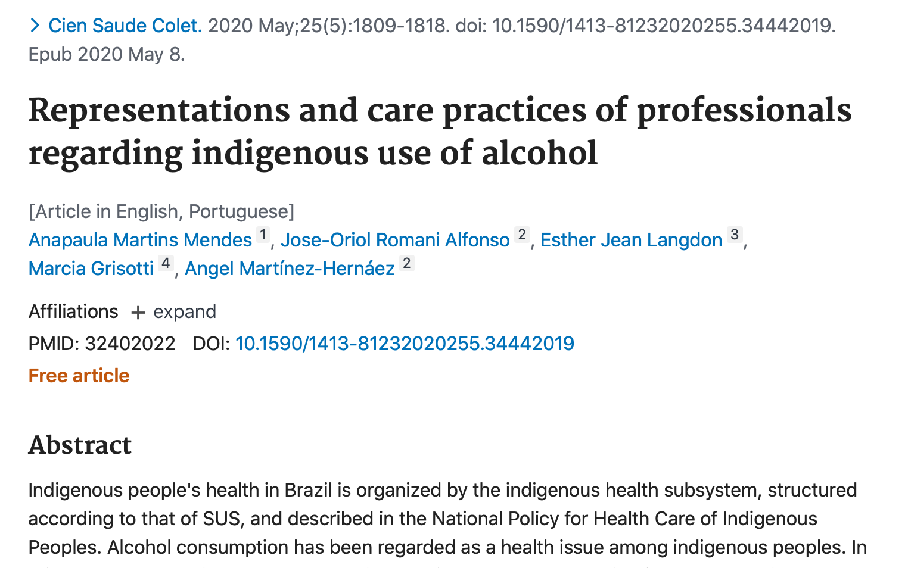
Representations and care practices of professionals regarding indigenous use of alcohol
Abstract. Indigenous people's health in Brazil is organized by the indigenous health subsystem, structured according to that of SUS, and described in the National Policy for Health Care of Indigenous Peoples. Alcohol consumption has been regarded as a health issue among indigenous peoples. In this paper, we describe the representations attributed by health professionals concerning alcohol use among indigenous peoples, and how these influence care practices. This is a descriptive ethnographic study based on interviews and participant observation. Analysis and interpretation were made with the support of Software Atlas TI 8.0. Excessive consumption occurs in specific contexts, and professionals view alcohol use as a problem. Drinking patterns vary with ethnicity, religion, and location, thus resulting in the need to develop cultural competencies that support implementation of effective actions and that also allow for collective construction, as stipulated in the policies. A network of supporters is described, among which are indigenous leaders, traditional healers, and the Evangelical Church. The study shows the difficulties of both carrying out policies and implementing actions which correspond to the indigenous peoples' expectations, recognizing the cultural and social rationale related to alcohol use.

Slide 18
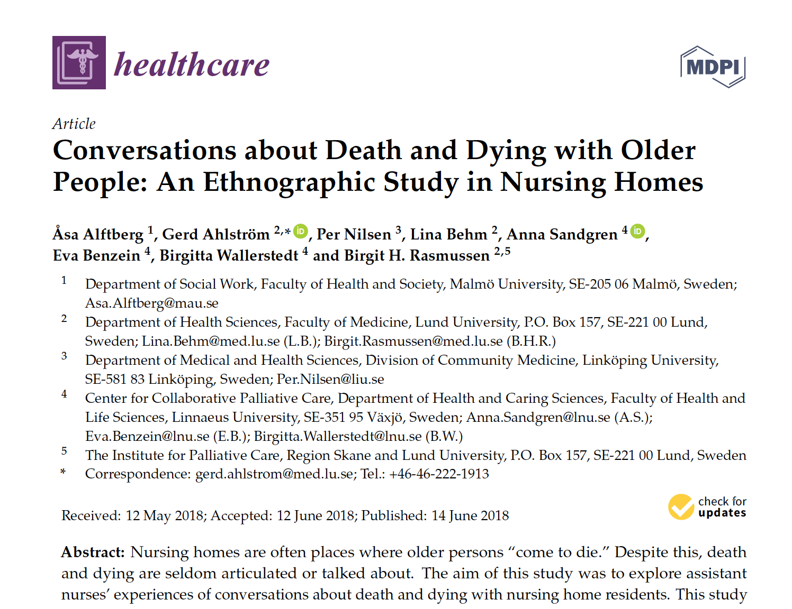
Conversation about Death with older people: an Etnographic study in Nursing Homes
Abstract: Nursing homes are often places where older persons “come to die.” Despite this, death and dying are seldom articulated or talked about. The aim of this study was to explore assistant nurses’ experiences of conversations about death and dying with nursing home residents. This study is part of an implementation project through a knowledge-based educational intervention based on palliative care principles. An ethnographic study design was applied in seven nursing homes, where eight assistant nurses were interviewed and followed in their daily assignments through participant observations. The assistant nurses stated that they had the knowledge and tools to conduct such conversations, even though they lacked the time and felt that emotional strain could be a hinder for conversations about death and dying. The assistant nurses used the strategies of distracting, comforting, and disregarding either when they perceived that residents’ reflections on death and dying were part of their illness and disease or when there was a lack of alignment between the residents’ contemplations and the concept of dying well. They indicated that ambivalence and ambiguity toward conversations about death and dying should be taken into consideration in future implementations of knowledge-based palliative care that take place in nursing homes after this project is finalized.

Slide 19
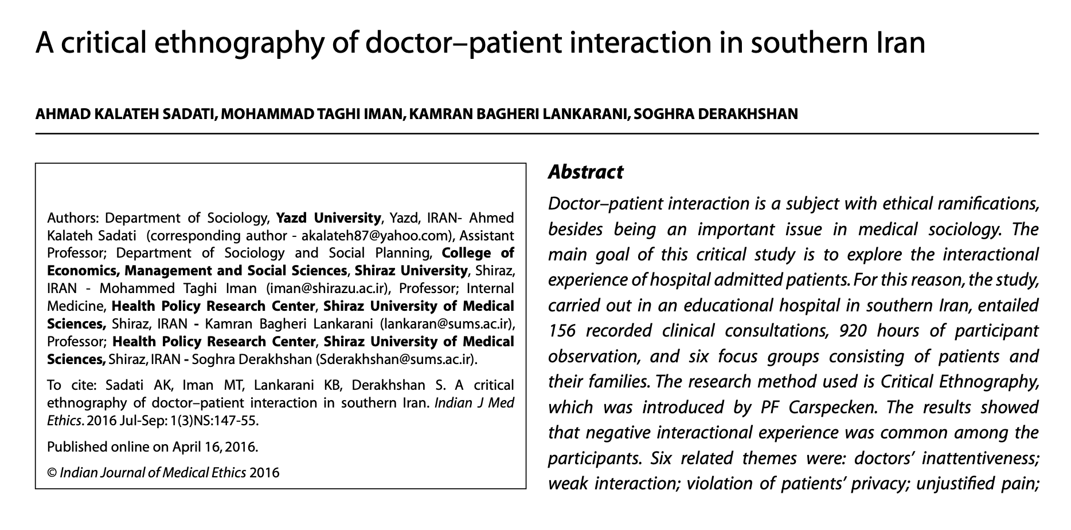
A critical ethnography of doctor-patient interaction in southern Iran
Abstract
Doctor-patient interaction is a subject with ethical ramifications, besides being an important issue in medical sociology. The main goal of this critical study is to explore the interactional experience of hospital admitted patients. For this reason, the study, carried out in an educational hospital in southern Iran, entailed 156 recorded clinical consultations, 920 hours of participant observation, and six focus groups consisting of patients and their families. The research method used is Critical Ethnography, which was introduced by PF Carspecken. The results showed that negative interactional experience was common among the participants. Six related themes were: doctors' inattentiveness; weak interaction; violation of patients' privacy; unjustified pain; long waiting period and ambiguity; and faceless physicians. According to the participants' observations, poor interaction with doctors has led to these negative experiences. The findings showed that doctors were inconsiderate about patients' concerns and due to this, patients were dissatisfied. Theoretically, this form of fragmented collaboration has deep roots in the framework of modern medicine, but in the context of this study, the intensity of the fragmentation between doctors and patients was observed to be intolerable. To solve this problem, models of patient-centredness and narrative medicine are recommended. In addition, the health system should monitor and evaluate the observance of ethics by physicians.

Slide 20
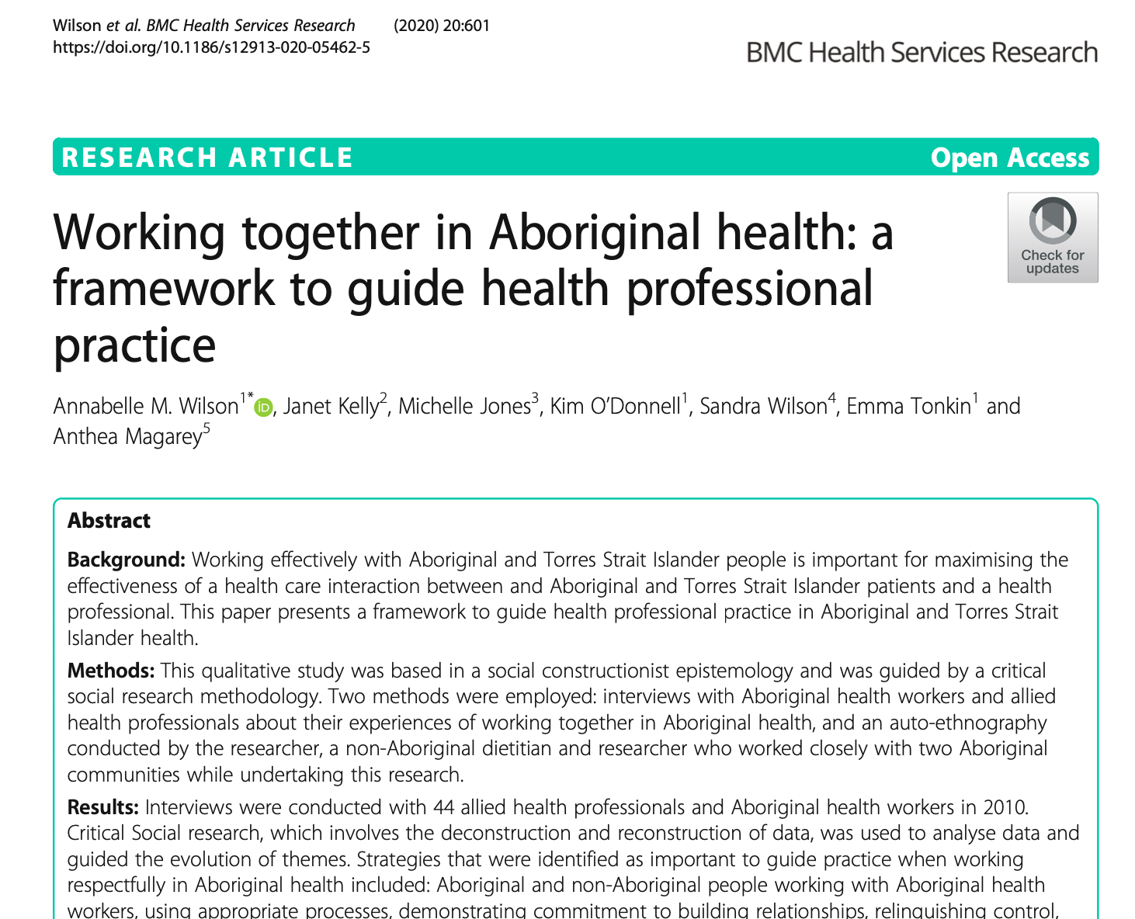
Working together in Aboriginal health: a framework to guide health professional practice
Background: Working effectively with Aboriginal and Torres Strait Islander people is important for maximising the effectiveness of a health care interaction between and Aboriginal and Torres Strait Islander patients and a health professional. This paper presents a framework to guide health professional practice in Aboriginal and Torres Strait Islander health.
Methods: This qualitative study was based in a social constructionist epistemology and was guided by a critical social research methodology. Two methods were employed: interviews with Aboriginal health workers and allied health professionals about their experiences of working together in Aboriginal health, and an auto-ethnography conducted by the researcher, a non-Aboriginal dietitian and researcher who worked closely with two Aboriginal communities while undertaking this research.
Results: Interviews were conducted with 44 allied health professionals and Aboriginal health workers in 2010. Critical Social research, which involves the deconstruction and reconstruction of data, was used to analyse data and guided the evolution of themes. Strategies that were identified as important to guide practice when working respectfully in Aboriginal health included: Aboriginal and non-Aboriginal people working with Aboriginal health workers, using appropriate processes, demonstrating commitment to building relationships, relinquishing control, having an awareness of Aboriginal history, communication, commitment, flexibility, humility, honesty, and persistence. Reciprocity and reflection/reflexivity were found to be cornerstone strategies from which many other strategies naturally followed. Strategies were grouped into three categories: approach, skills and personal attributes which led to development of the Framework.
Conclusions: The approach, skills and personal attributes of health professionals are important when working in Aboriginal health. The strategies identified in each category provide a Framework for all health professionals to use when working with Aboriginal and Torres Strait Islander people.

Slide 21
Macro and micro-etnohgraphies
A macro-etnohgraphies examines a large culture with its institutions, communities and value systems.
Micro-etnohgraphies consist of research in small unit, or focus on activities within small social settings.

Slide 22
The main features of etnography
Planning issues: access and ethics
Selection of sample and settings
Data collection through observation and interviews;
The emic-etic dimension
The use of “thick” description

Slide 23
Planning issues: access and ethics
Ethnographic research to be undertaken in an ethical way, with due care and attention to safeguarding the interests of research participants.
Access into the research setting cannot be considered a ‘one-off’ event. Often access will need to be re-negotiated with the different individuals at different stages of a study (initial contact, entry into different research sites) as the work proceeds over time.
To all ethnographies need prior ethical approval from the research ethics committee which covers the institution in which the study is due to be undertaken.
After ethical approval the responsibility of the ethnographer to ensure it is effectively practiced:
  undertaking informed consent before data collection activities,
  ensuring anonymity of participants,
  maintaining confidentiality and privacy of all data gathered.
    S. Reeves, J. Peller, J. Goldman, S. Kitto Ethnography in qualitative educational research: AMEE Guide No. 80; Published online: 28 Jun 2013: e1365-e1379 https://doi.org/10.3109/0142159X.2013.804977

Slide 24
Selection of sample and settings
The criteria for sampling must be justified in the study and be explicit.
The choosed informants should be suitable and representative of the group under study.
The sampling have be taken from a particular cultural or subcultural group.
Etnographers have to search for idividuals (key informants) within a culture who can give them specific detailed information about culture.
  Key informants hold special and expert knowledge about the history and subculture of a group, about interactions processes in it and cultural rules, rituals and language.
I.Holloway, K.Galvin Etnography. Qualitative research in Nursing and Healthcare. 4th edition Wiley Blackwell, 2017; p.159-177
K.Gerrish, J.Lathlean Etnography. The researh process in nursing. 7th edition Wiley Blackwell, 2015; p.199-210

Slide 25
Data collection

Slide 26
Data collection
Data collection through observation and interviews
  Participant observation
  The ethnographic interviews
  Documentary data

Slide 27
Participant observation
Researches are immersed in the setting and become familiar with it.
Prolonged observation produced more in-depth knowledge of culture.
Researchers need to attempt to put aside their assumptions, come to the setting as 'cultural strangers' and keep an open mind in seeking the emic perspective (insider view) perspective of the inhabitant of the world they study.
Observation might be become starting points for in-depth interviews

Slide 28
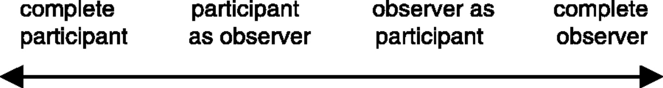
Participant observation: typology of researchers role
Typology of researchers role:
An ethnographer begins to act and act as an insider through participation, but always has a sense of objectivity to the observation involved, which allows a person to separate from the group under study.
Gold's typology of research roles
    S. Reeves, J. Peller, J. Goldman, S. Kitto Ethnography in qualitative educational research: AMEE Guide No. 80; Published online: 28 Jun 2013: e1365-e1379 https://doi.org/10.3109/0142159X.2013.804977

Slide 29
Observational dimensions and their descriptions
Space—Physical layout of the place(s)
Actor—Range of people involved
Activity—A set of related activities that occur
Object—The physical things that are present
Act—Single actions people undertake
Event—Activities that people carry out
Time—The sequencing of events that occur
Goal—Things that people are trying to accomplish
Feeling—Emotions felt and expressed
S. Reeves, A. Kuper, B. D. Hodges QUALITATIVE RESEARCH Qualitative research methodologies: ethnography; BMJ 30 AUGUST, 2008 (337):512-514
K.Gerrish, J.Lathlean Etnography. The researh process in nursing. 7th edition Wiley Blackwell, 2015; p.199-210

Slide 30
The ethnographic interviews
This method of interviewing “does not use fixed questions, but aims to engage the interviewee in conversation to elicit their understandings and interpretations” (Liamputtong & Ezzy 2005, p.332).
    S. Reeves, J. Peller, J. Goldman, S. Kitto Ethnography in qualitative educational research: AMEE Guide No. 80; Published online: 28 Jun 2013: e1365-e1379 https://doi.org/10.3109/0142159X.2013.804977
These interviews engaging the participant to converse about a particular topic or discussion relevant to the research questions or topic being explored.
The interviews are complimentary to participant observation and provide insight into articulating and explaining social everyday life.
The interviews may be formal or informal, in depth and unstructured or semi-structured.

Slide 31
The ethnographic interviews
The interviews questions could start from general (former) to focused (specific).
Example No 1:
  General questions:
    Tell me about your illness
  Focused questions:
    What did you feel when you were first diagnosed?
    What was you reaction to this?
Example No 2:
  General questions:
    Can you describe you care and treatment?
  Focused questions:
    Tell me about your experiences of nursing care.
    You said that the nurses always make time for patients in spite of having so much work to do, please, can you tell me more about this?
K.Gerrish, J.Lathlean Etnography. The researh process in nursing. 7th edition Wiley Blackwell, 2015; p.199-210

Slide 32
Documentary data
Document analysis is the analysis of textual documents such as media reports, legislation and/or graphic documents such as photographs and maps.
Document analysis can provide useful background information to the study while also providing insight into how participants view themselves.
This analysis, in triangulation with the other methods, can provide insight into how participants represent themselves.

Slide 33
The emic-etic dimension
Etnographers use the constructs of the informants and also aply their own sceintific conceptual farmework, the called – emic and etic perspectives.
Emic perspectives (insider’s):
  The researcher needs an understanding or the emic perspective, the insider’s or native’s perceptions.
  The researcher who uses the emic perspective gives explanations of events from cultural member’s point of view.
Etic perspectives (outsider’s):
  The researcher used to identify the problems and described them rather than listening to the members’ own ideas.
  Etic are sceintific accounts by researcher, based on that whch is directly observable

Slide 34
Fieldwork and fieldnotes

Slide 35
Fieldwork
The term fieldwork is used to describe data collection outside laboratories.
Fieldwork means working in the natural settingof the informats, observing them and talking to them over prolonged periods of time.
The steps of fieldwork:
  The researches gain access to observe and study the culture in which they are interested and write notes on their observation.
  The researches start focusing on particular issues. They question the informants on the initial observations.
  The researches realise that saturation has occurred and they start the process of disengagement.

Slide 36
The etnographic record: field and analytic notes
The types of fieldnotes in etnography:
  The condensed account
  The expanded account
  The fieldwork journal
  Analysis and interpretation notes

Slide 37
The analyse of field notes (Wadsworth 1998, p55)
Issues to consider | Description
1 | Diligently record your observations as soon as possible after you have finished them, remembering to describe not only what you have seen and experienced but also recording your feelings and perceptions of the events.
2 | Work out themes as they emerge.
3 | Record your reflections about primary observation but keep them separate by using a separate column alongside.
4 | Work out how to check these interpretations. What questions will you need to ask to make sure that you are hearing or seeing what you think you are? Who will you need to ask?
5 | Arrange a series of more formal ‘feedback’ sessions with the informants.
S. Reeves, J. Peller, J. Goldman, S. Kitto Ethnography in qualitative educational research: AMEE Guide No. 80; Published online: 28 Jun 2013: e1365-e1379 https://doi.org/10.3109/0142159X.2013.804977

Slide 38
The fieldnotes in etnography
It is important that observations, descriptions and interpretations are clearly indicated throughout writing field notes because the field notes become a record and a data point during the data analysis and writing process.
The clearer the differentiation becomes, the better position the ethnographer is in to report both the phenomenon they record and the interpretations they add during the research process.
S. Reeves, J. Peller, J. Goldman, S. Kitto Ethnography in qualitative educational research: AMEE Guide No. 80; Published online: 28 Jun 2013: e1365-e1379 https://doi.org/10.3109/0142159X.2013.804977

Slide 39
Example of fieldnotes:
“In my ethnographic study, I collated contemporaneous contextual fieldnotes (concerning policies, economic and political circumstances at the point of time I was conducting the fieldwork). I included those fieldnotes in presenting a description of the sample in question, concerning their motivations to remain resident in the South of France, as well as their hesitation in moving to another location or returning to their home countries.
  The legal working hours in France were 35 hours a week for all companies. Any overtime in excess of these 35 hours must be compensated by time off in lieu (so called RTT days). In addition employees are entitled to a minimum 25 days annual leave. With the RTT days on top of annual vacation, total annual leave of over 50 days is not uncommon. This is a major incentive for the sample in their desire to remain in France, where they can avail of such policies.
Approaches To Qualitative Research: Theory & Its Practical Application A Guide For Dissertation Students Edited By John Hogan, Paddy Dolan & Paul Donnelly. Published 2009 By OAK TREE PRESS 19 Rutland Street, Cork, Ireland

Slide 40
Data analysis and interpretation

Slide 41
Data analysis
There are three aspects of data analysis:
  Description,
  Analysis
  Interpretation
These three components are not always easily teased apart.

Slide 42
Description
Not everything observed or heard is described but only that which is relevnant for the study at hand. This involves analysis and interpretation
Researchers describe by writing a story, which is a report of the actions, interactions and events within a cultural group.
The description is enhanced by the portrayal of critical event and ordinary life, as well as rituals and roles.
  I.Holloway, K.Galvin Etnography. Qualitative research in Nursing and Healthcare. 4th edition Wiley Blackwell, 2017; p.159-177

Slide 43
The use of “thick description”
“Thick description” – it’s description that make explicit the detailed patterns of cultural and social relationships and puts them in context.
“Thick description” aims to give readers a sense of the emotion, thoughts and perceptions that research participants experience.
It deal with the meaning and interpretations of people in a culture.

Slide 44
Analysis
Analysis entails working with the data.
The researchers process the data by coding/labelling and transform the raw data through finding themes and by making linkages between ideas.
Analysis and interpretation proceed parallel but is more scientific and systematic.
The analytic proceed is iterative: this means that researchers go back and forth, from the data collection, reading and thinking about them to the analysis.
They then return to collecting new data and analysing them. This process continues until the collection and analysis are complete.
Notes:
It brings order to disorderly data, and the researchers must show how they arrived at the structures and linkages.

Slide 45
Steps in the analysis
Searching for relationships and grouping categories together
Recognising and describing patterns, themes and typologies
Interpreting and searching for meaning
Ordering and organising the collected material
Summarising and reducing the codes to large categories
Reading, rereading and thinking about the data
Coding the data
The process of analysis involves several steps.
Notes:
The each step or stage can be revisted or repeated.

Slide 46
Interpretation
Researchers take the last step, that of interpretation, during and after the analysis, making inferences, providing meaning and giving possible explanations for the phenomena.
Interpretation involves some speculation, theorising and explaining, although it must be directly grounded in the data.
Eventually, the story is put together form the descriptions, analyses and interpretations.

Slide 47
Evaluating the quality of ethnographic work
The good quality ethnographic work needs to ensure it explicitly incorporates such factors in its design and implementation. This table also provides a useful way for readers of ethnographic work to begin to evaluate its methodological quality.
Consideration | Descriptor
Substantive contribution | Does this piece contribute to our understanding of social-life? Does the writer demonstrate a deeply grounded (if embedded) human-world understanding and perspective? How has this perspective informed the construction of the text?
Aesthetic merit | Does this piece succeed aesthetically? Does the use of creative analytical practices open up the text, invite interpretive responses? Is the text artistically shaped, satisfying, complex, and not boring?
Reflexivity | How did the author come to write this text? How was the information gathered? Ethical issues? How has the author's subjectivity been both a producer and a product of this text? Is there adequate self-awareness and self exposure for the reader to make judgments about the point of view? Do authors hold themselves accountable to the standards of knowing and telling of the people they have studied?
Impact | Does this affect me? Emotionally? Intellectually? Generate new questions? Move me to write? Move me to try new research practices? Move me to action?
Expresses a reality | Does this text embody a fleshed out, embodied sense of lived-experience? Does it seem “true” – a credible account of a cultural, social, individual, or communal sense of the “real”?
S. Reeves, J. Peller, J. Goldman, S. Kitto Ethnography in qualitative educational research: AMEE Guide No. 80; Published online: 28 Jun 2013: e1365-e1379

Slide 48
Advantages and Disadvantages of ethnography
Advantages of ethnography | Disadvantages of ethnography
It gives the researcher direct access to the culture and practices of a group. It is a useful approach for learning first-hand about the behaviour and interactions of people within a particular context. May have access to more authentic information and spontaneously observe dynamics that you could not have found out about simply by asking. It aims to offer a rich narrative account of a specific culture, allowing to explore many different aspects of the group and setting. | It is a time-consuming method. This long-term immersion can be challenging, and requires careful planning. Ethnographic research can run the risk of researcher bias. There are often also ethical considerations to take into account.

Slide 49
Pitfalls and problems during ethnonursing
It's difficult to conduct a research lasting a year and longer.
It is difficult as an insider to become ‘cultural stranger’ questioning the assumptions of the familiar culture:
  Nurse ethnographers often experience conflict between their role as researcher and their nursing role.
  The health professionals are taught to adopt a systematic approach to their clinical work, could find it difficult to bear ambiguity.
  Vigilance and advice from outsiders are very important.
Key informants might have their own preconceptions of the setting and let this guid their own observations. There is also the risk that participants might only tell what they think researchers wish to hear.
Findings can be re-interpreted at a later stage in the light of reflection or new evidence.

Slide 50
Conclusion
An ethnography is the descriptions of a culture, subculture or group.
The data sources are mainly participant obseravtion by immersion in the setting and interviews with key informants.
The research uncover the emic view.
“Thick descriptions” is used - the study come alive and to give both an empirical and a theoretical perspective.

Slide 51
Assignment for students
Assignment for students (group work 3-4 students). Analyse the submitted articles and determine:
  What ethnographic research was done (Descriptive ethnography; Critical ethnography; ar Auto - ethnography).
  What kind of research: micro or macro-etnography. What are the signs of this?
  Do researchers “thick describe” the results when analysing the data.
  Does the methodology describe in detail the process of analysing the results.

Slide 52
References:
C.Pope, N.Mays Qualitative research in Health Care. Wiley Blackwell, 2020
I.Holloway, K.Galvin Etnography. Qualitative research in Nursing and Healthcare. 4th edition Wiley Blackwell, 2017; p.159-177
K.Gerrish, J.Lathlean Etnography. The researh process in nursing. 7th edition Wiley Blackwell, 2015; p.199-210
S. Reeves, J. Peller, J. Goldman, S. Kitto Ethnography in qualitative educational research: AMEE Guide No. 80; Published online: 28 Jun 2013: e1365-e1379 https://doi.org/10.3109/0142159X.2013.804977
S. Reeves, A. Kuper, B. D. Hodges QUALITATIVE RESEARCH Qualitative research methodologies: ethnography; BMJ 30 AUGUST, 2008 (337):512-514
Morgan-Trimmer, S., Wood, F. Ethnographic methods for process evaluations of complex health behaviour interventions. Trials 17, 232 (2016). https://doi.org/10.1186/s13063-016-1340-2
Approaches To Qualitative Research: Theory & Its Practical Application A Guide For Dissertation Students Edited by John Hogan, Paddy Dolan & Paul Donnelly. Published 2009 by OAK TREE PRESS 19 Rutland Street, Cork, Ireland

Slide 53
Thank you

