Slide 1
Different approaches of qualitative research and their application IV
CASE STUDIES
Presented by Jurgita Gulbiniene
LSMU

Slide 2
Introduction to case study
A case study is a research approach that is used to generate an in-depth, multi-faceted understanding of a complex issue in its real-life context.
Case studies enable researchers to explore particular phenomen in one or more real-life settings.
The central tenet of a case study is being the need to explore an event or phenomenon in depth and in its natural context. It is for this reason sometimes referred to as a "naturalistic" design.
Notes:
What is a case study?

Slide 3
When to Use a Case Study Approach?
A case study design should be considered when:
  The focus of the study is to answer “how” and “why” questions;
  You cannot manipulate the behaviour of those involved in the study;
  You want to cover contextual conditions because you believe they are relevant to the phenomenon under study; or
  The boundaries are not clear between the phenomenon and context.

Slide 4
Definitions of a case study
"A case study is both the process of learning about the case and the product of our learning" (Stake )
"The all-encompassing feature of a case study is its intense focus on a single phenomenon within its real-life context...[Case studies are] research situations where the number of variables of interest far outstrips the number of datapoints" (Yin 1999 p. 1211; Yin 1994 p. 13)
"A case study is an empirical inquiry that investigates a contemporary phenomenon in depth and within its real-life context, especially when the boundaries between phenomenon and context are not clearly evident." (Yin 2009 p18)
"In-depth study undertaken of one particular 'case', which could be a site, individual or policy" (Green and Thorogood)
“...an instance of a class of events [where] the term class of events refers to a phenomenon of scientific interest...that the investigator chooses to study with the aim of developing theory regarding causes of similarities or differences among instances (cases) of that class of events" (George and Bennett)”

Slide 5
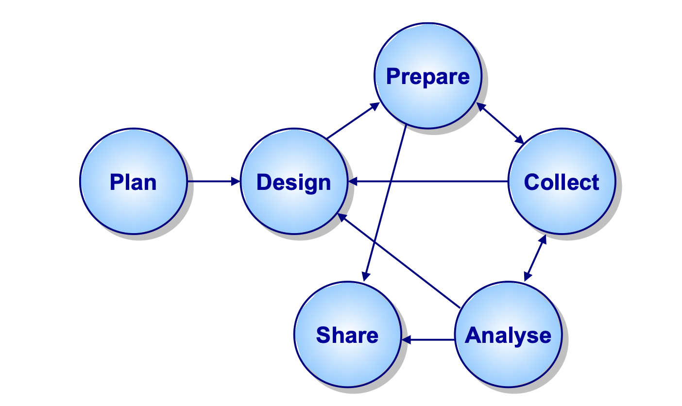
The Case Study Process
The Case Study Process are:
  Planning stage
  Defining the case
  Selecting the case(s)
  Collecting and analysing the data
  Interpreting data
  Reporting the findings
S. Baškarada Qualitative Case Study Guidelines. The Qualitative Report. 2014; 1(24): 1-18

Slide 6
Plan of case study
The planning stage focuses on identifying the research questions
Clearly defining the research problem/questions is the most important step in the entire research project (Yin, 1984).
Every case study should begin with a comprehensive literature review and a careful consideration of the research questions and study objectives.
    S. Baškarada Qualitative Case Study Guidelines. The Qualitative Report. 2014; 1(24): 1-18 http://www.nova.edu/ssss/QR/QR19/baskarada24.pd

Slide 7
Research questions
A fundament part of carrying out a case is to identify the research questions.
  The research questions and the ways of answering them are correspondingly individual and need careful thinking.
Case studies may have goals or questions that are about describing phenomena or making links.
The different aims give rise to question as follows:
  How does this family deal with and manage the implication sof this family member’s health problem?
  How are services for people with this health problem organised?
  How do staff manage appointments in this clinic?
  Ha sthe reorganisation of the system for making appointments reduced non-contact time for staff?
There should be a logical flow from the researcch question to the selection of the case and the process of data collection and analysis.
K.Gerrish, J.Lathlean Case study research. The researh process in nursing. 7th edition Wiley Blackwell, 2015; p.199-210

Slide 8
Determining the Case/Unit of Analysis
Determining what the unit of analysis (case) is can be a challenge for both novice and seasoned researchers alike.
Asking the following questions can help to determine what your case is:
  Do I want to “analyze” the individual?
  Do I want to “analyze” a program?
  Do I want to “analyze” the process?
  Do I want to “analyze” the difference between organizations?
Answering these questions along with talking with a colleague can be effective strategies to further delineate your case

Slide 9
Developing Case Study Research Questions
Case Examples | The Research Questions
1. The decision making process of women between the age of 30 and 40 years | How do women between the ages of 30 and 40 years decide whether or not to have reconstructive surgery after a radical mastectomy? What factors influence their decision?
2. The experiences of 30-40 year old women following radical mastectomy faced with the decision of whether or not to undergo reconstructive surgery | How women (30-40 years of age) describe their post-op (first 6 months) experiences following a radical mastectomy? Do these experiences influence their decisions making related to breast reconstructive surgery?
3. The decision making process (related to breast reconstruction post-radical mastectomy) of women between the age of 30 and 40 years attending four cancer centers in Ontario. | How do women (ages 30-40) attending four different cancer centers in Ontario describe their decision making related to breast reconstructive surgery following a radical mastectomy?

Slide 10
Defining the case
Carefully formulated research question(s), are important in appropriately and succinctly defining the case.
Each case should have a pre-defined boundary which clarifies:
  the nature and time period covered by the case study ,
  the relevant social group,
  organisation or geographical area of interest to the investigator,
  the types of evidence to be collected,
  the priorities for data collection and
  analysis.

Slide 11
Defining the case
Communication | Clarity: Does the proposal read well?
 | Integrity: Do its pieces fit together?
 | Attractiveness: Does it pique the reader's interest?
Content | The case: Is the case adequately defined?
 | The issues: Are major research questions identified?
 | Data Resource: Are sufficient data sources identified?
Method | Case Selection: Is the selection plan reasonable?
 | Data Gathering: Are data-gathering activities outlined?
 | Validation: Is the need and opportunity for triangulation indicated?
Practicality | Access: Are arrangements for start-up anticipated?
 | Confidentiality: Is there sensitivity to the protection of people?
 | Cost: Are time and resource estimates reasonable?

Slide 12
Binding the Case
Most importantly in the case study is avoids the ambiguity of and the difficulty of concentrating and analysing large areas and volumes of information.
Baxter and Jack (2008) in particular recommend binding the case in order to avoid making the scope of research too broad, and suggest three ways to how to do it:
  by time and place (Creswell, 2003);
  by time and activity (Stake 1995); and
  by definition and context (Miles &Huberman, 1994)
  B. Njie, S. Asimiran Case Study as a Choice in Qualitative Methodology IOSR Journal of Research & Method in Education (IOSR-JRME) e-ISSN: 2320–7388,p-ISSN: 2320–737X Volume 4, Issue 3 Ver. I (May-Jun. 2014): 35-40

Slide 13
Method for selecting cases
The selection of a specific type of case study design will be guided by the overall study purpose.
Yin (2003) and Stake (1995) use different terms to describe a variety of case studies:
  Yin (2003) categorizes case studies as explanatory, exploratory, or descriptive. He also differentiates between single, holistic case studies and multiple-case studies.
  Stake (1995) identifies case studies as intrinsic, instrumental, or collective.

Slide 14
Method for selecting case studies
Explanatory - This type of case study would be used if you were seeking to answer a question that sought to explain the presumed causal links in real-life interventions that are too complex for the survey or experimental strategies(Yin, 2003).
Exploratory - This type of case study is used to explore those situations in which the intervention being evaluated has no clear, single set of outcomes (Yin, 2003).
Descriptive - This type of case study is used to describe an intervention or phenomenon and the real-life context in which it occurred (Yin, 2003).
Multiple-case studies - A multiple case study enables the researcher to explore differences within and between cases. The goal is to replicate findings across cases. (Yin, 2003).

Slide 15
Methods for selecting cases
Intrinsic - that researchers who have a genuine interest in the case should use this approach when the intent is to better understand the case. It is not undertaken primarily because the case represents other cases or because it illustrates a particular trait or problem, but because in all its particularity and ordinariness, the case itself is of interest (Stake, 1995).
Instrumental - something other than understanding a particular situation. It provides insight into an issue or helps to refine a theory. The case is of secondary interest; it plays a supportive role, facilitating our understanding of something else. The case is often looked at in depth, its contexts scrutinized, its ordinary activities detailed, and because it helps the researcher pursue the external interest (Stake, 1995)
Collective - Collective case studies are similar in nature and description to multiple case studies (Yin, 2003)

Slide 16
Design of Case Study
In addition to identifying the “case” and the specific “type” of case study to be conducted, researchers must consider if it is prudent to conduct a single case study or if a better understanding of the phenomenon will be gained through conducting a multiple case study.
Case study design:
  Single
  Multiple

Slide 17
Design of Case Study
Individual cases may be selected based on convenience, purpose, and probability .
According to Yin, reasons for justifying single-case studies include studying a critical case, an extreme case, a representative or typical case, a revelatory case (involving a novel situation), and a longitudinal case.
Purposive case selection provides an ability to collect the most relevant data , and longitudinal cases provide an ability to identify trends over time.

Slide 18
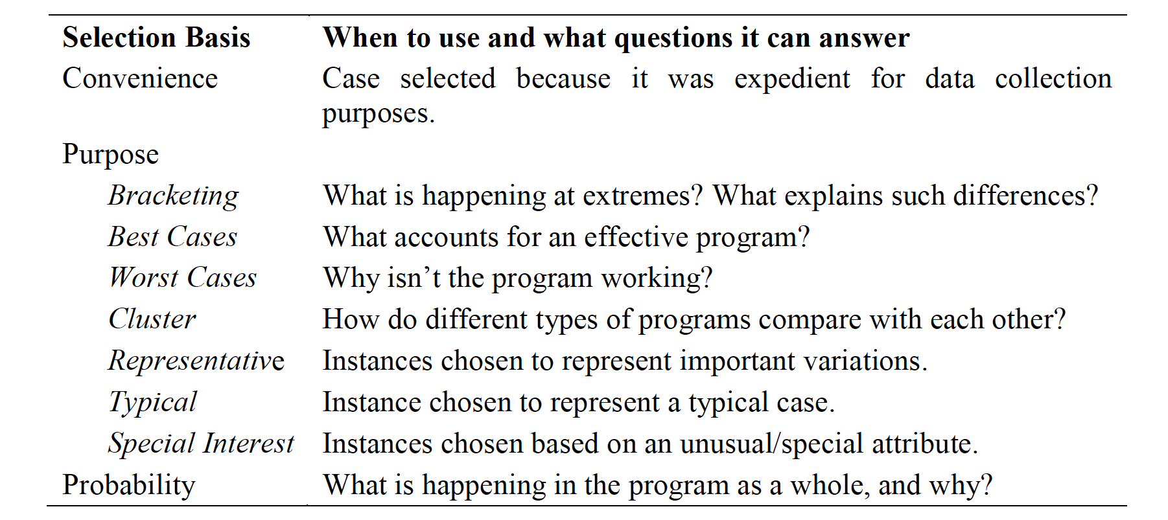
Individual cases
Individual cases may be selected based on convenience, purpose, and probability

Slide 19
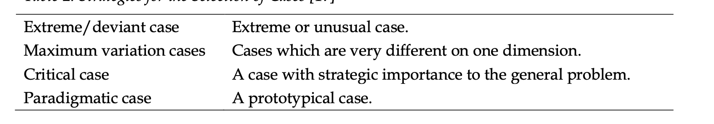
Strategies for the Selection of Cases

Slide 20
Design of Case Study
In multi-case studies, each case should be selected so that:
  it either predicts similar results,
  predicts contrasting results but for anticipatable reasons.
  Yin (2003)
If multiple cases lead to contradictory results, the preliminary theory should be revised and tested with another set of cases.

Slide 21
Selecting the case(s)
The selected case study site(s) should allow the research team access to the group of individuals, the organisation, the processes or whatever else constitutes the chosen unit of analysis for the study.
Selected cases need to be not only interesting but also hospitable to the inquiry if they are to be informative and answer the research question(s).
It is important to consider in advance the likely burden and risks associated with participation for those who comprise the case study.

Slide 22
Collect data
The collect stage involves following:
  the case study protocol,
  using multiple sources of evidence,
  creating a case study database,
  maintaining a chain of evidence
Yin argues that any case study findings are “likely to be more convincing and accurate if [they] are based on several different sources of information”

Slide 23
Collect data
Relevant data may be collected through:
  documents,
  archival records,
  interviews,
  direct observations, and physical artefacts [48].
According to Yin, when reviewing documents, researchers should bear in mind that they may not always accurately reflect reality.

Slide 24
Interviews
Interviews - are usually one of the most important sources of case study evidence.
Interviews can be:
  structured,
  semi- structured, or
  unstructured.

Slide 25
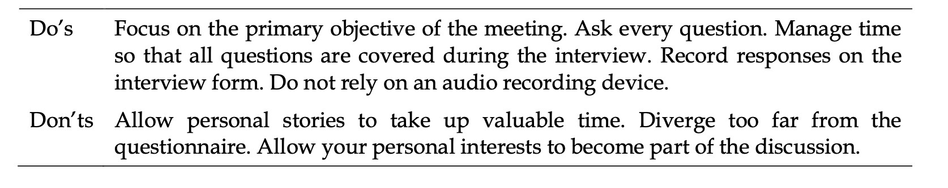
Do’s and Don’ts for the interviewer

Slide 26
Analyse
Qualitative analysis has been described as both the most difficult and the least codified part of the case study process.
The analyse stage relies on theoretical propositions and other strategies, considers and employs analytic techniques, explores rival explanations, and displays data (facts) apart from interpretations.
The most important strategy is to focus on the most relevant data, organise the entire case study, and define alternative explanations.

Slide 27
Advantages of case study
The examination of the data is most often conducted within the context of its use (Yin, 1984), that is, within the situation in which the activity takes place.
The detailed qualitative accounts often produced in case studies not only help to explore or describe the data in real-life environment, but also help to explain the complexities of real- life situations which may not be captured through experimental or survey research.

Slide 28
Disadvantages of case studies
Case studies are often accused of lack of rigour.
Case studies provide very little basis for scientific generalisation since they use a small number of subjects, some conducted with only one subject. The question commonly raised is “how can you generalise from a single case?” (Yin, 1984:21).
Case studies are often labelled as being too long, difficult to conduct and producing a massive amount of documentation (Yin, 1984)
A common criticism of case study method is its dependency on a single case exploration making it difficult to reach a generalising conclusion (Tellis, 1997). Yin (1993) considered case methodology ‘microscopic’ because of the limited sampling cases.

Slide 29
What are the potential pitfalls and how can these be avoided?
The importance of avoiding the temptation to collect as much data as possible;
Adequate time also needs to be set aside for data analysis and interpretation of what are often highly complex datasets.
Case study research has sometimes been criticised for lacking scientific rigour and providing little basis for generalisation i.e. producing findings that may be transferable to other settings.
There are several ways to address these concerns, including:
  the use of theoretical sampling;
  respondent validation (i.e. participants checking emerging findings and the researcher's interpretation, and
  providing an opinion as to whether they feel these are accurate);
  and transparency throughout the research process (see Table ​Table88)[8,18-21,23,26].

Slide 30
Potential pitfalls and mitigating actions when undertaking case study research
Potential pitfall | Mitigating action
Selecting/conceptualising the wrong case(s) resulting in lack of theoretical generalisations | Developing in-depth knowledge of theoretical and empirical literature, justifying choices made
Collecting large volumes of data that are not relevant to the case or too little to be of any value | Focus data collection in line with research questions, whilst being flexible and allowing different paths to be explored
Defining/bounding the case | Focus on related components (either by time and/or space), be clear what is outside the scope of the case
Lack of rigour | Triangulation, respondent validation, the use of theoretical sampling, transparency throughout the research process
Ethical issues | Anonymise appropriately as cases are often easily identifiable to insiders, informed consent of participants
Integration with theoretical framework | Allow for unexpected issues to emerge and do not force fit, test out preliminary explanations, be clear about epistemological positions in advance

Slide 31
Stake's checklist for assessing the quality of a case study report
1. Is this report easy to read?
2. Does it fit together, each sentence contributing to the whole?
3. Does this report have a conceptual structure (i.e. themes or issues)?
4. Are its issues developed in a series and scholarly way?
5. Is the case adequately defined?
6. Is there a sense of story to the presentation?
7. Is the reader provided some vicarious experience?
8. Have quotations been used effectively?
9. Are headings, figures, artefacts, appendices, indexes effectively used?
10. Was it edited well, then again with a last minute polish?
11. Has the writer made sound assertions, neither over- or under-interpreting?
12. Has adequate attention been paid to various contexts?
13. Were sufficient raw data presented?
14. Were data sources well chosen and in sufficient number?
15. Do observations and interpretations appear to have been triangulated?
16. Is the role and point of view of the researcher nicely apparent?
17. Is the nature of the intended audience apparent?
18. Is empathy shown for all sides?

Slide 32
Conclusion
The case study approach allows, critical events, interventions, policy developments and programme-based service reforms to be studied in detail in a real-life context.
Though inherently challenging, the research case study can, if carefully conceptualised and thoughtfully undertaken and reported, yield powerful insights into many important aspects of health and healthcare delivery.

Slide 33
Assignment for students
Assignment for students (group work 3-4 students).
    Analyse the submitted articles and using the Stake's checklist assess the quality of a case study report.

Slide 34
References:
C.Pope, N.Mays Qualitative research in Health Care. Wiley Blackwll, 2020
S. Baškarada Qualitative Case Study Guidelines. The Qualitative Report 2014 Volume 19, How To Article 24, 1-18
S. Crowe, K. Cresswell, A. Robertson, G. Huby, A. Avery, A. Sheikh The case study approach. BMC Med Res Methodol. 2011; 11: 100. Published online 2011 Jun 27. doi: 10.1186/1471-2288-11-10 https://www.ncbi.nlm.nih.gov/pmc/articles/PMC3141799/
Baxter, P., & Jack, S. (2008). Qualitative Case Study Methodology: Study Design and Implementation for Novice Researchers. The Qualitative Report, 13(4), 544-559. https://doi.org/10.46743/2160-3715/ 2008.1573
A. B. Starman The case study as a type of qualitative research. Journal Of Contemporary Educational Studies 1/2013, 28–43
K.Gerrish, J.Lathlean Case study research. The researh process in nursing. 7th edition Wiley Blackwell, 2015; p.199-210
B. Njie, S. Asimiran Case Study as a Choice in Qualitative Methodology IOSR Journal of Research & Method in Education (IOSR-JRME) e-ISSN: 2320–7388,p-ISSN: 2320–737X Volume 4, Issue 3 Ver. I (May-Jun. 2014): 35-40

Slide 35
Thank you

