Slide 1
Different approaches of qualitative research and their application IV
Historical research
Olga Riklikiene RN, PhD

Slide 2
Aim
To gain knowledge on historical research and its process
To be familiar with the some historical research studies in the field of nursing

Slide 3
Historical research: description
A narrative description or analysis of events that occurred in the remote or recent past
Burns and Grove, 2011
A method of inquiry that combines science and literature, often supports a common thesis that an informed understanding of nursing history provides insights that can contribute effective approaches to current professional issues.
Hewitt, 1997
A research approach that examines past events to increase understanding and gain new knowledge to inform current and future practice
Moule and Goodman, 2009
It often starts without firm assumptions and preconceived ideas. Researcher might study a particular era in history or attempt to find out how a particular condition was treated or perceived by society over time
Holloway and Wheeler, 2002
History is important to know the past to understand the present and direct the future

Slide 4
Historical research in nursing
Has not been a valued activity; a few nurse researchers had the skills or desire to conduct this research
An understanding of nursing history enables a clearer understanding of ongoing challenges and provides for more successful approaches to current professional problems (Hewitt, 1997)
Implications for contemporary nursing policy and practice (Kent-Wilkinson, 2021)
Knowing where we are going (Quo Vadis) depends on understanding where we have been and our capacity to draw upon that experience to guide our forward journey.
Past events, reported by those interested in history, provide information that can enlighten our judgment and transform our professional, cultural and moral environments. Recorded history is a gift passed from one generation to the next.
Clinical nurses’ stories contribute to historical research. All nurses are responsible for gathering and distributing contemporary local narratives on clinical nursing (McDonald, 2020)

Slide 5
Historical research: conducting a study
Identify an interest area
Raise question(s)
Tell the story
Formulate title
Conduct literature review
Collect data
Interpret data
Historians study the past for patterns that can lead to generalization (Burns and Grove, 2011)
Contemporary text and documentary sources are analysed by expert (Vieira et al., 2019)
The period of history or the condition under study (e.g. development of nursing profession) is discussed
A comparison between past and present is developed
The problem and purpose focus on a specific individuals, characteristics of society, an event, or a situation in the past and identifies the time period
Research question must be congruent with the method: it guides the sources of material that may be available to answer it

Slide 6
Historical research: context of the study
Historical context – the context (family, society, or the history, social, or political trends of the subject’s life) in which the researcher presents the life of the subjects (Denzin, 1989. In Creswell,2007)
Events placed in the context of the era
All aspects of the time considered, e.g. roles of men and women, other events, socioeconomic and political concerns, etc.
Reconstruct not only what happened, but how and why

Slide 7
Historical research: literature review
A literature review can justify the historian's efforts to add to prior knowledge and allow the reader to identify divergent viewpoints
Hawkins et al. (1994) organized the literature review by decades to show a distinct change of focus in each decade from the 1960s to the present
Olson (1996) wove his literature review throughout the introduction to his study
Sutherland (1995) had the most formal of reviews and used it to clearly establish the value of her research
For the researchers who presented their work as chronological narratives, reviewing the work of other historians would have strengthened and justified the implied thesis that understanding nursing's past has present value
Hewitt, 1997

Slide 8
Example of historical research in nursing student work
Development of medical sisters‘ training and practice during the Soviet period (1945– 1990) in Lithuania
Rimkuvienė Sandra
Master‘s degree thesis / scientific adviser prof. O. Riklikienė; Lithuanian University of Health Sciences, Faculty of Nursing. – Kaunas, 2015, P.85.
The aim was to explore the development of medical sister‘s’ training and practice during the soviet period (1945– 1990) in Lithuania.
Research questions:
In what circumstances the training and practice of medical sisters took place in Lithuania during 1945–1990?
What values and work priorities did the medical sisters‘ professional image describe in Lithuania?
What kind of influence did the public life, economical and cultural factors of those years have had for the training and practice of medical sisters?
Methods. The qualitative research was carried on applying two research designs: historical research (content analysis of historical written materials) and life history research (individual and group interviews). Historical and empirical data was collected during 2013-2014.
Fifteen medical sisters that were graduated from medical schools and worked in health care institutions during study period participated in the interviews. Purposive convenient selection of study sample was applied.
Results: Medical sisters were centrally trained at vocational level grounded on the biomedical model with the vast majority of doctors as teachers. The main duty of a medical sister was to accomplish doctor‘s orders perfectly and on time by remaining sensitive, discreet, neat and sincere to the patients. The qualification improvement process for medical sisters was irregular and informal, the absolute authority of doctor was predominant in everyday practice. The lack of medications and medical equipment, low salaries for medical sisters, declarative attention on public health education, improvement of healthy lifestyle and prevention prevailed.
Conclusions: Medical sisters were unable to develop and improve their own professional knowledge and practice; their professional status remained low at the working environment and in society. Discipline and control was maintained in the practice of medical sisters with communist-atheist education of personnel and public. Medical sisters‘ professional practice was also characterized by influence of communist party politics, dissemination of soviet propaganda and activity in trade-union under very limited social welfare and restriction of religious freedom. Nevertheless atheistic propaganda didn‘t restrain medical sisters from mercifulness in helping patients to meet their spiritual needs in illness or during end-of-life care. Keywords: medical sisters, profession, Soviet period, Lithuania.

Slide 9
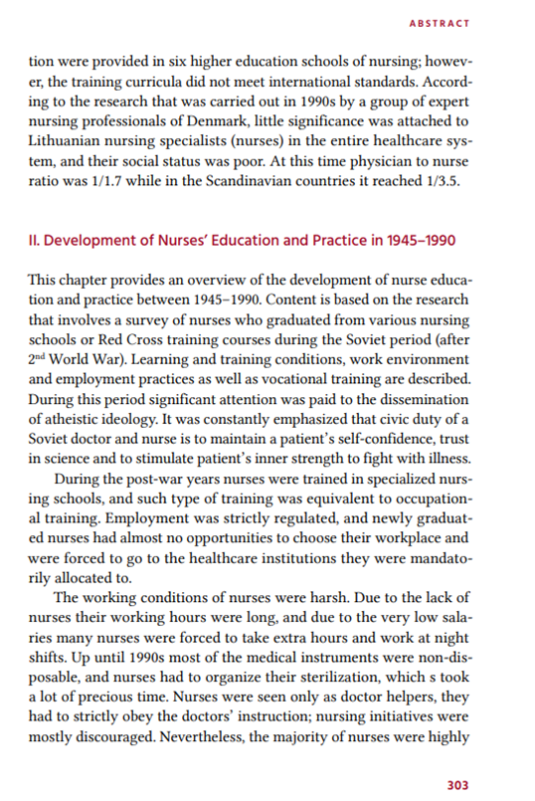
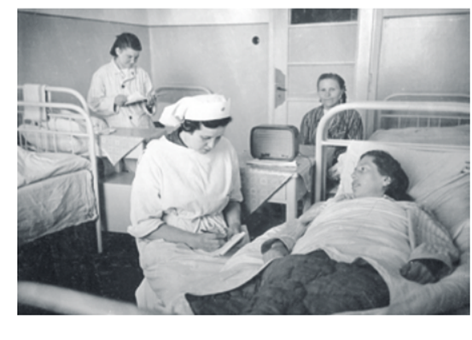
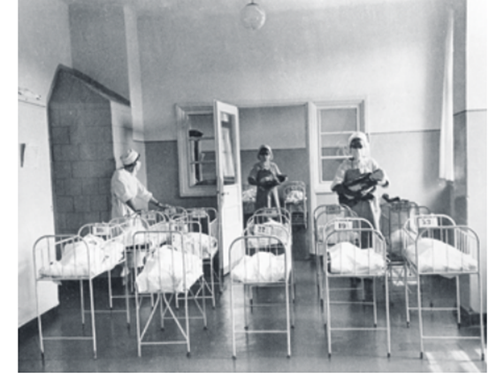
Application of the results
Lithuanian Nursing History
1918-2018
https://www.sskc.lt/uploads/Slaugos%20knyga%202018/Knyga_Lietuvos%20slaugos%20istorija.pdf

Slide 10
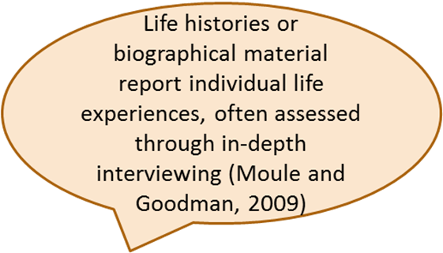
Sources of information: search
Documentary, books, newspapers, autobiographies, photographs, tape recordings, video, letters, diaries….
PRIMARY
SECONDARY
Genuine and authentic
Genuine: document is what it says it is. Authentic: makes sense compared to other documents, events, context
Provide the best data and first hand account (Fitzpatrick, 1993)
Account of the event by an eyewitness
Originators has influenced what is written
Less shaped by interpretation of others
In archives, private collections, oral histories
Digitalized and web-based materials
Descriptions of an event from non-eyewitnesses who did not experience the event
Bibliographical and historical texts (Brown, 2015)
May provide broader context
Agreement of secondary sources
In library and archives
Historical data – research data used by historical researchers that can be text-based, visual, verbal or numerical
Notes:
10

Slide 11
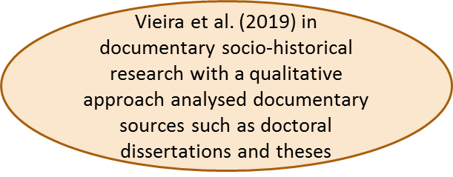
Primary and secondary sources: examples
Autobiographies were selected based on a systematic review of historical sources containing nurses’ personal accounts and historical studies on nursing during the American Civil War.
All the autobiographies written by women nurses in the context of the American Civil War were included.
Nurses’ letters and diaries were excluded in light of the study aims. Indeed, unlike in the case of autobiographies, in letters and diaries, the exercise of vital reconstruction is suppressed; therefore, the historical perspective is lost since the act of writing is immediate to the historical fact.
Furthermore, in letters and diaries, the relationship between the reader and the author is not established, as there is no desire for visibility or dissemination (Choperena, 2020)
A study provided an understanding of the nature of military nursing development from 1948 to 1970 researchers adopted an oral history approach. This consisted of a literature review, the collection of photographs, a review of formal documents and four face-to-face in-depth interviews (Mu and Lin, 2007)

Slide 12
Sources of information: criticism
Quality of the sources could be questionable (that time collected not for the research purpose)
Researcher must be confident of reliability and validity of the sources (originality, accuracy, authenticity)
External criticism
Establish validity
Internal criticism
Establish the reliability
Comparison with the second independent source of evidence related to the same event (diary or photographs from different individuals)
The origins of the source
(who produce the material, when, where and how)

Slide 13
Interpretation and story telling
Interpret your findings
Trends
Comparisons (Wood, 2016)
Relationships
Context
Theoretical framework
Tell one story
One version of what happened
Theories regarding trends
How events influenced each other
Does it explain the present?
What can you predict for the future?

Slide 14
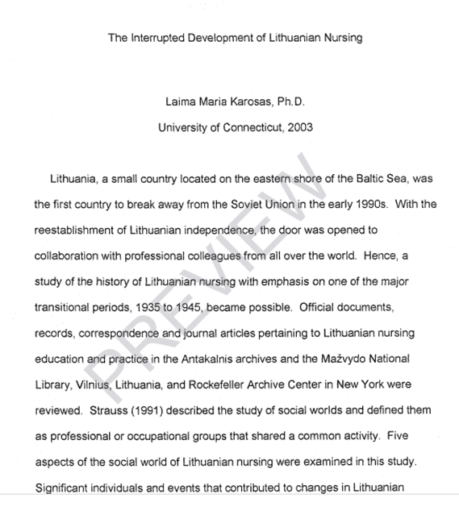
Task in a group
The interrupted development of Lithuanian nursing
Karosas, Laima Maria. University of Connecticut. ProQuest Dissertations Publishing, 2003. 3101694.
https://www.proquest.com/docview/305343657
Read P.1-9 of the historical research, conducted by Laima Maria Karosas.
Analyse and discuss in a group :
The material sources and their access
The parameters of historical investigation and their determination
The establishment of historical facts and data analysis
Application of Social theory framework in historical research

Slide 15
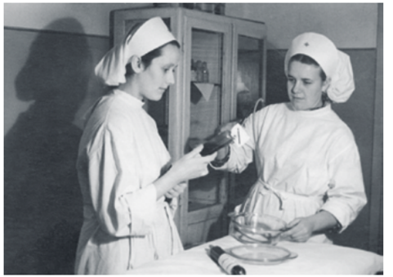
The Interrupted Development of Lithuanian Nursing
Laima Karosas PhD, APRN, FAANP Quinnipiac Universtiy
1. Research questions:
What changes in Lithuanian nursing between 1935 and 1945 contributed to the social awareness and self-identity of Lithuanian nurses?
What was the social world of Lithuanian nursing?
How did intersections of Lithuanian women, physicians, German and Soviet occupying forces and trends in the United States influence Lithuanian nursing?
How did Lithuanian nurses view their own discipline and solve challenges to the discipline?
How was Lithuanian nursing from 1935 to 1945 influenced by the era of independence (1918 to 1940) and what social movements were sustained under Soviet occupation after 1945?
2. Significance and purpose:
No cumulative, written history
Document changes in Lithuanian nursing
1935 to 1939: pre-World War II
1940 to 1944: wartime
1945 and beyond: adjustment to a new regime
Nurses as a subset of women
Compare to trends in Poland and United States

Slide 16
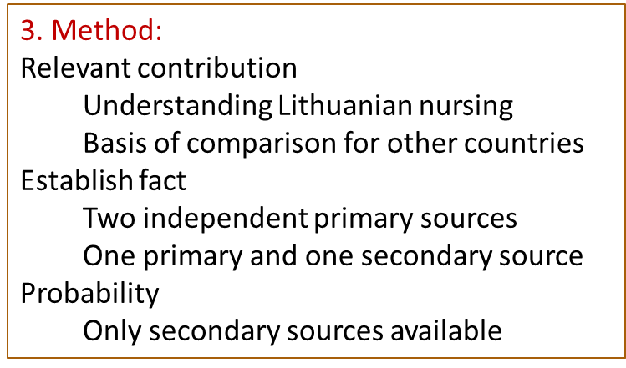
3.2 Materials
Many records not saved or lost
Antakalnis Central Archive
Mažvydas National Library
Public access from 1991
Consultant Jolita Steponaitienė
Rockefeller Archive Center (NY)
3.3 Theoretical framework:
Strauss’ social world: share a common activity
Characteristics
Authenticity: maintain and control membership
Socialization: entering and leaving the social world
Arenas: places where issues are discussed
Social movements: change in segments
Processes: methods used to manage problems or unite the group for action

Slide 17
References and recommended readings
Brown W. J. (2015). Nursing in the 8th Evacuation Hospital, 1942-1945. U.S. Army Medical Department journal, 92–98.
McDonald T. (2020). Quo Vadis? A question of historical awareness. International nursing review, 67(2), 288–293. https://doi.org/10.1111/inr.12575
Hewitt L. C. (1997). Historical research in nursing: standards for research and evaluation. The Journal of the New York State Nurses' Association, 28(3), 16–19. https://pubmed.ncbi.nlm.nih.gov/9369656/
Wood P. J. (2017). Managing boundaries between professional and lay nursing following the influenza pandemic, 1918-1919: insights for professional resilience today?. Journal of clinical nursing, 26(5-6), 805–812. https://doi.org/10.1111/jocn.13570
Vieira, A. N., Petry, S., & Padilha, M. I. (2019). Best Practices in Historical Studies of Nursing and Health (1999-2017). Revista brasileira de enfermagem, 72(4), 973–978. https://doi.org/10.1590/0034-7167-2018-0538
Choperena A. (2021). Triumphal narratives in the American Civil War: A new nursing professional identity. Journal of advanced nursing, 77(3), 1422–1431. https://doi.org/10.1111/jan.14693
Kent-Wilkinson A. (2021). Where in the world is Florence Nightingale's medicine chest?. International nursing review, 68(2), 166–171. https://doi.org/10.1111/inr.12678
Mu, P. F., & Lin, S. (2007). An oral historical study of the development of the discipline of military nursing in Taiwan from 1948 to 1970. The journal of nursing research : JNR, 15(2), 117–126. https://doi.org/10.1097/01.jnr.0000387606.55403.5f
Recommended readings:
Tobbell D. A. (2018). Nursing's Boundary Work: Theory Development and the Making of Nursing Science, ca. 1950-1980. Nursing research, 67(2), 63–73. https://doi.org/10.1097/NNR.0000000000000251
Sweeney J. F. (2005). Historical research: examining documentary sources. Nurse researcher, 12(3), 61–73. https://doi.org/10.7748/nr2005.01.12.3.61.c5949

Slide 18
Examples of historical study:
Leifer, S. L., & Glass, L. K. (2008). Planning for mass disaster in the 1950s: Harriet H. Werley and nursing research. Nursing research, 57(4), 237–244. https://doi.org/10.1097/01.NNR.0000313491.94906.8e
Beaird G. (2019). CE: A Historical Review of Nurse-Physician Bedside Rounding. The American journal of nursing, 119(4), 30–38. https://doi.org/10.1097/01.NAJ.0000554525.02127.3b
Steger, F., & Kosenko, O. (2021). Historical Research: Marie-Elise Kayser (1885-1950): Pioneer of Milk Banking. Journal of human lactation : official journal of International Lactation Consultant Association, 37(3), 501–508. https://doi.org/10.1177/08903344211018164
Karosas L. M., Riklikiene O. An analysis of the social world of Lithuanian nursing during the turbulent period of 1935–1945. Journal of Nursing, Social Sciences, Public Health and Rehabilitation, 2014, 1-2. http://casopis-zsfju.zsf.jcu.cz/journal-of-nursing-social-studies-public-health-and-rehabilitation/
Karosas L.M., Riklikiene O. Development of the Nursing Profession in Pre-War Independent Lithuania (1918–1939): A Comparison Between Past and Present. NERP (Kaunas) 2011; 1 (1): 4-11.
Sedlak C. A. (1997). Historical perspectives on orthopaedic nursing research in Orthopaedic Nursing from 1982 to 1995. Orthopedic nursing, 16(6), 33–42.

Slide 19
Critical questions to discuss
Historical researchers believe that by studying data and materials related to the past we can inform current and future practices. What do you think about this statement? Is it relevant for your country?
What stage of the historical research creates the main challenge for young researcher and why? What would be the right way to overcome the challenge? Argue your opinion.
What is the influence of the researcher himself in the interpretation of findings in historical study? May this create research bias?

