Slide 1


Reporting of qualitative data in research article and academic writing
Thóra B. Hafsteinsdóttir RN, PhD and Olga Riklikiene RN, PhD
T.hafsteinsdottir@umcutrecht.nl - olga.riklikiene@lsmuni.lt

Slide 2
Aim
To gain knowledge on preparation of the publication on qualitative study results for peer review journal
To understand the criteria for reporting qualitative research (COREQ)
To be familiar with the academic writing style

Slide 3
Learning outcomes
Students:
List and describe different sections of scientific publication
Will be familiar with the content of different sections of scientific publication and apply their knowledge during manuscript preparation
Will be able to identify and explain the academic writing style and skills development
Will be able to evaluate the quality of reporting of qualtative scientific paper according to the COREQ) criteria

Slide 4
Learning material
Presentation and critical thinking questions
Analysis of examples
Group and individual tasks with readings and audio listening
Ouiz

Slide 5
Structure of the lecture:
Writing an article focusing on the different parts of a scientific paper
Academic writing

Slide 6
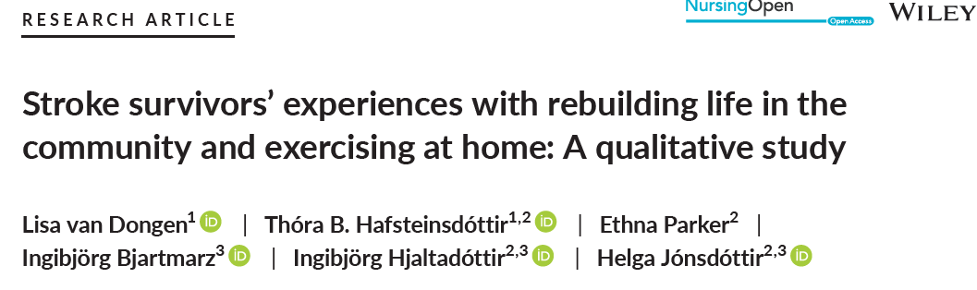

Title of an article
Short, clear, comprehensive with the key concepts included
The title should be short but give a clear description of the content of the paper
The research method mentioned
“A Qualitative Study” ; “A Phenomenological Study” ; „A Discourse analysis“, ect.
Vital information at the beginning to attract the reader!
Notes:
6

Slide 7
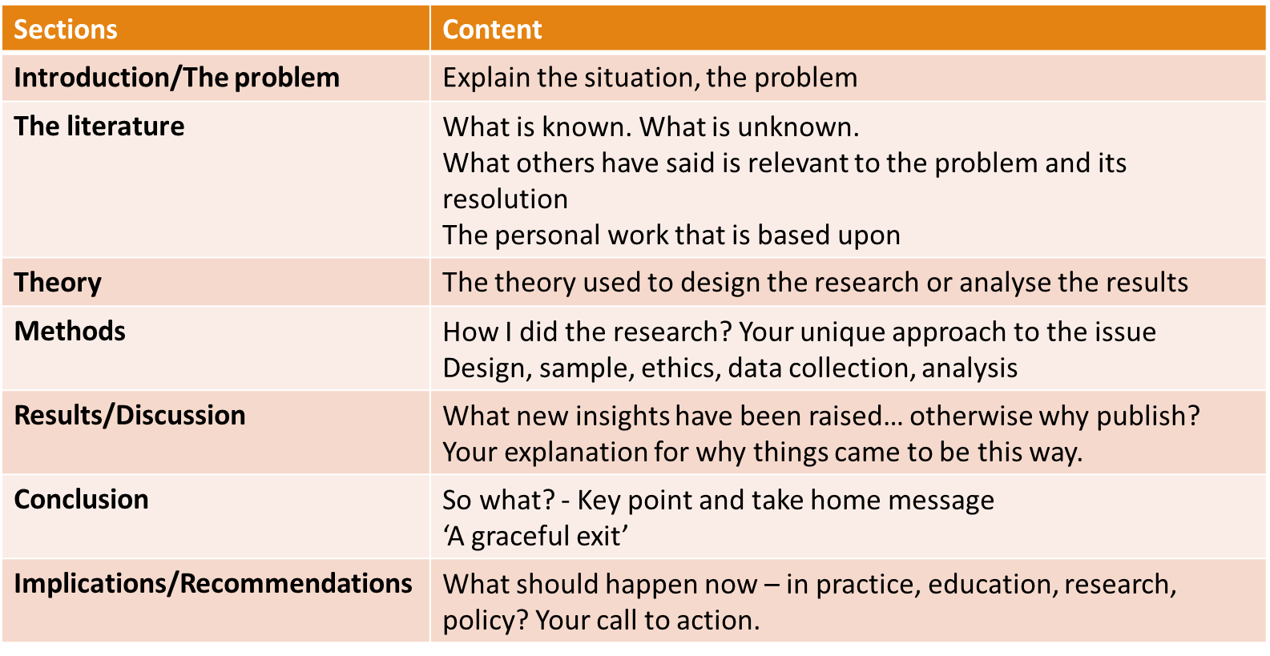
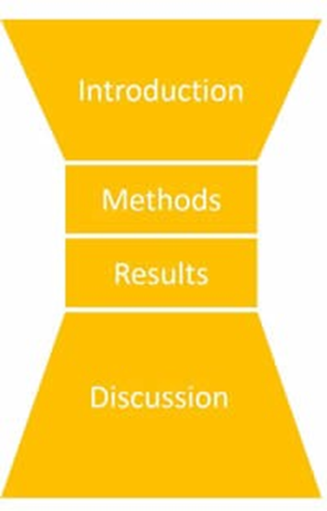
The conventional approach to present your work - IMRaD
(Nair & Nair 2014)
The method works really well for a journal article generic structure

Slide 8
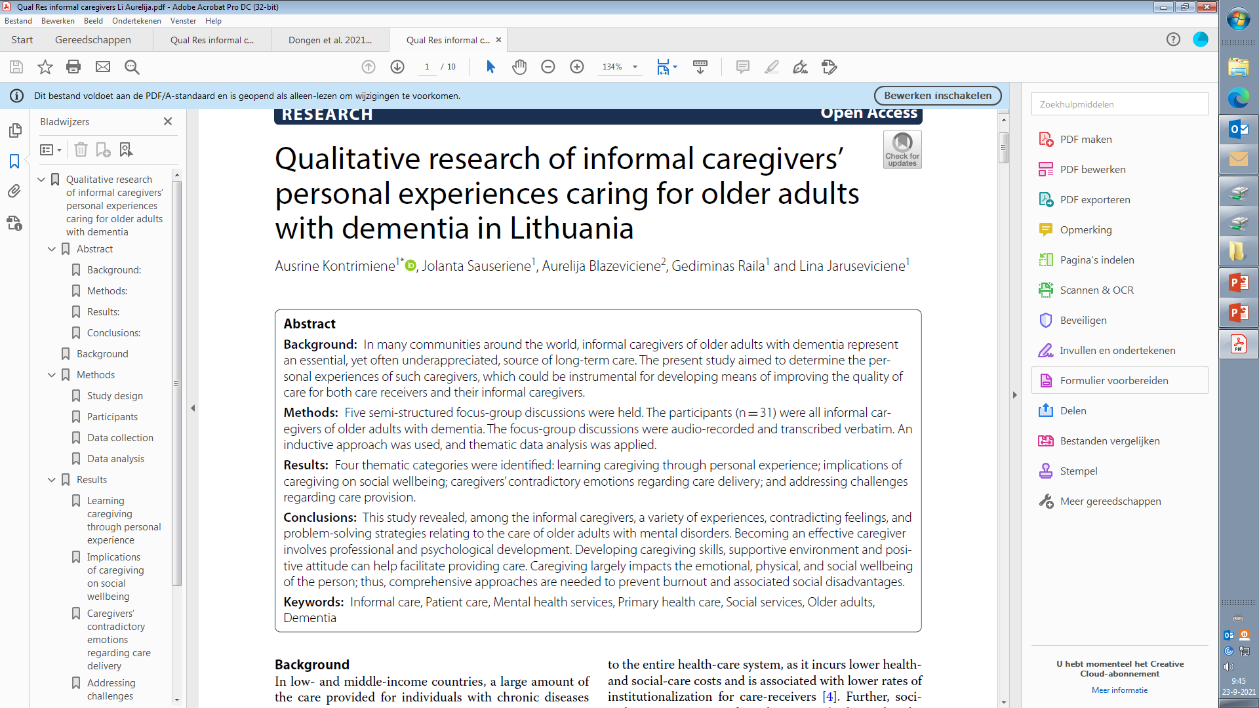
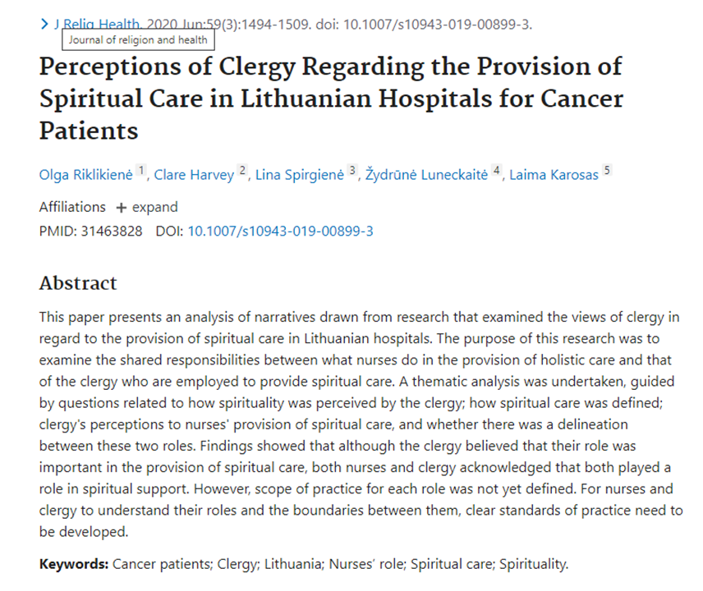
Abstract
Structure depends on the journal requirements
STRUCTURED
UNSTRUCTURED
Notes:
8

Slide 9
Abstract
It is important for the search and detection of the paper.
A good summary of a research study reported in a journal might include the following points by J.W. Creswell (2009):
Mention the problem being addressed
State the central purpose or focus of the study
Briefly state information about the sample, population, or subjects
Review key results that relate to the proposed study

Slide 10

Introduction
Provide a clear description of the background of the study.
Provide a clear description of the rationale or the reason for why the study was needed
Start with international (World, Europe/Asia) – then move towards Kazakstan (own country)
Which population: patients/professionals is the study focusing on?
How big is the problem (topic of study), - international and in Kazakhstan/your country
Is the focus on patient’s/professionals experiences or views – present that.
All concepts of the research questions or aims of the study need to be defined, described and presented/discussed in the introduction.
What are the “gaps in the literature” (on the topic of study)
The introduction leads to the aims/research questions
Notes:
10

Slide 11
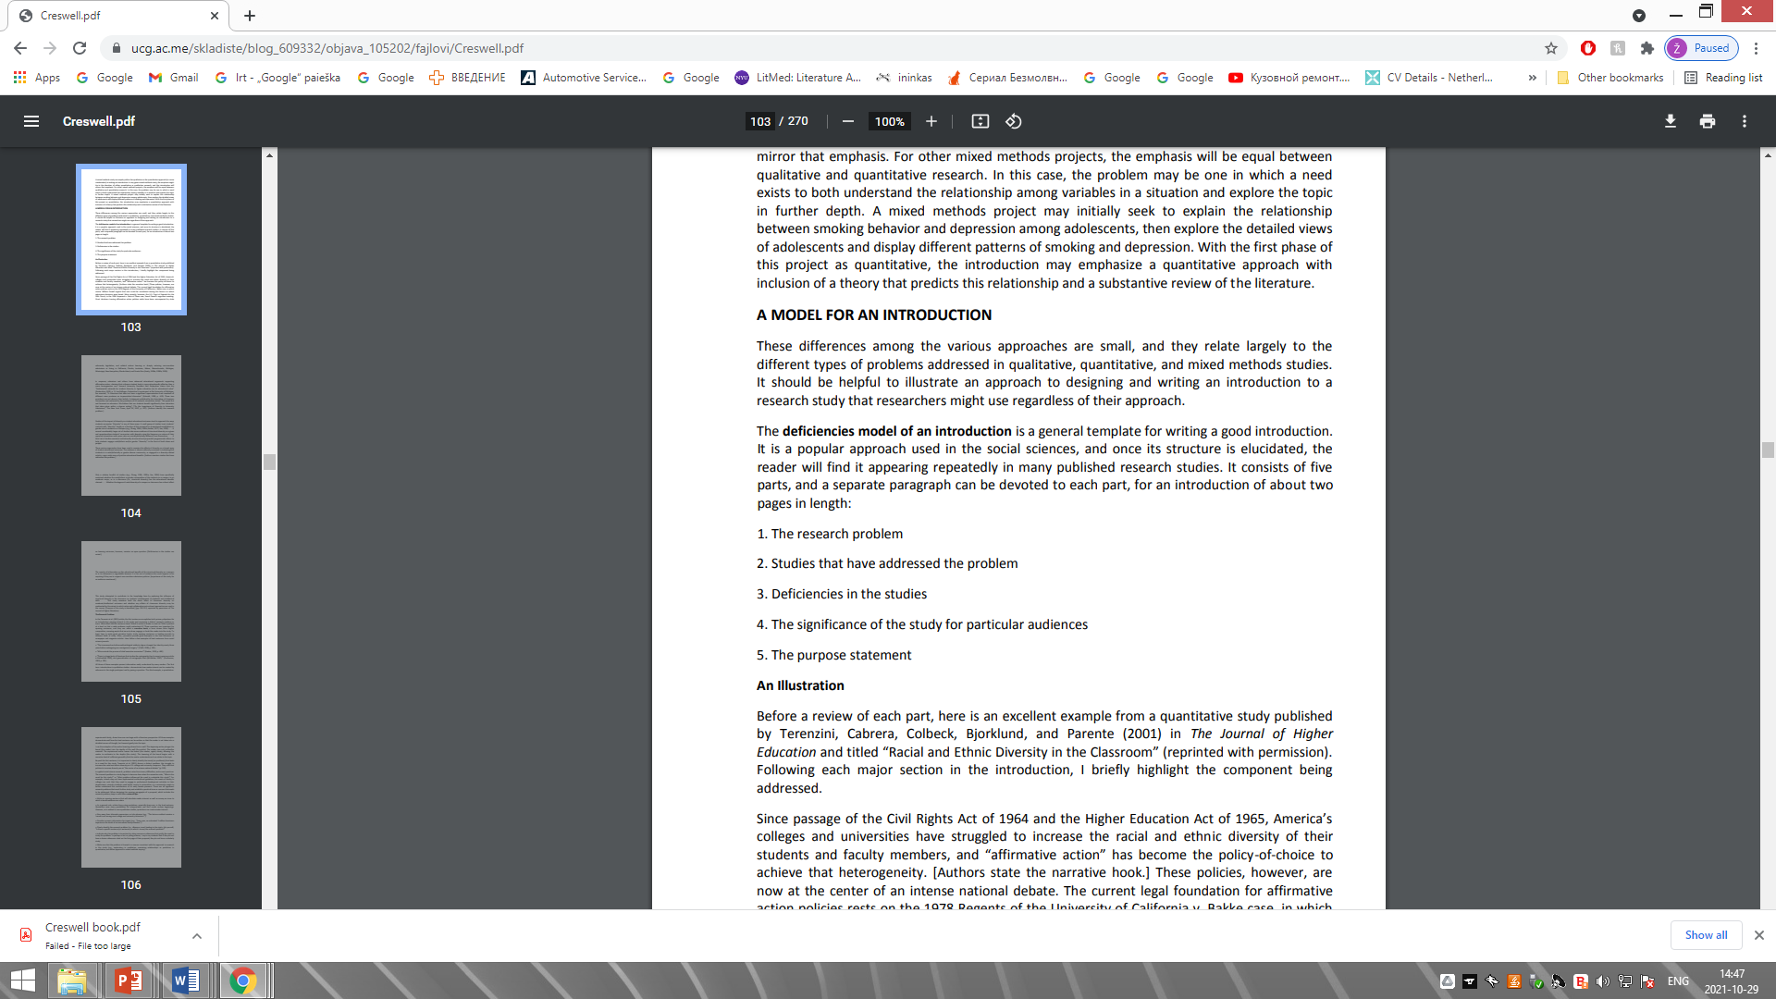
Task 1. Learning in the group
Task for the students:
Read the publication by Terenzini et al. (Introduction)
Identify the five main elements of “Deficiency model”, proposed by J.W. Creswell.
https://www.researchgate.net/publication/261699964_Racial_and_Ethnic_Diversity_in_the_Classroom_Does_It_Promote_Student_Learning
J.W.Creswell proposed the ‘Deficiency model’ for writing a good introduction.
Creswell, John W. Research design: Qualitative, quantitative, and mixed methods, 2009.

Slide 12
Task 2. Self-directed individual learning (take home task)
Listen to or / and read the podbean by Roger Watson, ex-editor-in-chief of JAN and current editor-in-chief of Nurse Education in Practice.
Will be able to:
A) List at least 7 key points that should be used writing the Introduction section.
b) Identify and describe the main differences between Introduction and Background sections in the research paper.
I Say “Introduction”; You Say “Background”
http://naepub.com/wp-content/uploads/2018/02/2018-28-1-4-Watson.pdf
http://rwatson1955.podbean.com/?s=introduction%2C+background

Slide 13
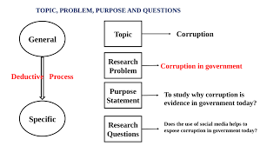
What is a Research Problem
In the introduction – the research problem needs to be presented very clearly
A research problem refers to some difficulty which a researcher experiences in the context of either a theoretical or practical situation and wants to obtain a solution for
A research problem is one which requires a researcher to find out the best solution by which cause of action the objective can be attained optimally in the context of a given environment
A Research Problem is a question that a researcher wants to answer or a problem that a researcher wants to solve
Example

Slide 14

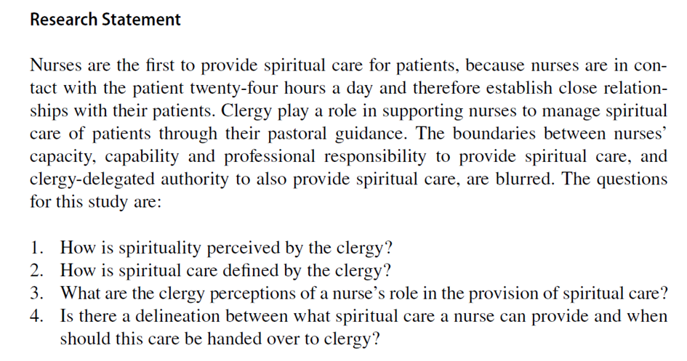


Aim(s) or research question (s)/research statement
Should be clearly formulated!
For qualitative studies: DDO (domain/determinant/outcome)
Notes:
14

Slide 15
Types of research questions in relation to the qualitative research design
Design | Description | Sample nursing research question
Action research | Conducted by and for those taking action to improve or refine actions | What happens to the quality of nursing practice when we implement a peer-mentoring system?
Case study | In-depth analysis of an entity or group of entities (case) | How is patient autonomy promoted by a unit?
Descriptive | Content analysis of data | What is the nurses role at the end-of life desicions?
Ethnography | In-depth analysis of a culture | How does Filipino culture influence childbirth experiences?
Grounded theory | Social processes within a social setting | How does the basic social process of role transition happen within the context of advanced practice nursing transitions?
Historical research | Past behaviors, events, conditions | When did nurses become researchers?
Narrative inquiry | Story as the object of inquiry | How does one live with a diagnosis of scleroderma?
Phenomenology | Lived experiences | What is the lived experience of nurses who were admitted as patients on their home practice unit?

Slide 16




Method
Design (what is the design of the qualitative study)
What methodological orientation was stated to underpin the study? e.g.
grounded theory, discourse analysis, ethnography, phenomenology,
content analysis, ect.
Notes:
16

Slide 17
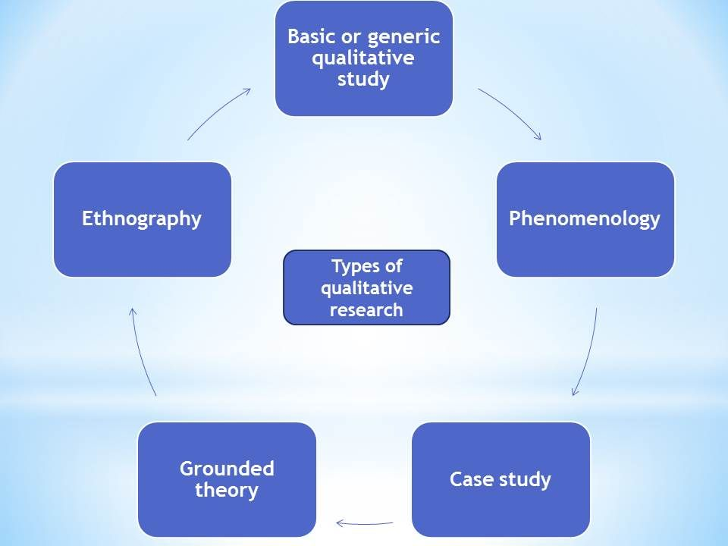
Types of qualitative research

Slide 18
Types of qualitative research designs
Types of qualitative research designs
Generic Qualitative | “A generic qualitative study design was used” ….. “is not guided by an explicit or established set of philosophic assumptions in the form of one of the known [or more established] qualitative methodologies” (Caelli et al., 2003)
Phenomenology | “A qualitative method with phenomenological approach was used… “ Describes the lived experience of patients, professionals. Phenomenology is an approach to qualitative research that focuses on the commonality of a lived experience within a particular group. The fundamental goal of the approach is to arrive at a description of the nature of the particular phenomenon (Creswell, 2013).
Ethnography | “A qualitative study with an Ethnography approach”– “A qualititative ethnographic study” Investigates cultures in depth. Ethnographic research is a qualitative method where researchers observe and/or interact with a study's participants in their real-life environment. Ethnography was popularised by anthropology, but is used across a wide range of social sciences.
Grounded theory | “A qualitative study with grounded theory design was used….” Formulate, test and refine a theory about a phenomena. Grounded theory refers to inductive methods aiming toward theory development. The term grounded theory denotes dual referents: (a) a method consisting of flexible methodological strategies and (b) the products of this type of inquiry. Increasingly, researchers use the term to mean the methods of inquiry for collecting and, in particular, analyzing data. The methodological strategies of grounded theory are aimed to construct middle-level theories directly from data analysis. The inductive theoretical thrust of these methods is central to their logic. The resulting analyses build their power on strong empirical foundations. These analyses provide focused, abstract, conceptual theories that explain the studied empirical phenomena.

Slide 19
Sample Size
How many participants do you need for qualitative research?
A sample size is estimated before a qualitative study begins
The final sample size depends on the study scope, data quality, sensitivity of the research topic or phenomenon of interest, and researchers’ skills
  For example, a study with a narrow scope, skilled researchers, and a non-sensitive topic likely will require a smaller sample
Data saturation frequently is a key consideration in final sample size
When no new insights or information are obtained, data saturation is attained and sampling stops. Although researchers may analyze one or two more cases to be certain

Slide 20
Sampling
Qualitative research sampling is concerned with accurately representing and discovering meaning in experience, rather than generalizability
For this reason, researchers tend to look for participants or informants who are considered “information rich” because they maximize understanding by representing varying demographics and/or ranges of experiences
As a study progresses, researchers look for participants who confirm, challenge, modify, or enrich understanding of the phenomenon of interest

Slide 21
Sampling
How were participants selected? e.g. purposive, convenience, consecutive, snowball...
Sampling type
Purposive sampling | Participants selected because they benefit the study (for ex because they have gone through specfic experience)
Conventience or volunteer | Participants are readily available Easy and efficcient May not be rich information
Shadow | Participants speak of others experiences in addition to their own
Snowball or chain | Early participants refer others Easy and efficient May not be rich information
Theoretical | Participants selected based on manifestation of theoretical construct

Slide 22
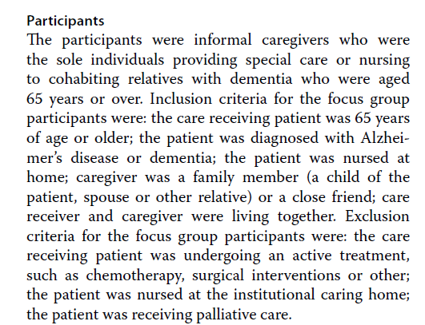
Inclusion criteria
Types of participants: patients who experienced communication problems, specifically aphasia, after stroke during the acute, rehabilitation or chronic stage
Examples
Inclusion:
Participants were eligible to participate if they had a
diagnosis of stroke (ICD);
moderate level of physical disability (Modified Rankin Scale (MRS) >2
and < 5),
were older than 18 years, had completed at least 3 months
of rehabilitation at a rehabilitation centre, were living at home, able
to speak and understand Icelandic.
Exclusion:
Stroke survivors with severe cognitive deflects and pre-existing
physical impairments as assessed by the Memory 2 item interRAI test were excluded (Morris et al., 2013).
DOI: 10.1186/s13033-020-00428-w

Slide 23
Data collection
Study design → guides data collection and analysis methods.
When collecting data, researchers must be mindful of gaining participant trust while also guarding against too much emotional involvement, ensuring comprehensive data collection and analysis, conducting appropriate data management, and engaging in reflexivity.
Common types of data collection
Interviews
  Semi-structured interviews
  Unstructured interviews
  In-depth interviews
  Focus group interviews
Other data collections:
Observations of people, environments, or contexts;
Documents; records; artifacts; photographs; or journals.

Slide 24
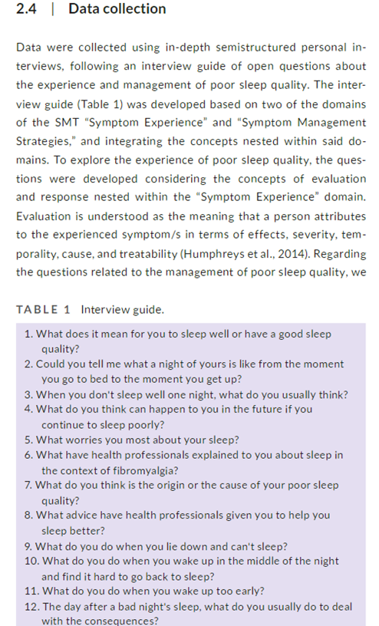
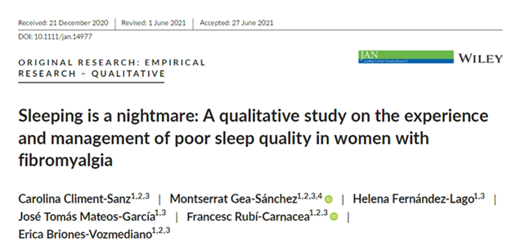
Description of data collection
Example

Slide 25
Data Analysis
Data usually are recorded in detailed notes, memos, and audio or visual recordings,
Data are transcribed verbatim and analyzed manually or using software programs, such as ATLAS.ti, HyperRESEARCH, MAXQDA, or NVivo
Analyzing qualitative data is complex work
Researchers act as reductionists, distilling enormous amounts of data into concise yet rich and valuable knowledge
They code or identify themes, translating abstract ideas into meaningful information
The good news is that qualitative research typically is easy to understand because it’s reported in stories told in everyday language

Slide 26

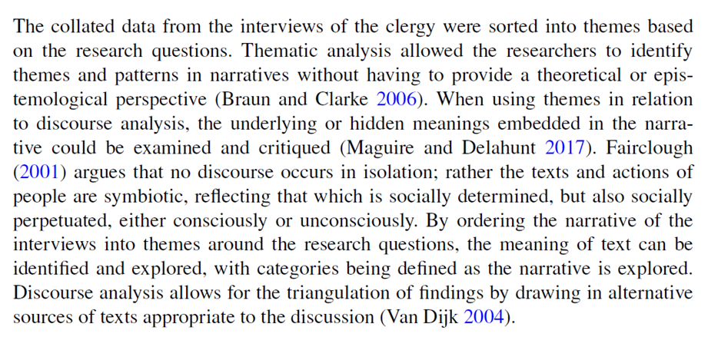

Description of the Data Analysis

Slide 27
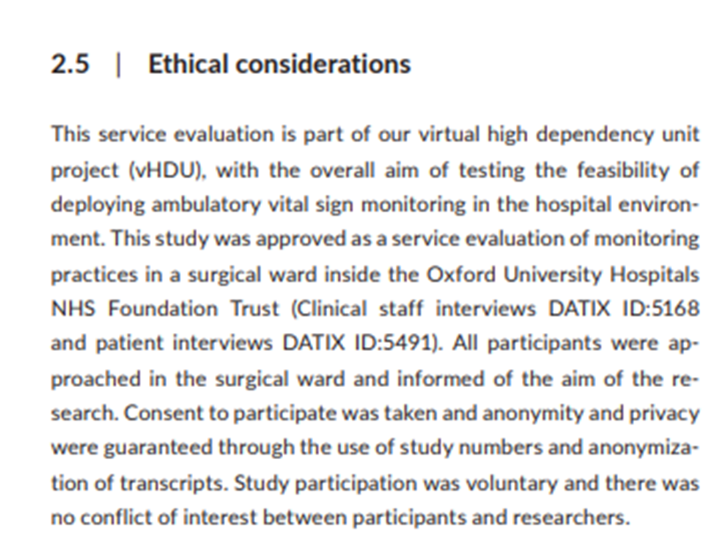
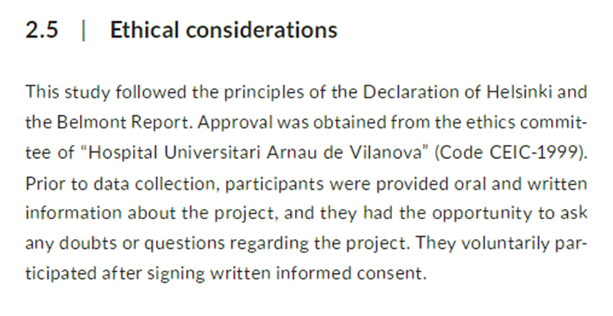


Ethical considerations
Report on ethical permissions, principals of research ethics

Slide 28
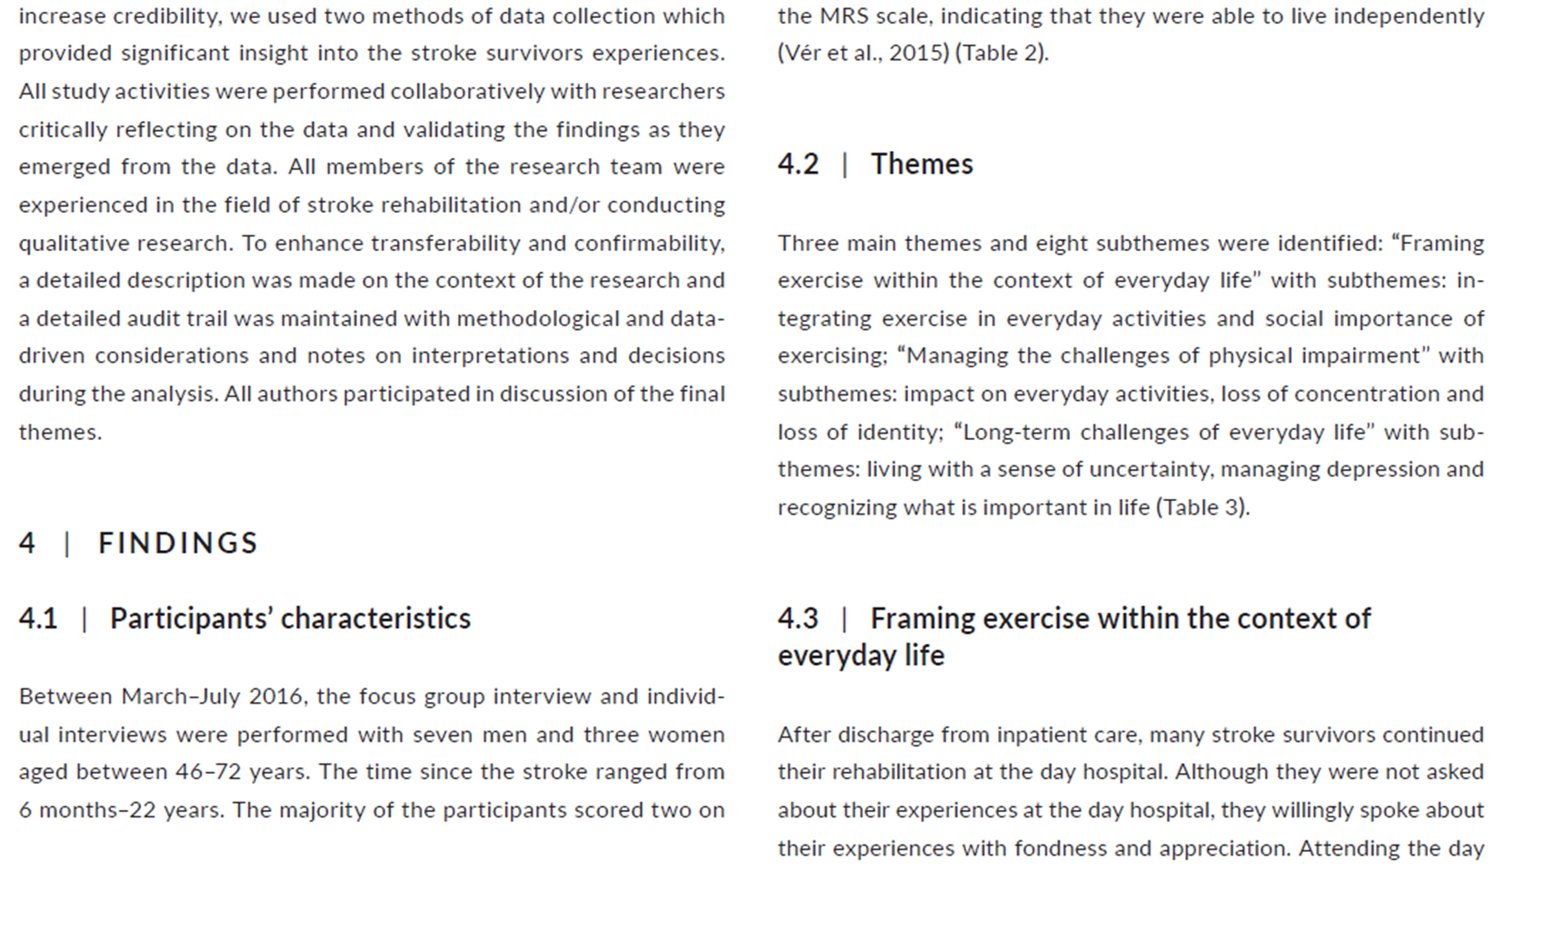
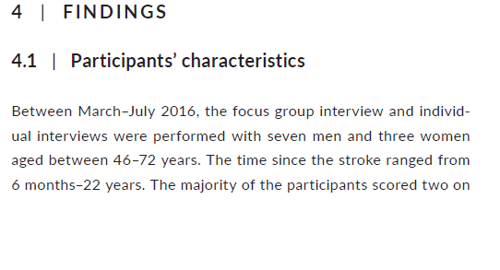
Results
How to organize the results section?
Describe:
Participants characteristics
Themes and subthemes

Slide 29
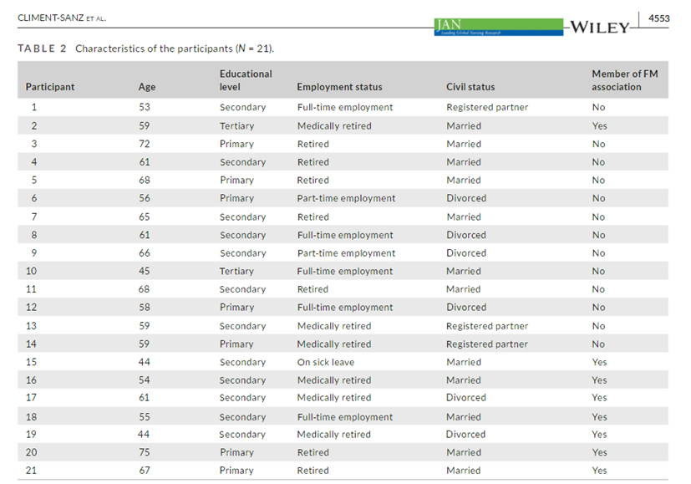
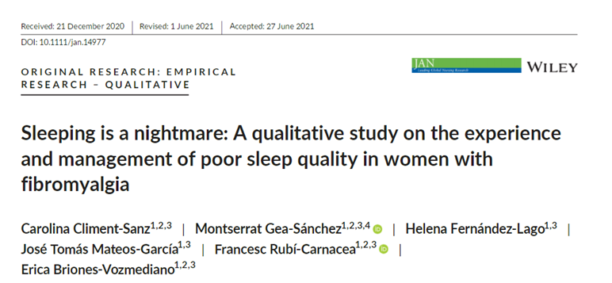
Results – Participant characteristics in table
Examples

Slide 30
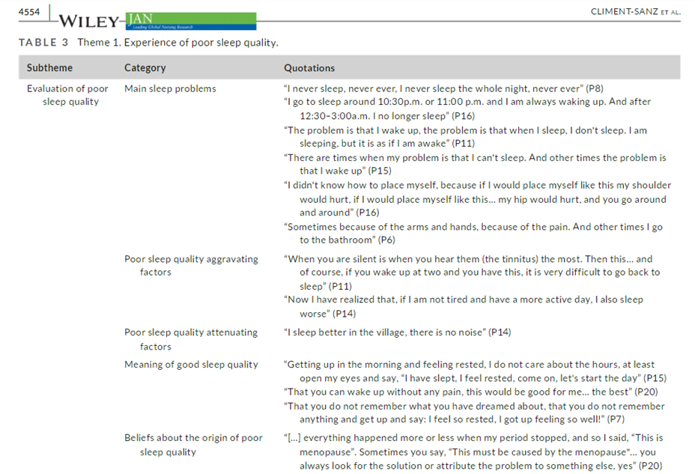
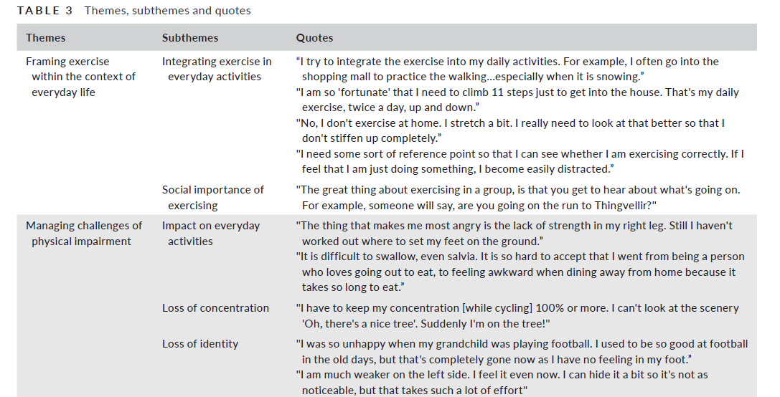
Results
Themes, subthemes and quotes in table
Example

Slide 31
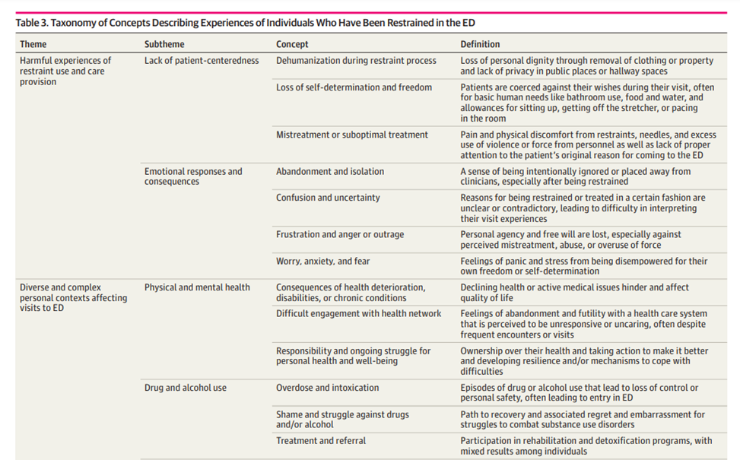
Results
Themes, subthemes and quotes in table
Example
JAMA Network Open. 2020;3(1):e1919381. doi:10.1001/jamanetworkopen.2019.19381

Slide 32
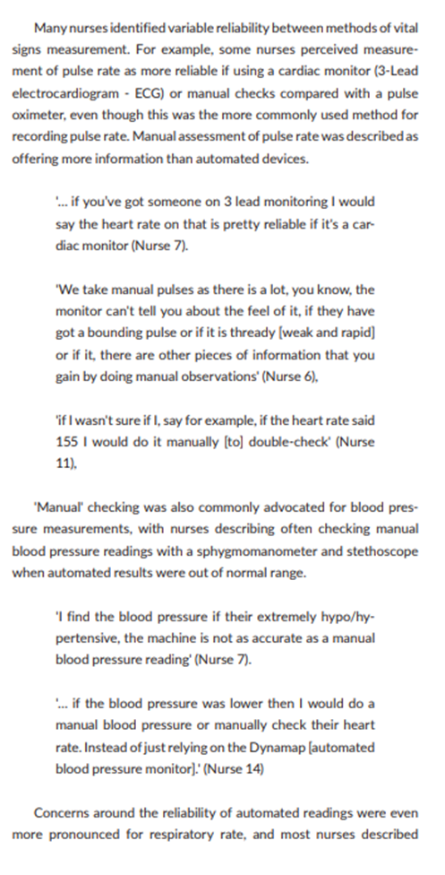
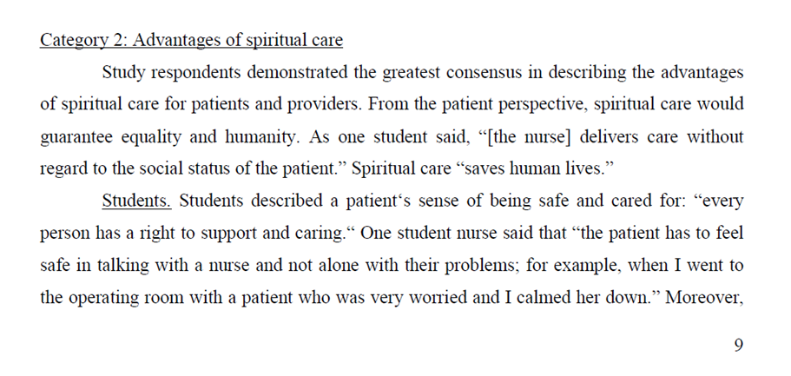

Results
Themes, subthemes and quotes in text
Example

Slide 33
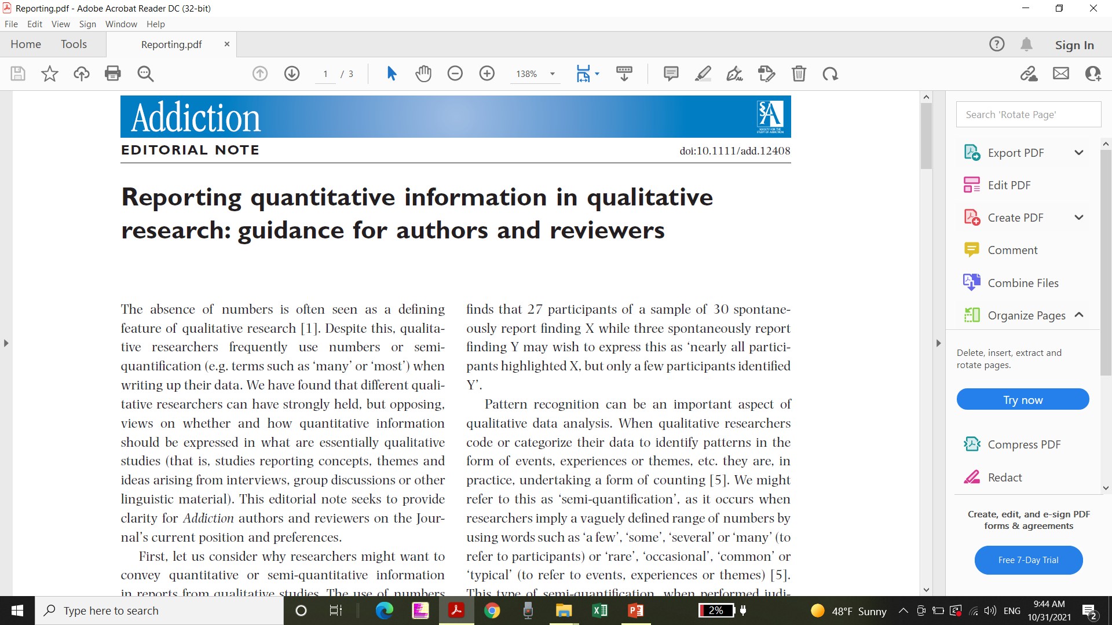
Quantitative or semi-quantitative information in reports from qualitative studies
The use of numbers to describe sample characteristics (e.g. number of participants and key demographics)
Quantification or semi-quantification can improve the
transparency of data analysis
Gives precision to statements
Enable patterns in the data to emerge with greater clarity
Increase the meaning of key findings by providing focus

Slide 34
Quantitative or semi-quantitative information in reports from qualitative studies
When it comes to reporting quantitative or semi-quantitative information in qualitative study publication it is suggested:
  Include a clear statement that no inferences can be drawn about the prevalence of phenomena observed beyond the sample.
  Limit reporting of raw numbers to features that have been assessed for all the participants in a manner that allows for comparison.
  Avoid percentages unless the study has a sample size greater than 50 or thereabouts.
  Do not use terms that have a specific quantitative meaning, e.g. ‘majority’, ‘minority’, ‘most’.
  If some form of semi-quantification is required (justification should be given), it is often better to use appropriately non-specific terms such as: ‘a few’, ‘several’, ‘some’, ‘many’ etc.

Slide 35
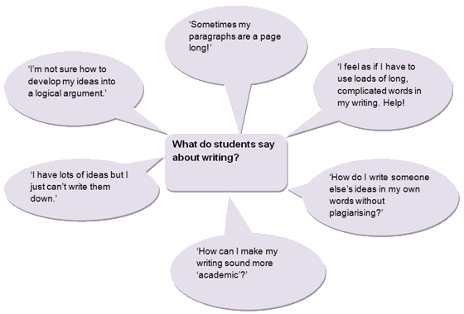
Discussion
Hoe moet ik de Discussie aanpakken?

Slide 36
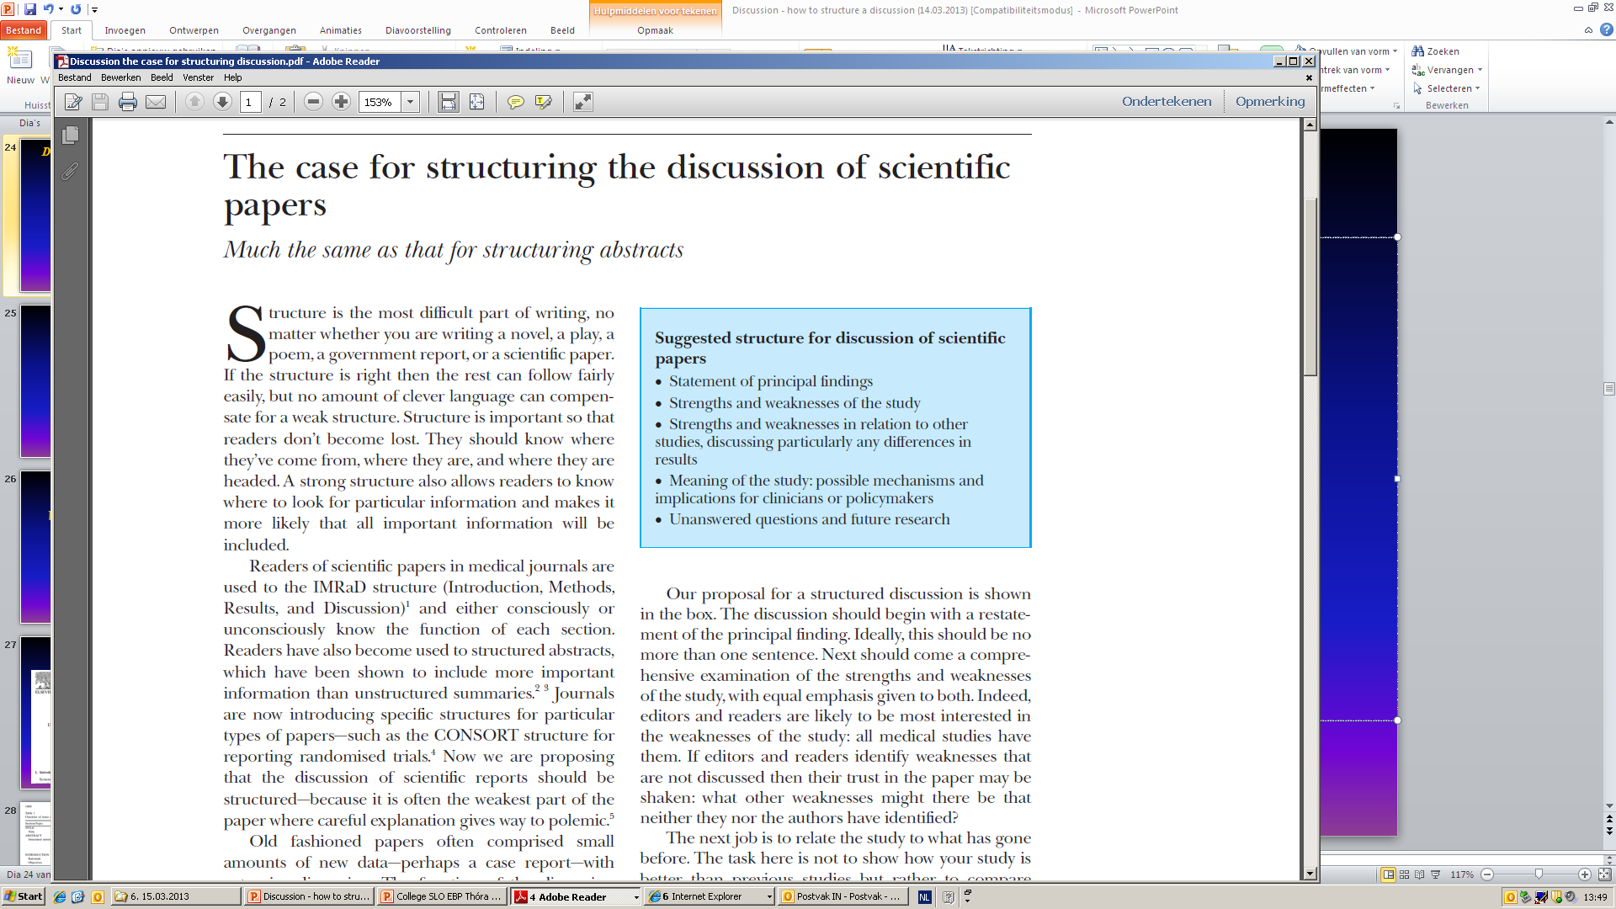
Discussion
The case for structuring the discussion of scientific paper
(Docherty & Smith BMJ 318 1999 1224-1225)

Slide 37
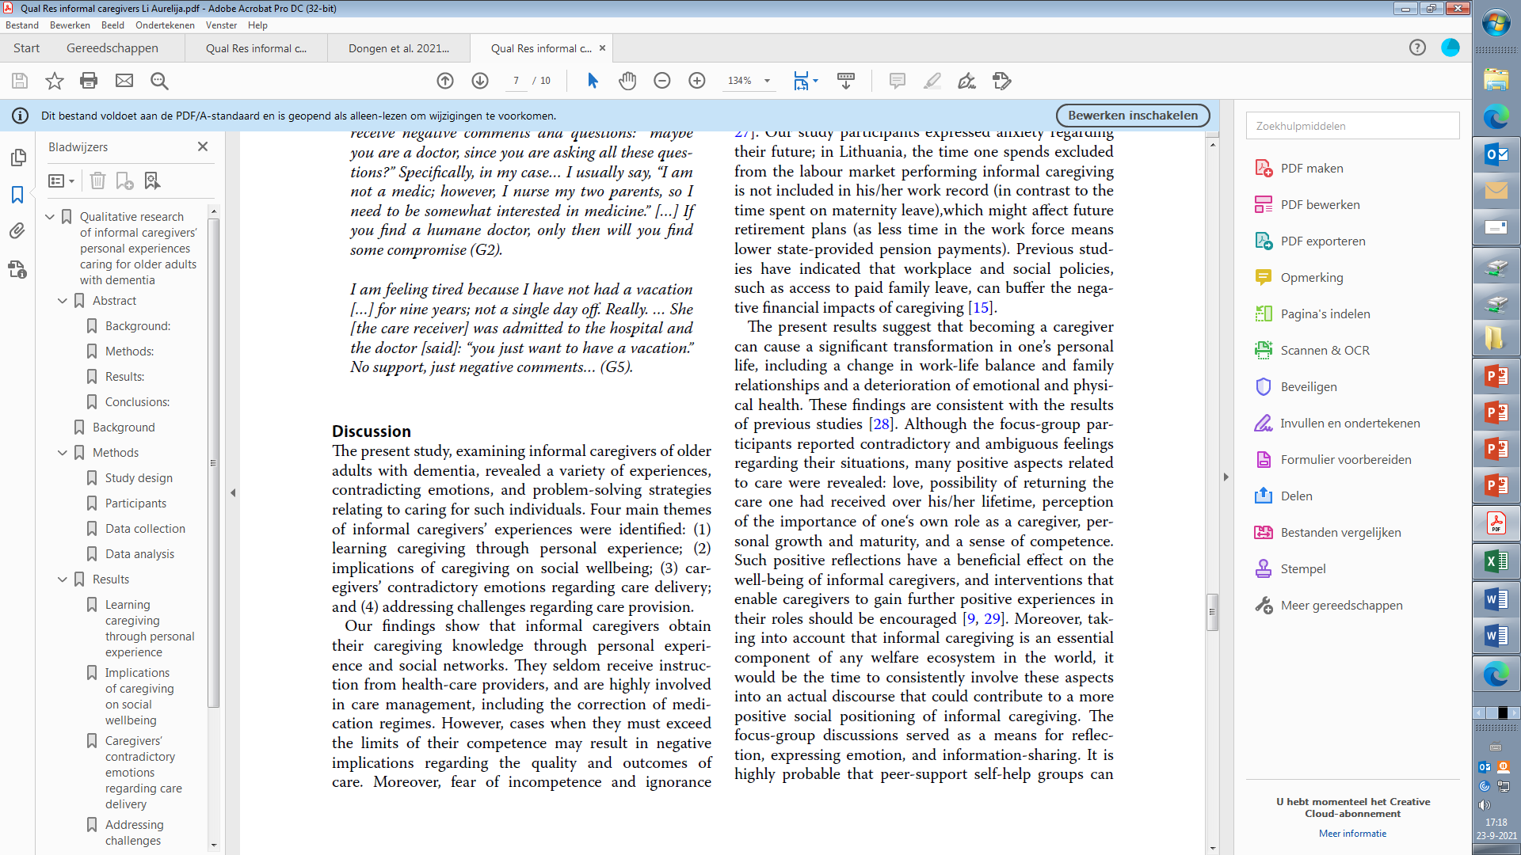
  Statement of principal findings
The discussion should begin with the restatement of the purpose of the study and principal findings
What are your findings?
Do they give answer to the research question?

Slide 38
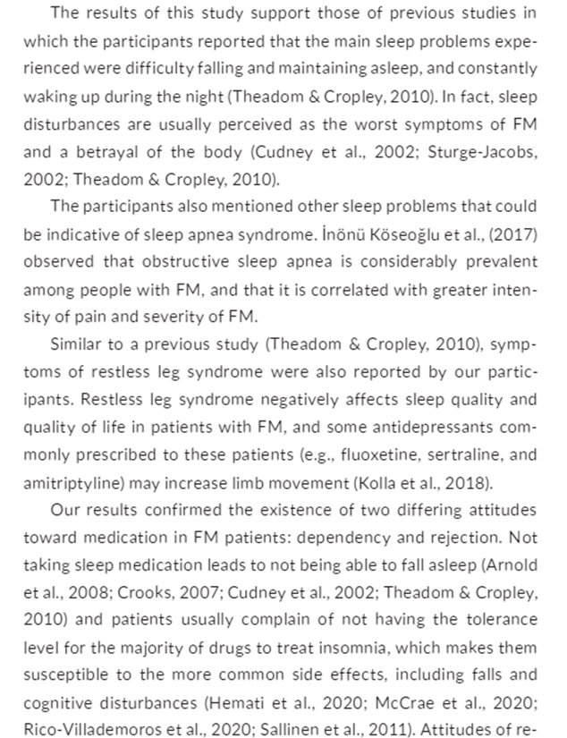
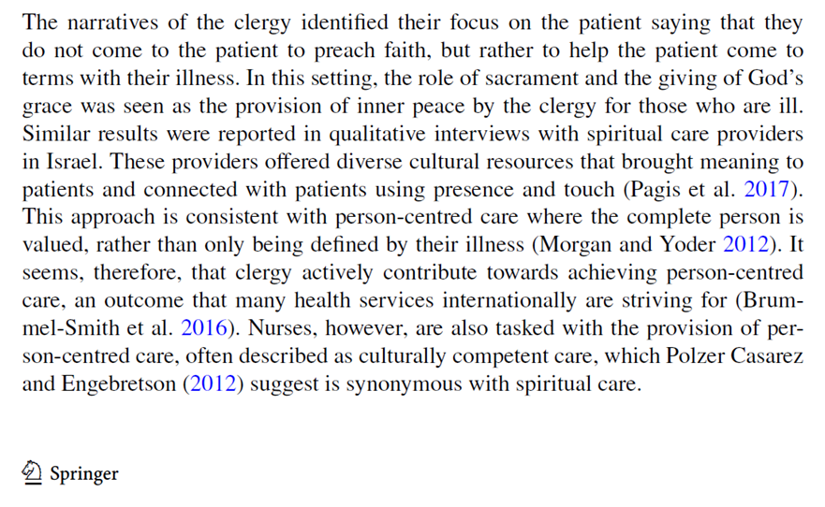
  Your findings in relation to other studies
Compare your results with results of other studies on the topic
DOI: 10.1111/jan.14977

Slide 39

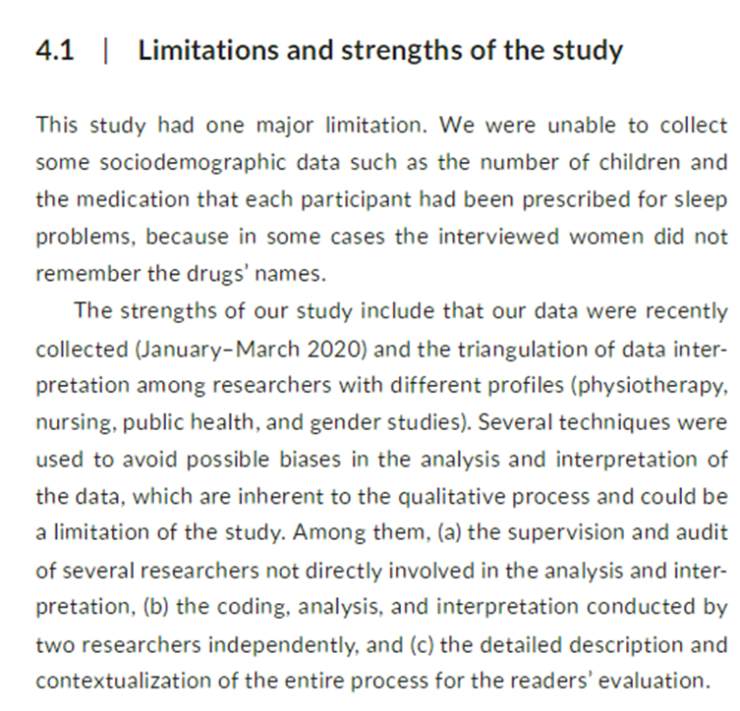
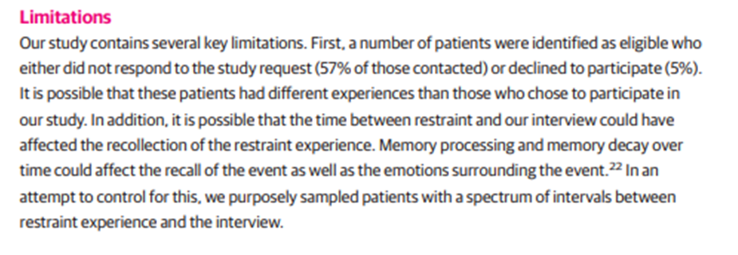
Strength & Weaknesses
Comprehensive examination of the strengths and weaknesses with emphasis on both.
Be honest in reporting this.
Remember: discussing the limitations does not show the poor quality of your paper!
JAMA Network Open. 2020;3(1):e1919381. doi:10.1001/jamanetworkopen.2019.19381
DOI: 10.1111/jan.14977

Slide 40
The meaning of your results
What is the practical relevance? How your findings can help to improve current practice?
Unanswered questions
  Which questions are still unanswered?
  Which “gaps” are now in the literature?
  What does next study need to focus on?

Slide 41

Conclusion
End the discussion section with a conclusion presenting
your findings in light of the evidence in the field and the specific strengths and limitations of your research.
Try to think of it as the one-liner (citable statement) that readers must remember when having seen your work.
(Writing tips series JCE 2013)
Notes:
41

Slide 42
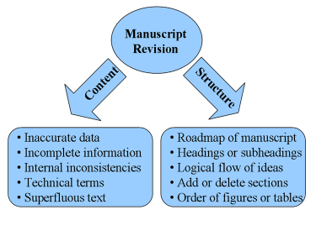
Manucript revision by the author(s)
‘But what makes your paper memorable is the finessing using story-telling skills’
  Margaret McCalister, 2019.

Slide 43

The equator network

Slide 44
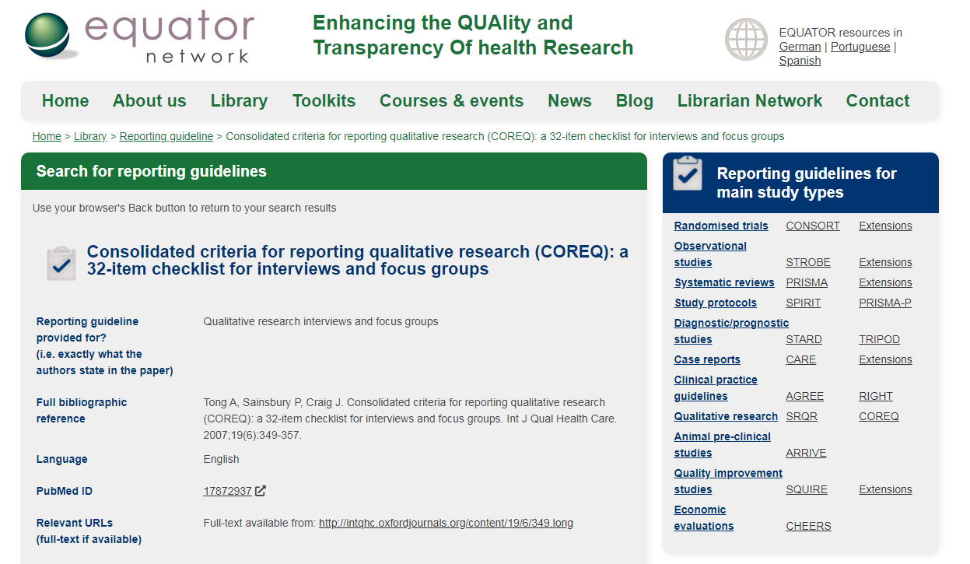

Slide 45
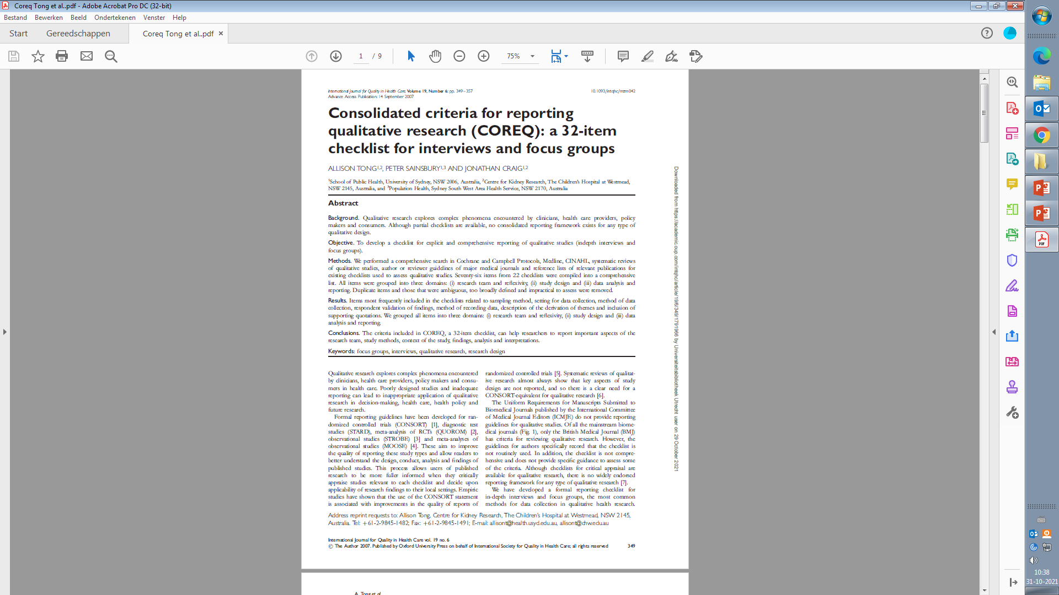
The COREQ criteria

Slide 46
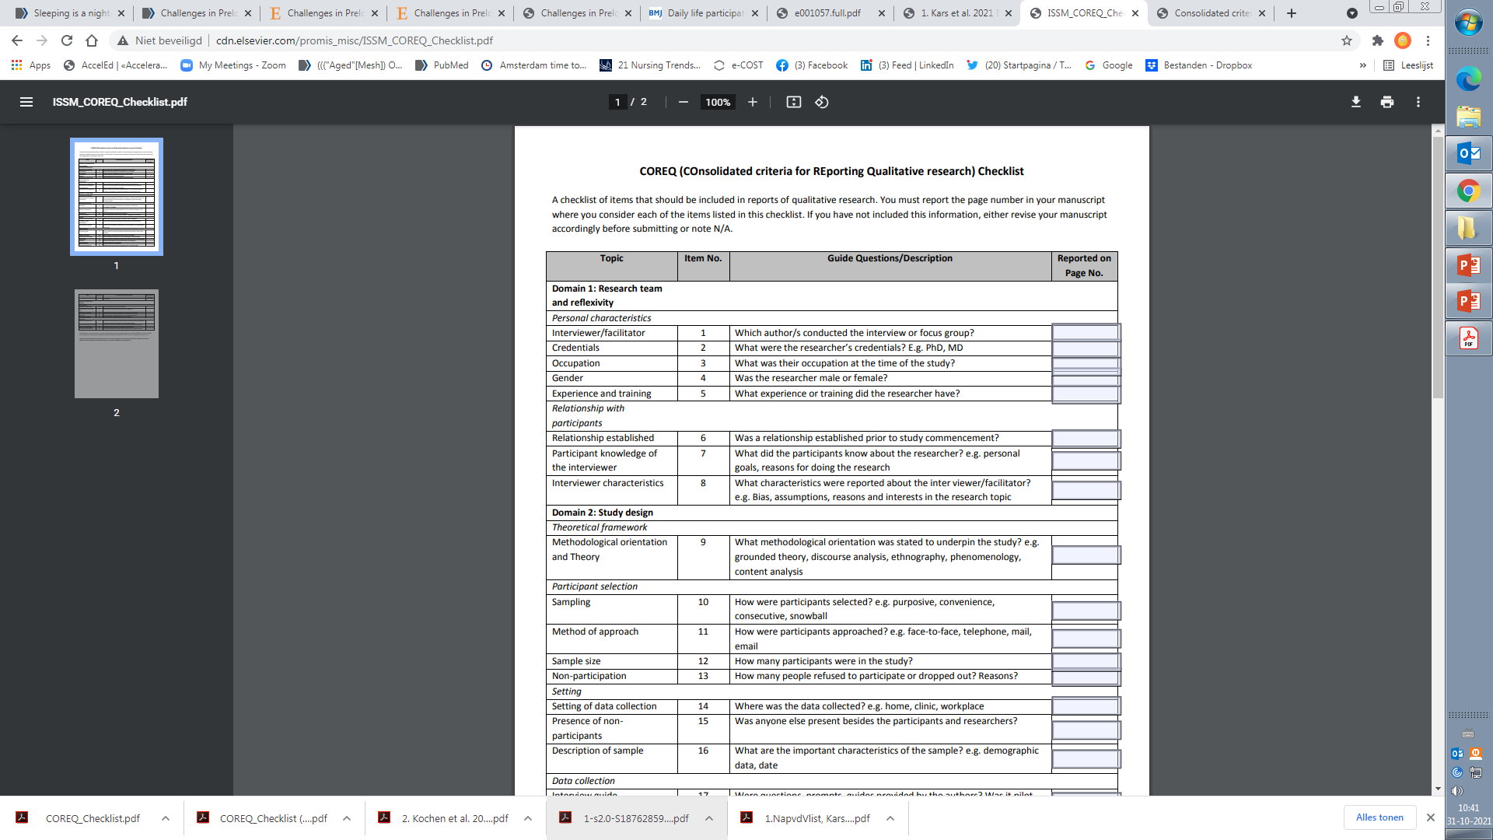
The COREQ criteria

Slide 47
The COREQ criteria

Slide 48
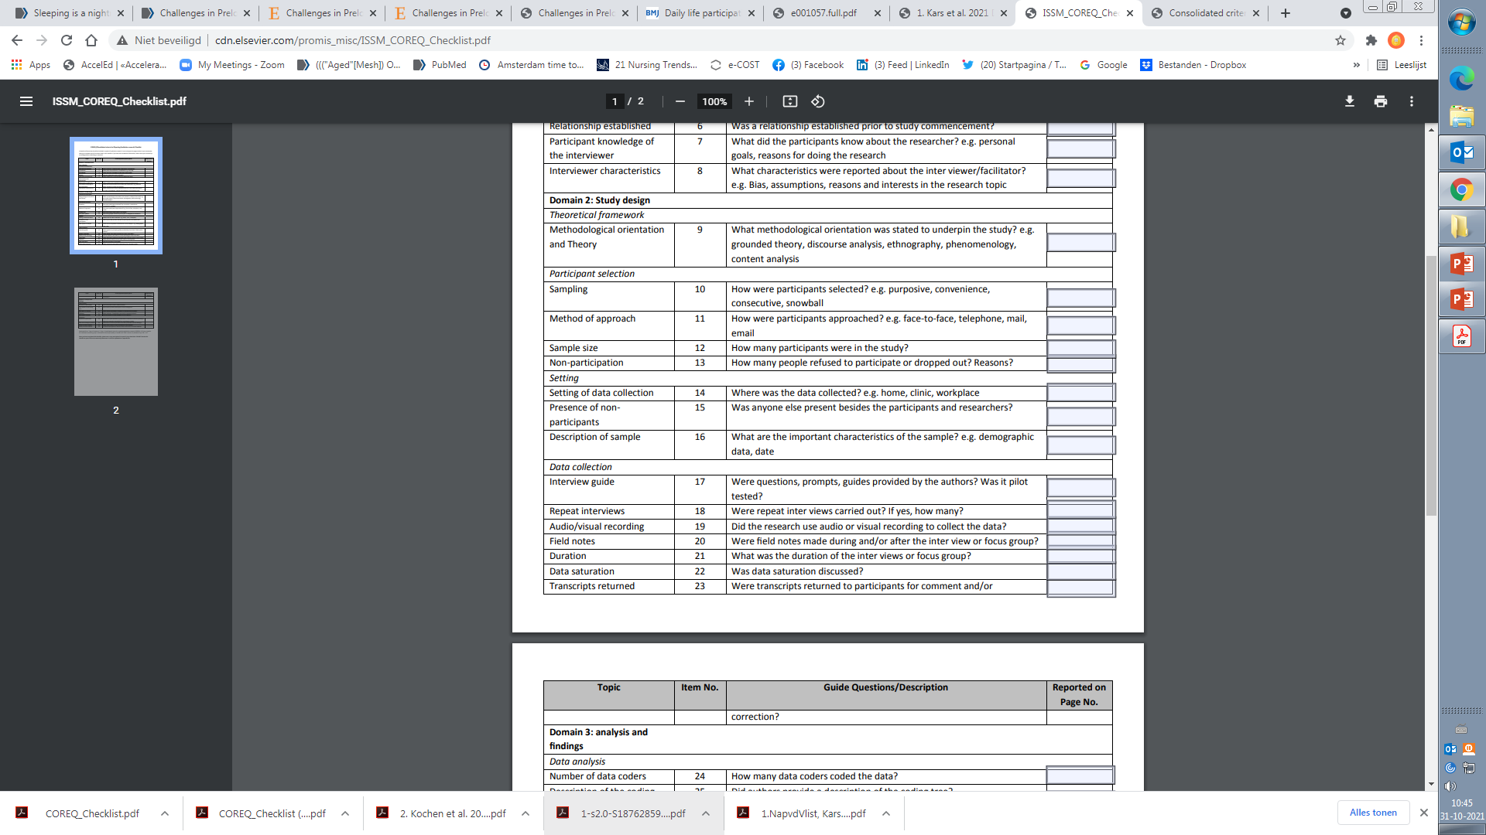
The COREQ criteria

Slide 49
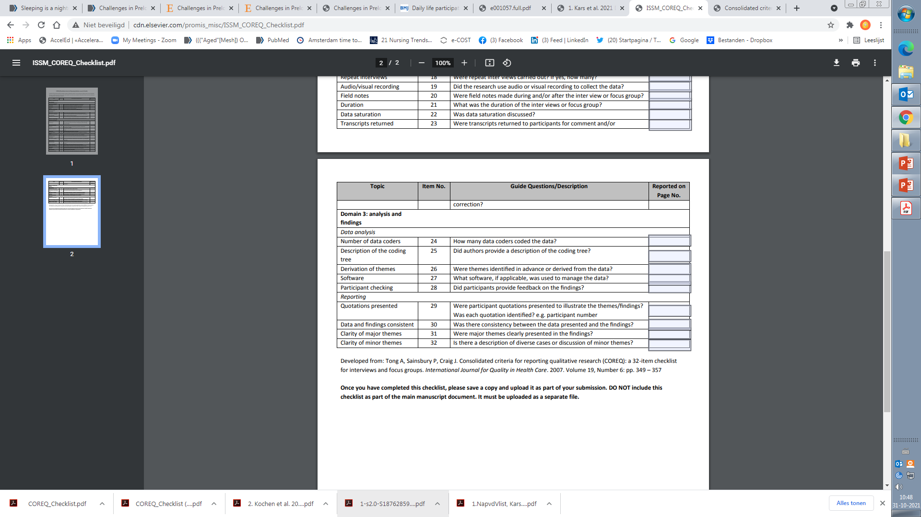
The COREQ criteria

Slide 50
Task 3. Work in peers for the assignment (take home task)
The evaluation of the quality of qualitative publication by applying COREQ criteria
Aim - to develop skills in evaluating the quality of the qualitative papers
What you have to do:
Two students in peer read the qualitative publication, provided by teacher
  Two peers will work on the same publication
Students evaluate quality of the publication by apply COREQ criteria
During next session peers will present and discuss their evaluation results with the group and teacher

Slide 51
Academic writing
Question for the discussion:
1.Share your thoughts on how academic writing is different from other types?:
creative writing (novels),
journalistic writing (press release),
writing technical literature (instruction on use of devices),
professional writing (filling out nursing documents)?
2. What is the main aim of academic (scholarly) writing?

Slide 52
Academic writing skills
Based on good writing principles and critical reading skills - It involves good story-telling
Readings the scientific literature helps to develop your skills
When thinking about your research, ‘write ideas down rather than talk about them’ – visualization of ideas helps for clarification of them
Do not try be perfect at once – the quality of your paper will improve gradually during the process
  ‘Most experienced researchers write the first draft carefully but do not work for a polished draft; the polish comes relatively late in the writing process’ (J.W.Creswell, 2009).

Slide 53
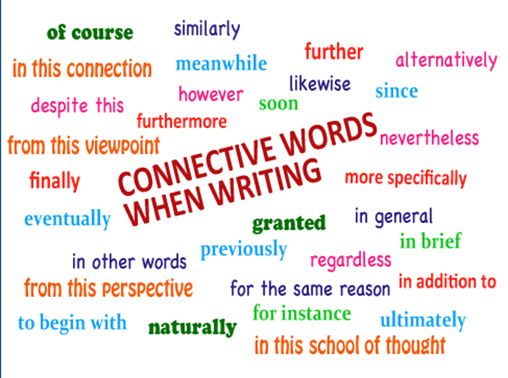
Academic writing skills
Divide the writing of a paper into manageable chunks
Coherence in writing - ‚the ideas tie together and logically flow from one sentence to another and from one paragraph to another‘. Use connecting words to help the sentences flow
About the tense: the past tense to describe results and the present tense to discuss the results and to present the conclusions.
Use the active voice as much as possible in academic writing
  By Ross-Larson (1982), “If the subject acts, the voice is active. If the subject is acted on, the voice is passive” (p. 29) (in JWC, 2009).
Additional words that are unnecessary to convey the meaning of ideas have to be deleted
Never use the same word twice in a paragraph. Never, never use it twice in a sentence!
Stylish academic writers hone and polish their sentences until they gleam.

Slide 54
Academic writing skills
Use the advice and support of your more advanced colleagues or supervisors
Habits of writing – convenient time, place, the same PC, regular amount of writing, monitoring of the progress
Make a brake at some point - break away to evaluate your work in another light
Reward yourself for achieving intermediate- and long-term goals.
The best teacher is practice!

Slide 55
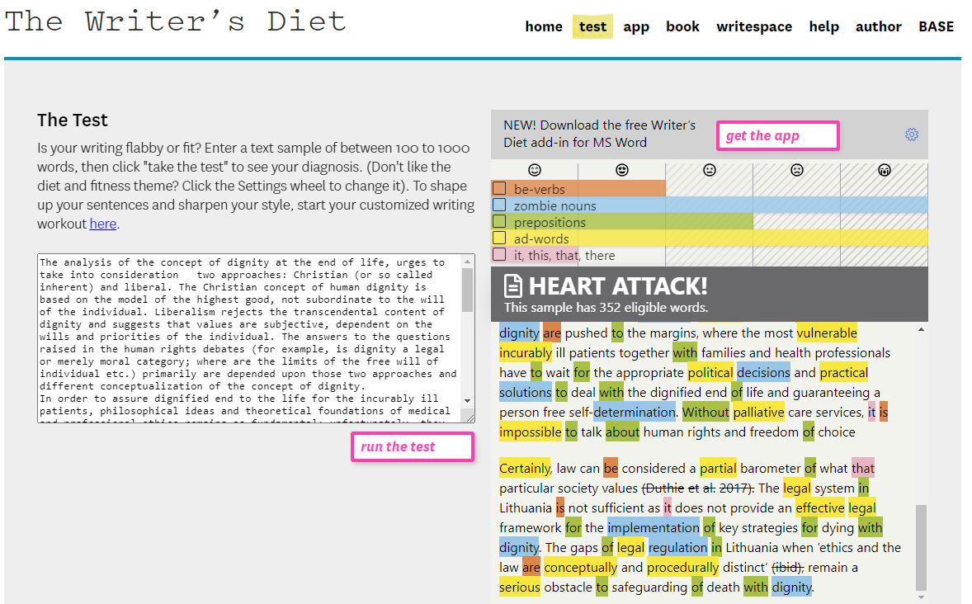
Task 4. Self-directed individual learning
Make a quick diagnostic about your writing style.
Assess it critically and try to work on your limitations in future.
https://writersdiet.com/test/

Slide 56
References
Corbin, Juliet M., Strauss, Anselm (2014). Basics of Qualitative Research: Techniques and Procedures for Developing Grounded Theory. 4th edition by Paperback (4th ed.). (2021). SAGE Publications, Inc.
Morse, J. M. (2012). Qualitative health research: Creating a new discipline. Left Coast Press.
Gardiner, & Kearns, (2012). The ABCDE of writing: Coaching high-quality high-quantity writing. International Coaching Psychology Review, 7(2), 237- 249.
Creswell, J. W. (2007). Qualitative inquiry and research design: Choosing among five approaches (2nd ed.). Sage Publications, Inc.
Holloway, I. (2002). Qualitative Research in Nursing 2e (2nd ed.). John Wiley & Sons.
Tong, A., Sainsbury, P., & Craig, J. (2007). Consolidated criteria for reporting qualitative research (COREQ): a 32-item checklist for interviews and focus groups. International journal for quality in health care : journal of the International Society for Quality in Health Care, 19(6), 349–357. https://doi.org/10.1093/intqhc/mzm042

